Slide 1
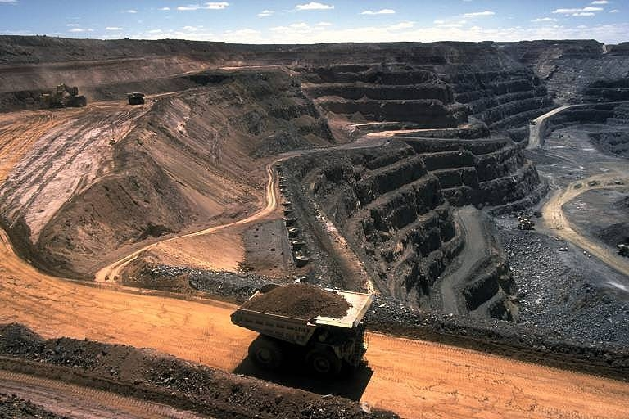
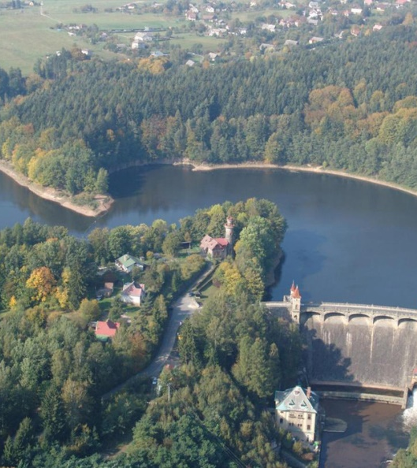
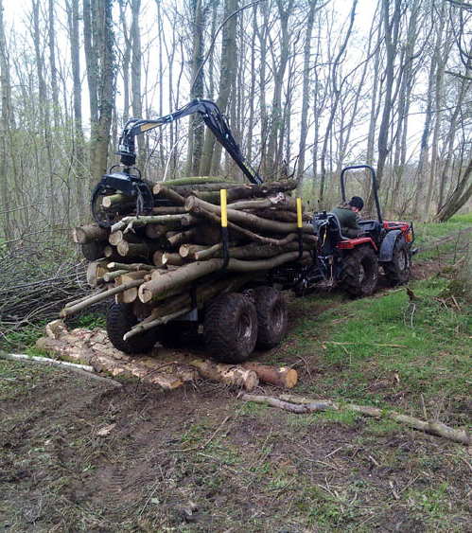
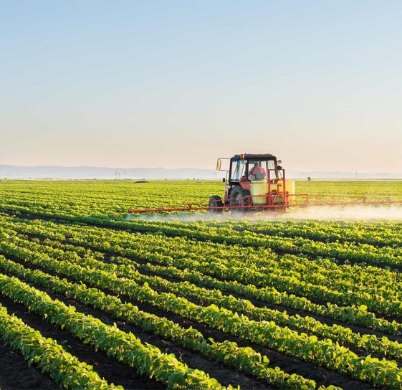
What links all of these photos?

Slide 2
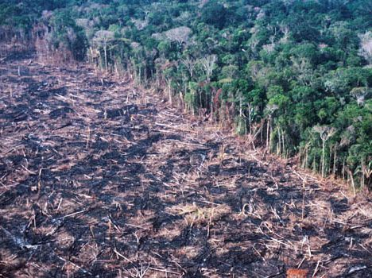
Deforestation

Slide 3
Causes of Deforestation
Outcomes
All will be able to define deforestation
All will be able to describe the causes of deforestation
Most will be able to evaluate the causes and consider their sources at different scales.

Slide 4
Write down your feelings about deforestation as you watch the following video

Slide 5
Deforestation Definition
2 Options - Fill in the bank or unscramble the sentence
Deforestation permanent forests make is to the uses available land for other destruction the of order in.
Deforestation is the __________destruction of ________ in order to make the ______ available for other _________.
Uses forests permanent land

Slide 6
Deforestation permanent forests make is to the uses available land for other destruction the of order in.
Deforestation permanent forests make is to the uses available land for other destruction the of order in.
Deforestation permanent forests make is to the uses available land for other destruction the of order in.
Deforestation permanent forests make is to the uses available land for other destruction the of order in.
Deforestation permanent forests make is to the uses available land for other destruction the of order in.
Deforestation permanent forests make is to the uses available land for other destruction the of order in.
Deforestation permanent forests make is to the uses available land for other destruction the of order in.
Deforestation permanent forests make is to the uses available land for other destruction the of order in.
Deforestation permanent forests make is to the uses available land for other destruction the of order in.
Deforestation permanent forests make is to the uses available land for other destruction the of order in.

Slide 7
Deforestation is the __________destruction of ________ in order to make the ______ available for other _________.
Uses forests permanent land
Deforestation is the __________destruction of ________ in order to make the ______ available for other _________.
Uses forests permanent land
Deforestation is the __________destruction of ________ in order to make the ______ available for other _________.
Uses forests permanent land
Deforestation is the __________destruction of ________ in order to make the ______ available for other _________.
Uses forests permanent land
Deforestation is the __________destruction of ________ in order to make the ______ available for other _________.
Uses forests permanent land
Deforestation is the __________destruction of ________ in order to make the ______ available for other _________.
Uses forests permanent land

Slide 8
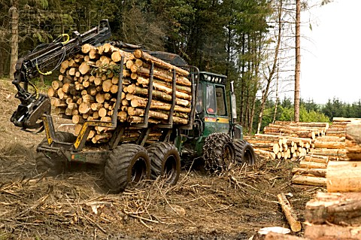
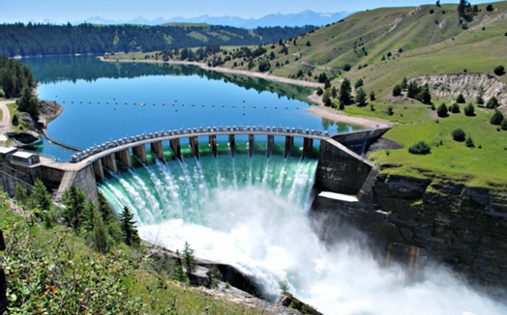
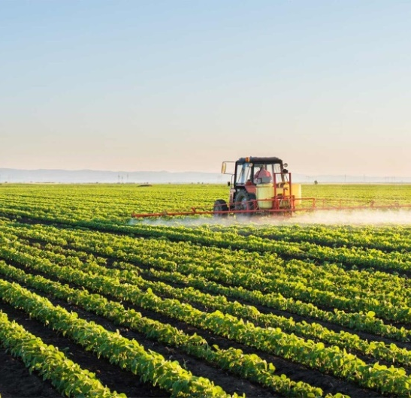
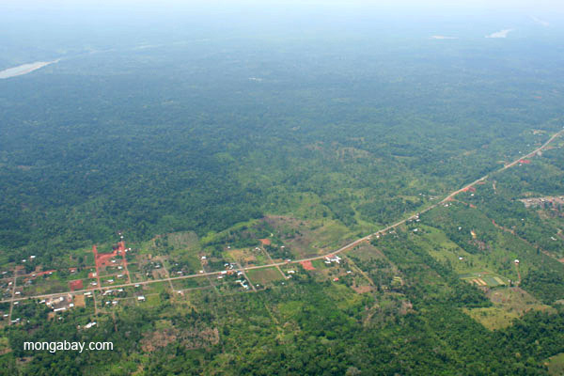

Slide 9
Challenge 2 – Describe the causes of deforestation.
Either label the 6 images, or cut and match them to each of the following causes:
Commercial timber extraction
Agriculture
Mining
Transport
Settlement
HEP
Extra Challenge – Describe what each of the causes actually mean using figure 7.12 on page 191
Super challenge – Name at least 3 places in the world that are experiencing rapid deforestation
Then, watch the video below to see if you can find any other causes. Explain why these causes are increasing in prevalence. Link to global changes in levels of development
Notes:
https://www.nationalgeographic.com/environment/global-warming/deforestation/

Slide 10
To finish
Use page 187 to describe which areas of the world have experienced forest loss.
Extra Challenge – Describe the trends in deforestation from 1990 to 2010. Why might Europe be experiencing afforestation?
1 Hectare is about the size of a football pitch!

Slide 12
