Slide 1
Castro’s Foreign Policy
1959-2010

Slide 2
Foreign policy theory
Foreign policy is usually utilised as a method to achieve domestic objections
For example, the success of economic policies relies on access to economic resources, which can be achieved through war, conquest, trade and alliances
The maintenance of power also requires the state to be secure against invasion or to meet political promises such as ‘returning lands’ previously taken or righting historic wrongs
Successful foreign policies have the ability to strengthen political power and achieve domestic political aims

Slide 3
Foreign policy aims for Cuba

Slide 4
Castro’s foreign policy
Castro had four main aims for Cuba and the Cuban Revolution:
The Republic had to break free of the traditional dominating relationship with the United States
The Revolution would have to be maintained at home: this related more so to creating a stable platform to accomplish his foreign policy goals
Protecting himself against future US aggression and avoiding the reliance on a great power sponsor and being subjected to domination by another power
The exportation of the Revolution to the rest of the world, particularly communities in Latin American and Africa
Goals relating specifically to his foreign policy included:
Gaining back US controlled property in the nation
Clearing the nation of damaging influence from powerful foreign nations in Cuba’s affairs
Strengthen national identity, by, for example, maintaining feelings associated with the revolution
Provide for economic independence

Slide 5
Castro’s Foreign Policy
Castro’s early commitment to end US control over Cuba had been one of the reasons behind the support his movement achieved both before and after the success of the revolution in 1959
Castro’s attitude towards foreign affairs appears to have been widely shared by the Cuban people. Initiatives linking to Castro’s foreign policy after 1959 created feelings of pride amongst Cubans.
Their island was show to stand up to the US who had dominated them since the Platt Amendment of 1901 not just in Latin America and the Caribbean but also on other continents.

Slide 6
Relationship between allies and ….enemies of the state

Slide 7
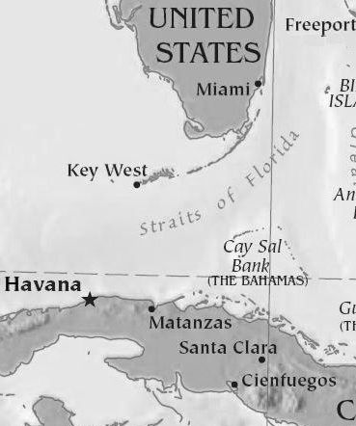
The USA
One of Castro’s aims was to break free of the traditional dominating relationship with the United States, gaining back US controlled property and clearing US influence from foreign affairs. This was achieved by October 1960, by which Washington had severed all diplomatic ties with Havana and placed an embargo on Cuba. Washington no longer had a say in Cuban foreign policy except that it was a powerful threat towards Castro.
The strained relations were not inevitable in the short-term: they were due to ideological incompatibility and the way Castro handled the break.
Castro emphasized the anti-US sentiment of José Martí, recalling that he wrote about risking his life to prevent ‘by the timely independence of Cuba, the United States from extending its hold’
Castro called this the ‘incredible legacy left to use by Cuban revolutionaries’

Slide 8
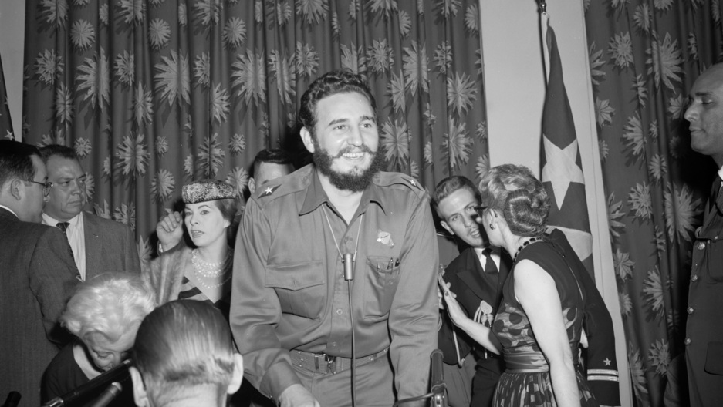
The USA
Castro understood that he needed to gain autonomy from the US to pursue his other aims, however US involvement was not immediately rejected.
In early 1959, friendly relations had appeared promising
Castro visited the US in mid-April 1959 to speak about fostering ‘good relations [and] good understanding’ and Eisenhower was told there was a possibility of ‘developing a constructive relationship with [Castro] and his government’
However, Castro avoided the topic of potential economic aid, repeatedly rejecting generous and assertive offers of aid from various US government agencies, viewing them as attempts by the US to re-establish economic dominance

Slide 9
The USA
Castro needed to address questions of elections and whether or not Cuba would accept Washington’s aid: he decided against both
Castro needed to ensure he did not fall into the cycle of American interventions that had characterized the Cuban government since 1898
Instead, he consolidated his power at home, nationalizing US-owned properties without compensation, jailing political prisoners and publicly denouncing the US. His aim in nationalization was to remove the US permanently from the Cuban economy.
On October 26th, Castro publicly condemned the US for a bombing of Havana that never actually occurred. He used further examples of anti-US sentiment to aid his consolidation.
In the spring of 1960, Castro nationalized Esso, Shell and Standard oil who refused to process Soviet crude before nationalizing US assets such as banks and sugar mills. He justified this with anti-Americanism and the problems caused by US imperialism

Slide 10
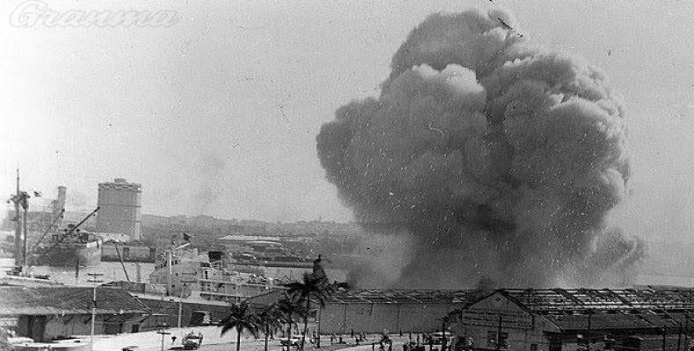
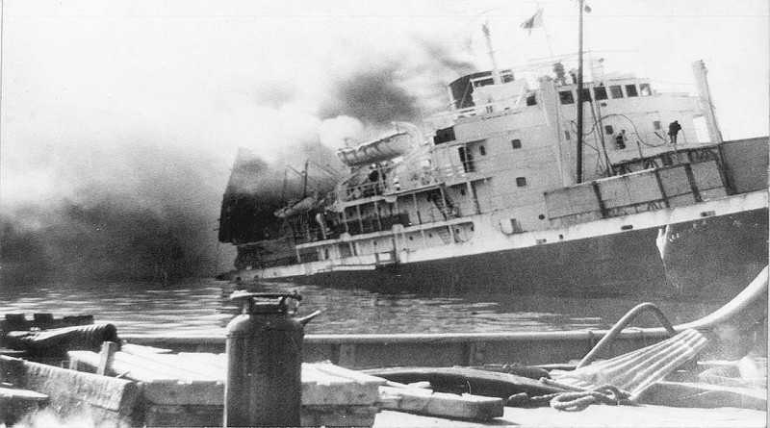
La Coubre
In March 1960, a French ship blew up in Havana Harbour that was carrying Belgian arms and ammunition, killing 81 people and injuring hundreds.
Although there was no evidence to support this, Castro blamed the incident on the US, further uniting Cubans via anti-US sentiment.
Based on the incident, Castro invented a new slogan: ‘Homeland or Death, We Shall Prevail’
Before this event, in the winter of 1959-1960, there was an increase in CIA supervised bombings and incendiary raids piloted by exiled Cubans based in the US. Later, in after Eisenhower was enabled to take ‘retaliatory steps’ in June, an embargo was placed on Cuba

Slide 11
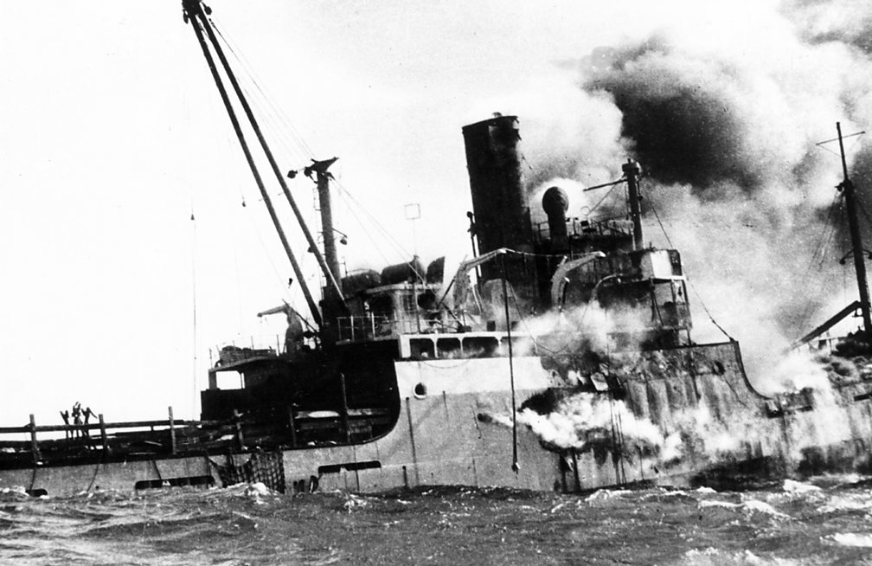
The Bay of Pigs, 1961
The effect of the Bay of Pigs related to Castro’s aim of establishing Cuban independence in foreign affairs, through intensifying fear of the US.
In April 1960, an invasion force of Cuban exiles trained in the US by the CIA invaded Cuba, using US equipment and landing at various sites, including one at the Bay of Pigs. Castro was prewarned of the invasion, arresting 20,000 people as a precaution. Castro agreed to the repatriation of the prisoners in exchange for $53 million in food and medicine.
To counter the US threat, Cuba needed a great power patron, turning to the USSR. The later ‘Cuban Missile Crisis’ would show the limitations to this support.

Slide 12
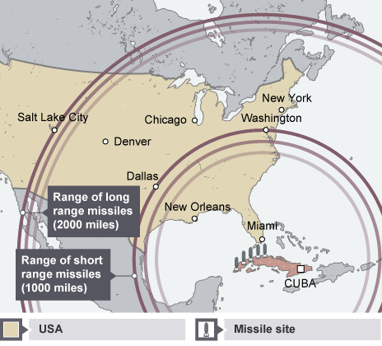
The Cuban Missile Crisis, 1962
In 1962, Khrushchev installed medium-range nuclear missiles in Cuba to counter U.S nuclear missiles in Turkey, with double the number of targets as Soviet missiles.
By October 16th President Kennedy opted for a naval quarantine to prevent Soviet ships with missiles from reaching Cuba. On October 24th Soviet ships moved away from Cuba
The US put nuclear forces on red alert and assembled an invasion force in Florida
Khrushchev offered to withdraw the missiles in Cuba in exchange for: a US pledge never to invade the island and the US withdrawal of nuclear missiles in Turkey.

Slide 13
The Cuban Missile Crisis, 1962
This was the closest to nuclear war that any two countries have ever come and resulted in the removal of both Soviet and US missiles. The US had to tolerate a Communist country in the Caribbean and relations were stained between Khrushchev and Castro with Khrushchev being discredited.
Relations with the Soviets were strained after this; Castro wanted the Soviets to oust the Americans from Guantanamo Bay, among other things.
Despite this, Castro benefitted from the 1962 missile crisis in two ways: having suffered no damage to his country, he emerged with a guarantee by the US not to invade Cuba. The US would be accountable to the USSR for any aggressive actions towards Cuba, which was a serious deterrent.
The perceived betrayal of Castro gave him the reason he needed to push the USSR away and assert his own independence politically.
The period of 1962 to 1968 was characterized by harsh criticisms of the two major players in the crisis and was a period of experimentation by Castro, with him independently approaching the foreign policy arena.

Slide 14
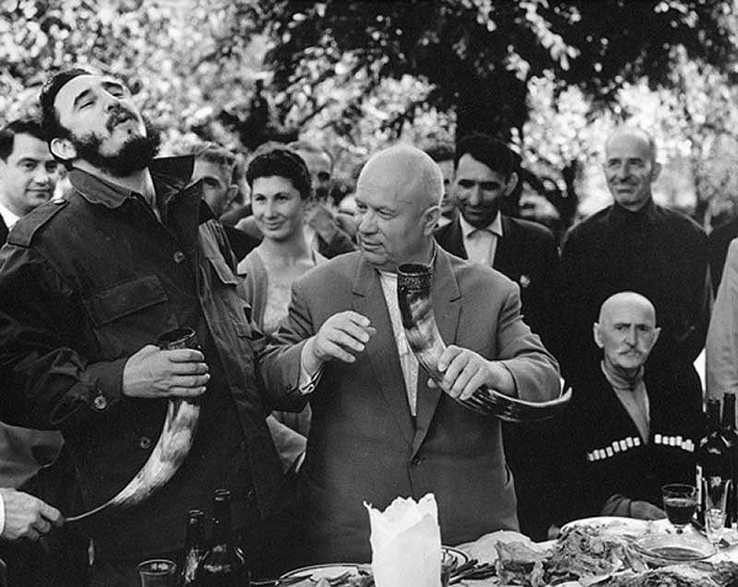
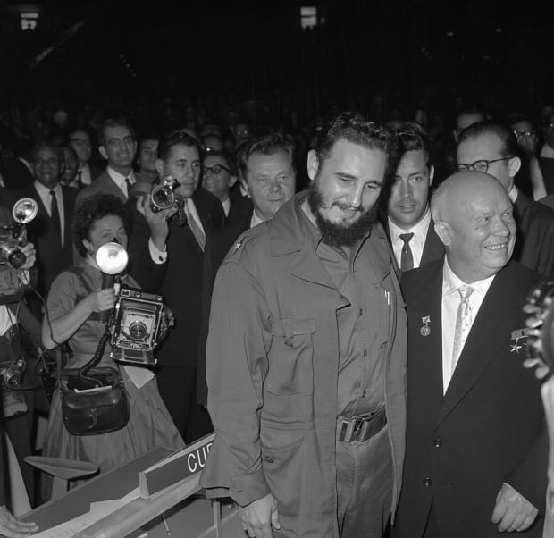
The USSR
It was not only US hostility that pushed Castro towards the Soviet Union and Soviet-style socialism. The Soviet economy model of modernization suited the Cuban leaders. They saw Stalin’s industrialisation of the Soviet Union without any outside assistance as a way of constructing a fairer society in Cuba in the face of hostility from the US.
The US trade embargo restricted the outlets for Cuban products to a limited number of countries, resulting in Cuba’s trade balance always being in deficit. Practically all Cuba’s oil purchases were from the USSR and Cuba was in debt to the USSR by 7 billion dollars. Cuba owed a further 3.5 billion to international banks.

Slide 15
The USSR
The Cuban Missile Crisis temporarily disrupted good relations with the Soviet Union as Castro felt Cuba had be used. Furthermore, after the Cuban Missile Crisis, the Soviets were put into a difficult situation. Cuba was safe from invasion, barring missteps by Castro that would present direct threats to vital US interests. There was also the problem that Washington had the tendency to view Communist actors as the puppets of Moscow. The Kremlin did not want the US to think the Soviets were behind Castro’s attempts to overturn the international system in the Western Hemisphere.
The USSR distanced itself from Castro’s actions, but maintained economic aid. It could not abandon its only ally in the Americas.

Slide 16
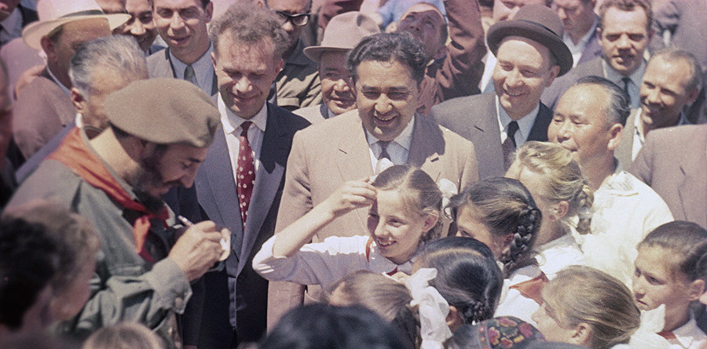
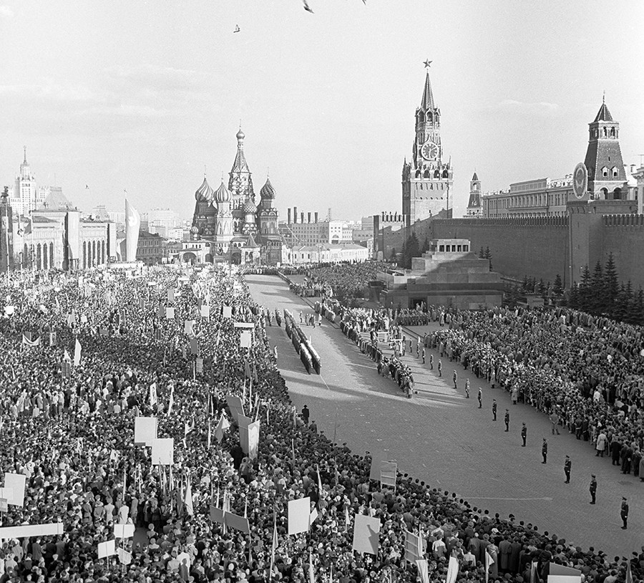
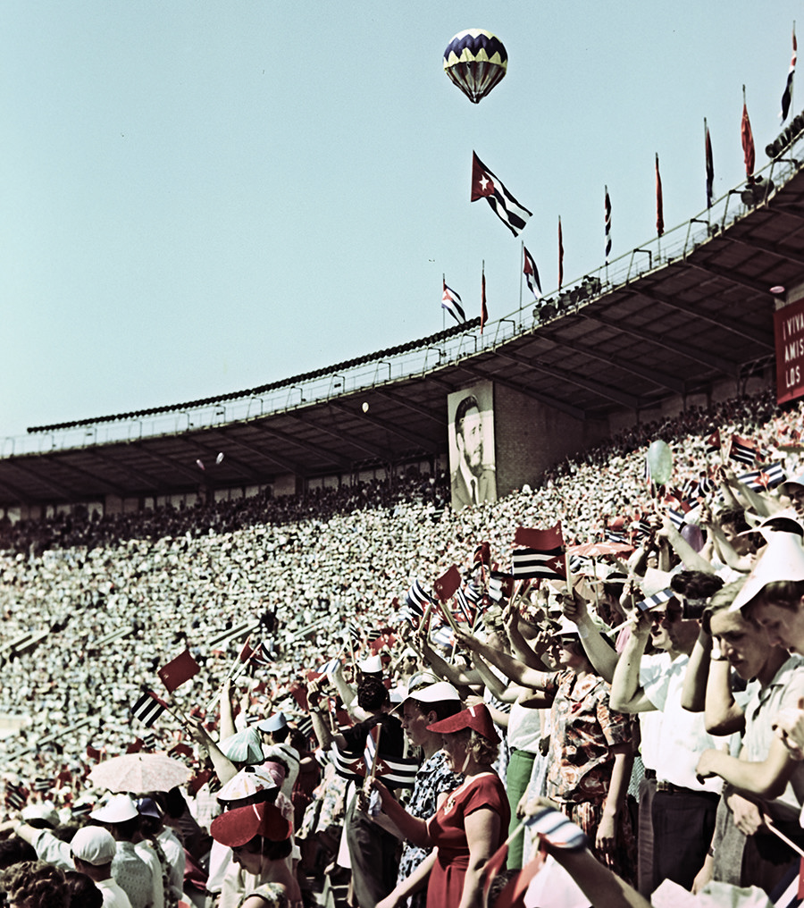
The USSR
In April 1960, Castro and some other Fidelista leaders went to Moscow following an invitation from Khrushchev. Castro stayed until June and had several important trade discussions. In January 1964, Castro paid a second visit to Moscow, promising to follow peaceful coexistence and to finalise economic deals.
Relations cooled again when in 1967, Castro attacked communist governments, including that of the Soviet Union for trading with countries that applied a trade embargo against Cuba. Consequently, the Soviet Union delayed the signing of trade agreements and cut back on oil supplies to Cuba
Cuba’s economy began to experience difficulties, in addition to restrictions on oil supplies there was a massive debt to the Soviet bloc.

Slide 17
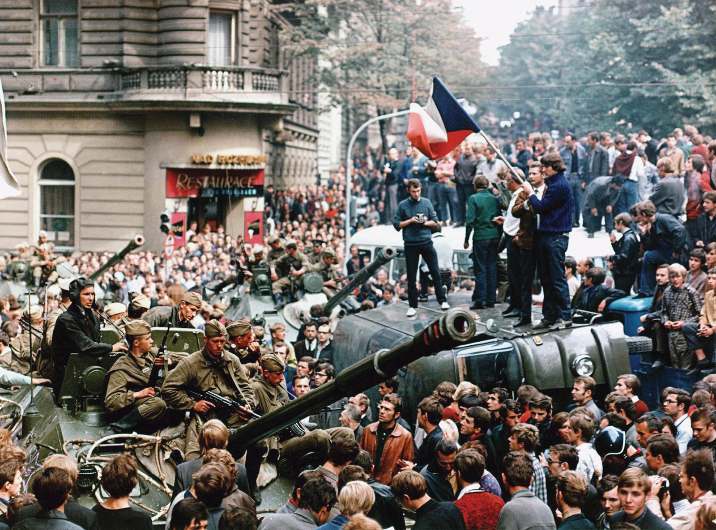
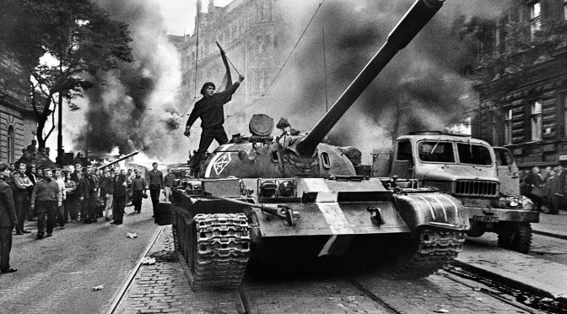
The USSR
Less able to defy Moscow, Castro gave qualified support to the Warsaw Pact invasion of Czechoslovakia on 21st August 1968. This opened the way for Moscow to repair relations with Havana in the following decades.
By forcefully supporting their coup in Czechoslovakia, Castro signalled a change in his policy towards the Soviet Union and caused Soviet leadership to reaffirm their support for him.
Two days after the Soviet invasion of Czechoslovakia to repress the Prague Spring, Castro publicly denounced the Czech rebellion.

Slide 18
The Soviet Connection
The decision to adopt Marxism for their new Cuban state was not just to do with the need for a strong power’s protection from the USA but also based on the belief that communism offered the only possible model of economic growth and that it was the only international movement with which Cuba could identify with.
Castro was prepared to accept the Soviet Union’s idea of a peaceful road to socialism, but he insisted that some roads might be non-peaceful
Relations suffered between 1965 and 1968 due to Castro’s attempts to establish revolutionary guerrilla groups in Latin America and developing countries. This conflicted with the Soviet Union’s aim to establish good relations with the USA and the West in peaceful coexistence. In 1967, Castro attacked the USSR for having capitulated to capitalism by preferring good relations over supporting revolution groups.

Slide 19
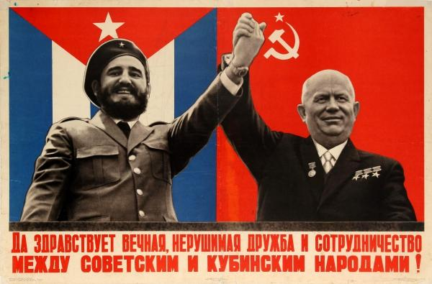
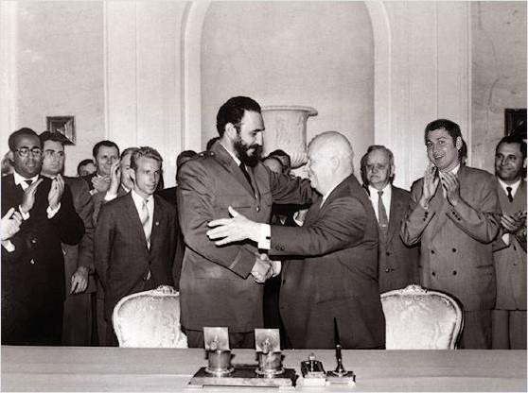
The Soviet Connection
Economic pressure from the US, the USSR and China showed Castro that economically he did not have the self-sufficient capabilities needed for true independence.
After Prague Spring, Castro announced support of the international obligations of socialist countries, which in 1968 became formalized as the Brezhnev doctrine. This signalled the end of Castro’s attempt to continue without a great power patron.
The undeveloped Cuban economy worsened by the crippling effects of Castro’s own economic reforms meant that Castro could not accomplish his aim of avoiding dependency; Cuba could not survive without the assistance of a great power patron.

Slide 20
Mao’s China
Castro could afford to be more aggressive than the Soviets, as Soviet challenges in Latin America seemed more credible than Cuban ones.
His insistence that armed struggle was the only way to successfully bring around a Communist Revolution put him more towards the philosophy of the Chinese.
China wanted to be seen as a more relatable ideological alternative in Latin America
Their common history of colonial oppression made the Chinese ideology more applicable to the situations in Latin America.
Relations with China could have acted as a counterweight to Soviet influence, however strong Sino-Cuban relations never occurred
Beijing did become a major trading partner as Castro looked to the Chinese for economic support. This allowed Castro to have a Communist country that could insure him against the Soviet unwillingness to pay the high prices for Cuban sugar.

Slide 21
Mao’s China
However the ideological assertiveness of the Chinese discouraged Castro, who criticized the Chinese for their anti-Soviet opinions
China pursued an extensive propaganda campaign in Cuba, mainly targeting military officers. This continued until mid-1965, which Castro could not tolerate.
Beijing also began to reel in economic aid, insisting that trade between the two needed to be balanced.
Castro had considered China as an alternative to the USSR as a great-power patron, but Beijing failed to capitalize on that interest. In his independent foreign policy phase, lasting until 1968, Castro could not be vulnerable to the Chinese if they did not recognize his independence.
However, by August 1968, Castro could no longer afford to pursue a policy of rhetorical hostility towards China and the USSR, facing economic pressure.

Slide 22
Impact of world events on foreign ….policy

Slide 23
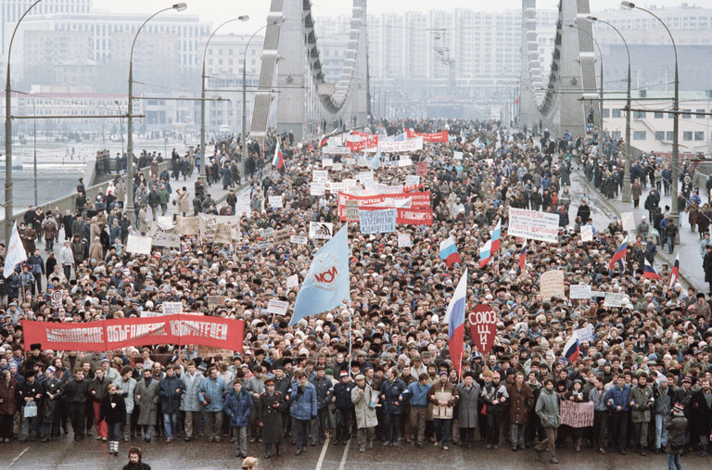
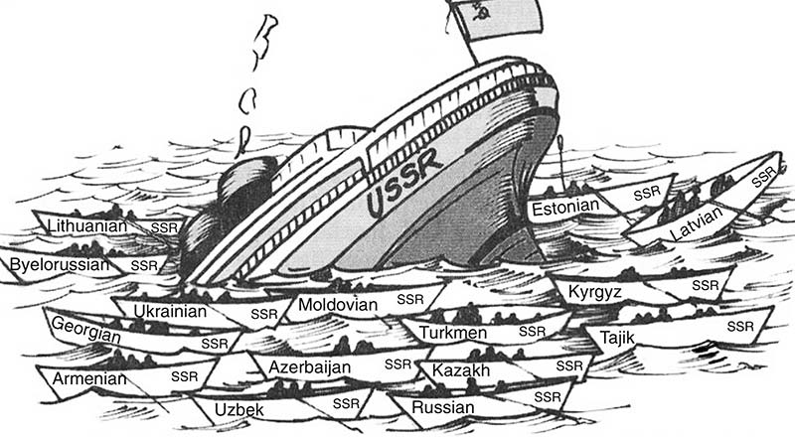
Collapse of the Soviet Union: The special period
In the late 80s and 90s, a series of resistance movements brought down the communist regimes in all the Eastern bloc countries and in 1991, the communist government in the USSR collapsed.
Castro’s reliance on the USSR became his handicap. Previously, this relationship gave Cuba greater stability but after the collapse of the USSR, Cuban income dropped by 50% from 1989 to 1992 and oil supplies dropped from 13 million tonnes to 2 million
The new Russia maintained contacts but felt no obligation to honour the Cuban-Soviet agreements. Cuba could no longer rely on the purchase of its sugar or financial grants.

Slide 24
Collapse of the Soviet Union: The special period
Castro had to make adjustments to indicate he was prepared to make concessions in Cuba’s interest:
The US dollar could operate as a legal currency in Cuba.
Tourists were encouraged, particularly from the USA
In 1994, an agreement with the US President Clinton permitted 20,000 Cubans to leave annually for the US. In 1998, a similar agreement allowed Cubans to receive money from their relatives in the USA
In 1998, John Paul II visited Cuba at Castro’s personal invitation, and Castro agreed to lift restriction on the Varela Project
Better relations were established with the European Union
Castro was keen to increase economic and political ties with Mao’s China
After a hurricane hit Cuba in 2001, Castro authorized the buying of massive food supplies, but insisted on a commercial agreement rather than an aid package. This was the first time in 40 years that the US embargo had been suspended

Slide 25
Domestic policy and foreign policy
For Castro, building his domestic political base and creating a stable platform from which to accomplish his foreign policy goals was important if Cuba was to be significant on the world stage.
In the early period for Castro’s Cuba, initial positive relations with the US gave him time to consolidate his rule and implement domestic reforms.
Castro realized that the survival of the Revolution depended on his ability to balance domestic stability considerations with a foreign policy that would allow him the freedom he needed to pursue his goal of exporting Communist revolution
After the Cuban Missile Crisis, weakened relations with the USSR allowed Castro to focus his resources on shoring up the domestic economy and exporting the Revolution.

Slide 26
Spreading the revolution

Slide 27
Spreading the revolution
Castro saw the world as divided between developed and underdeveloped countries.
He believed that Cuba, with a mix of both Latin American and African history and culture, had a special role in helping other ‘Third World’ countries overcome poverty and imperialism. He also believed that Cuba’s economic problems further provided a connection with such countries.
As a result, Castro’s early foreign policy was designed to promote similar revolutions in the region
As early as 1961, Castro was sending assistance to revolutionaries in Angola, Algeria, Bolivia, Palestine, Venezuela and Vietnam

Slide 28
Latin America and the Caribbean
In 1961, Kennedy was informed by the Directory of the CIA that by maintaining Cuban independence and reforming Cuba, Castro was in danger of initiating the fall of ‘most of Latin America’. This was due to the unequal social and economic conditions in so many Latin American countries.
Cuba’s example and revolutionary ideas, if successfully spread would also increase Cuba’s security
To revolutionary groups in Latin America, Cuba gave financial and logistical aid and military training to revolutionary groups. However, by the end of 1964, most of the guerrilla groups that had received such aid were suffering from setbacks

Slide 29
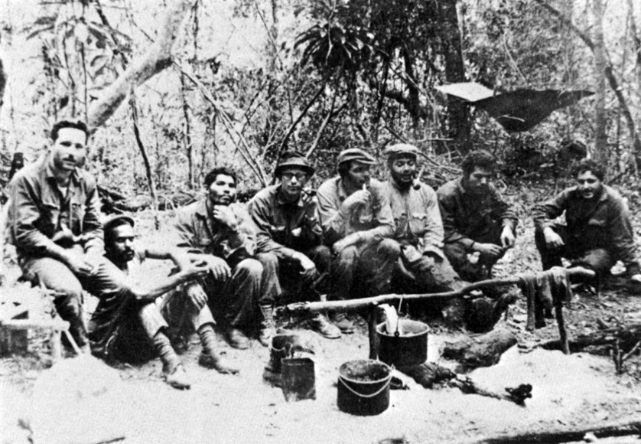
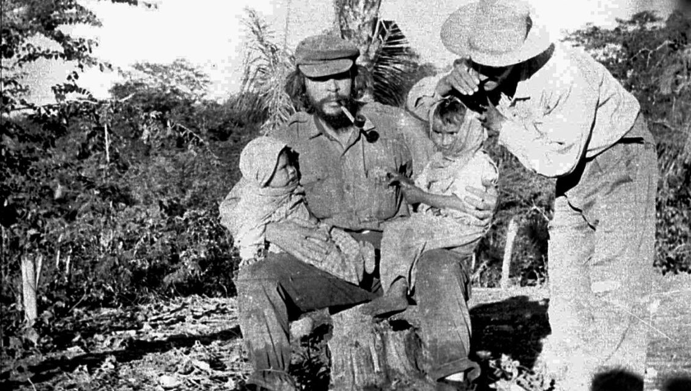
Bolivia 1966-1967
In November 1966, Che Guevara went to Bolivia with several other Cuban fighters to help the ELN guerrillas struggle against the military dictatorship that had been established there in 1964 with aid from the US.
If Guevara was successful, this would end Cuba’s isolation in the region, helping to improve its security and end US and Western imperialism by spreading the revolution
This insurgency only lasted from March to October 1967 however it made Cubans proud of their country’s role, enhancing the popularity of Castro’s regime.

Slide 30
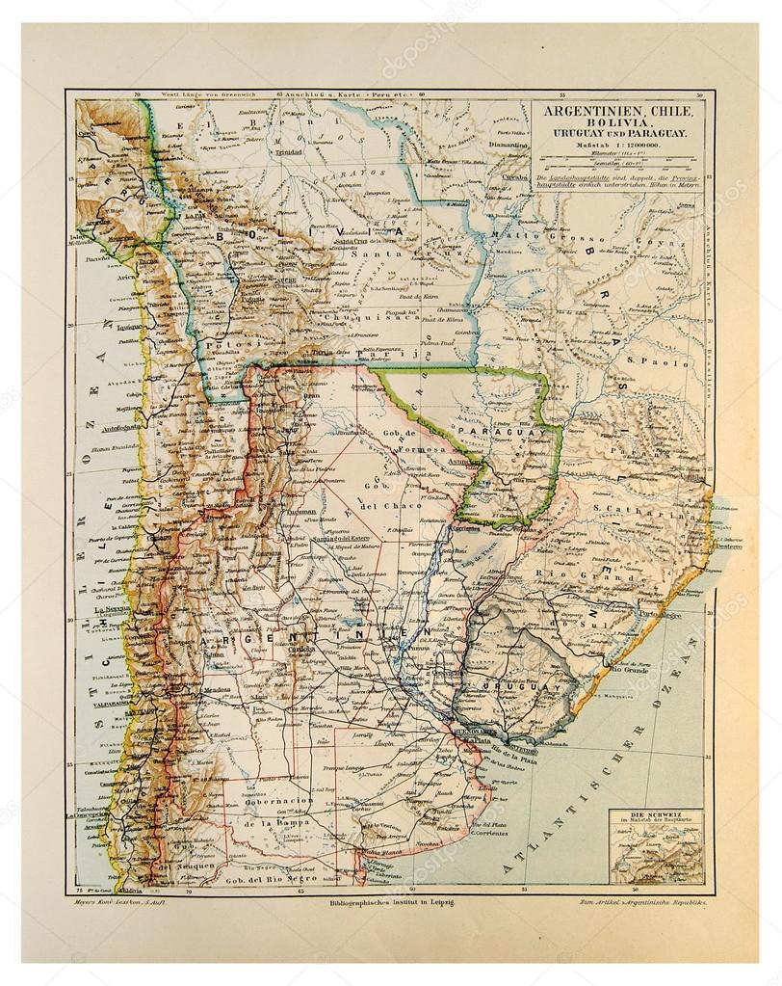
ELN guerrillas
They formed the Ejercito de Liberacion Nacional de Bolivia; the National Liberation Army of Bolivia.
They aimed to develop the ‘foco’ system of revolution, based on the conditions of Cuba before 1959
The ‘foco’ system was based on the idea that small groups of guerrillas could act as a focus for popular discontent against repressive, elitist regimes
These groups could eventually come to power in a successful revolution

Slide 31
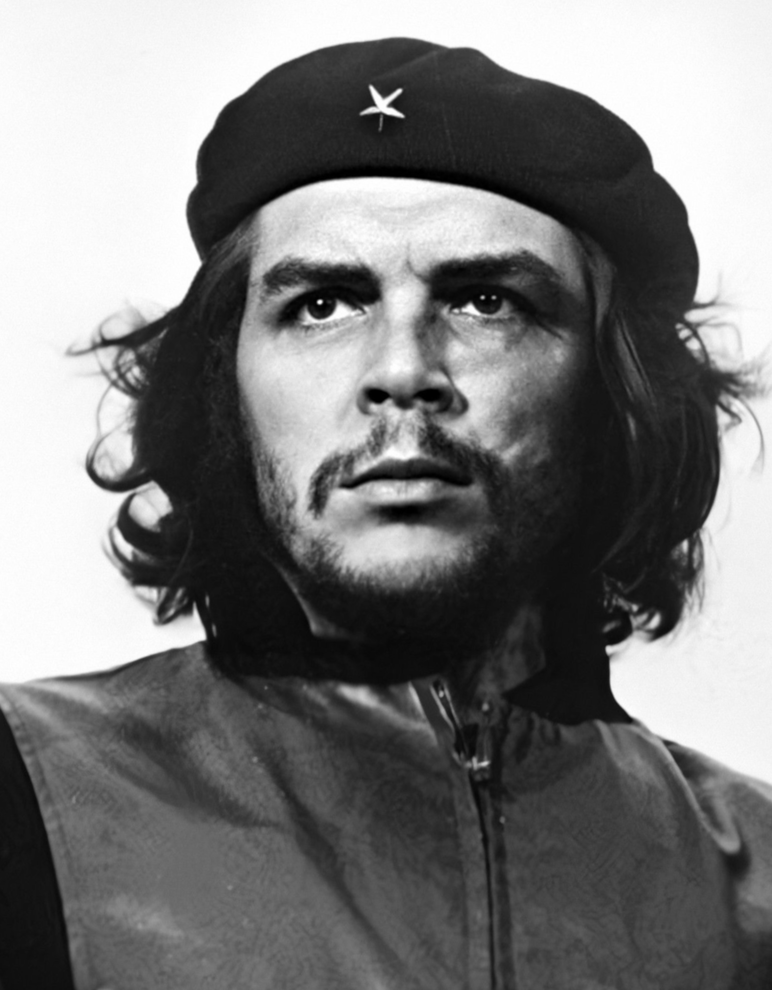
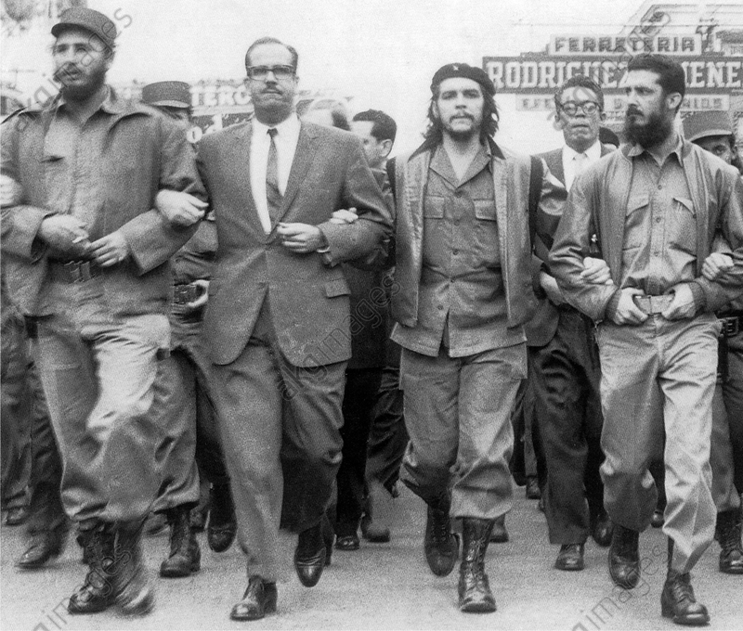
Che Guevara
Guevara joined the 26JM in Mexico and was 2nd in command during the revolution. In 1965, he went to the Congo to educate the Marxist Simba movement in Marxist ideolog and guerrilla warfare. He later fled to Europe before leading a rebellion in Bolivia without substantial Cuba support.
On October 8th, 1967, Che Guevara was captured by a mixed group of CIA commandos and Bolivian special forces trained by the US. He was interrogated but refused to answer the questions asked. The next day, Guevara was murdered by one of the Bolivian Rangers acting on the orders of the CIA

Slide 32
Che Guevara
After his death, Guevara became a worldwide symbol of resistance for many young people in the following decade. He was also a cultural symbol in Cuba
During his life he had:
Reviewed appeals for those convicted as war criminals
Instituted agrarian reforms, being Minister of industries
Served as the Instructional Director for the Cuban armed forces
Travelled as a diplomate for Cuban Socialism

Slide 33
Chile 1970-1973
In 1967, Castro’s government continued to give aid to revolutionary groups despite concerns from Moscow that such actions were ‘complicating’ their relationship with the US. By 1970, groups in Venezuela, Colombia and Guatemala were experiencing serious setbacks.
Such defeats coupled with economic problems led to reduced aid whilst Cuba sought Soviet economic aid. However, support and limited aid was given to liberation groups and successful reformist governments throughout the 1970s

Slide 34
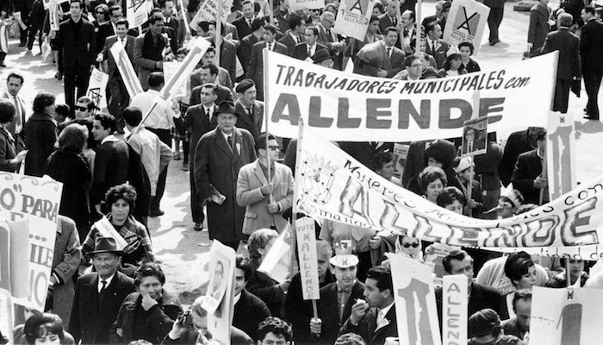
Chile 1970-1973
One example of support given was to Allende’s Popular Unity coalition government which won the 1970 elections in Chile.
As with the other examples of Castro’s support of revolutions abroad, Castro saw this as a way of ending Cuba’s isolation and reducing US domination of the area
However, despite giving Allende an AK-46 Kalashnikov rifle, no military help was given beyond providing personnel and training for a special body guard
When the expected US-inspired coup took place on the 11th September, 1973, no troops were sent to help the Chilean resistance

Slide 35
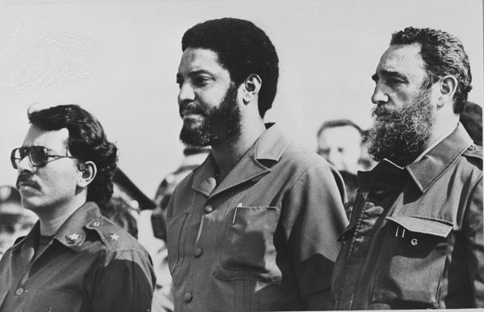
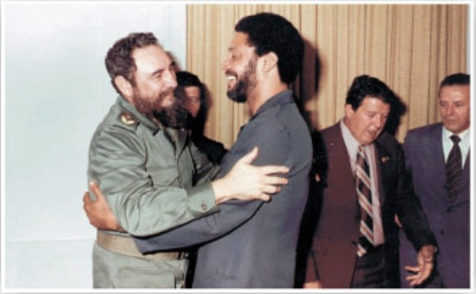
Grenada and Nicaragua
In March 1979, the left wing New Jewel Movement led a successful revolution in Grenada, which was part of the British Commonwealth
US President Reagan refused to give aid, however Cuba sent construction workers to help build a new international airport for tourists and military instructors to help establish a new police force
In October 1983, The US sent in troops from its Rapid Deployment Force to overthrow the NJM government, killing 25 Cubans. Castro feared a US attack was imminent
Although it was condemned by Britain and the UN, the US used its veto in the Security Council to block the resolution

Slide 36
Grenada and Nicaragua
In 1979, following the overthrow of a US-backed dictator in Nicaragua by the Sandinistas, Cuba gave the new government considerable aid for its literacy, educational and medical reform programmes. This included 2,500 nurses, teachers, doctors and engineers. Cuba also gave industrial aid and technical advice and as the US-sponsored Contras began to attack and murder education and medical workers, it also provided military training.
This aid was useful as before 1979 most aid came from the US, which was cut off after the Sandinista’s victory. Cuba had almost immediately stepped in with grants and unconditional loans.

Slide 37
Grenada and Nicaragua
Although the Sandinistas won elections that were attested to be free and fair in 1984, US opposition continued and in 1990, the Sandinistas lost the elections.
The Sandinistas were members of the Sandinista National Liberation Front (FSLN) which was a coalition that included Marxists, liberals, democratic socialists and Catholic priests united against the US-backed dictatorship
The Contras was a terrorist group that opposed the Sandinistas. When aid was banned by congress due to mounting examples of Contra atrocities, President Reagan used money from illegal arms sales to Iran to continue Contra funding
This led to the Iran-Contra political scandal

Slide 38
Venezuela and Bolivarian Revolution
Cuba gave support to Hugo Chavez, the first elected president in Venezuela in 1998. He was an admirer of Castro and Cuba and immediately began a massive programme of reforms to reduce the inequalities that existed in Venezuela.
He won massive support amongst ordinary Venezuelans, enabling Chavez to win four presidential elections in succession before dying in 2013
His rejection of neo-liberal capitalist economic policies and his strong opposition to US imperialism made him an ally in Castro’s eyes

Slide 39
Venezuela and Bolivarian Revolution
Bilateral agreements meant that in return for sending large numbers of doctors to help medical reforms, Castro received badly needed oil. Cuba also received large amounts of grants, loans and investments.
The alliance with Chavez helped the struggling Cuban economy after 2003 and resulted in a foreign policy with popular outcomes for many Cubans
Castro also backed Chavez’s ‘Bolivarian Revolution’, which attempted to overcome the great inequalities in Latin America and to resist US domination
In 2006, reformist politicians came to power in Bolivia and Ecuador

Slide 40
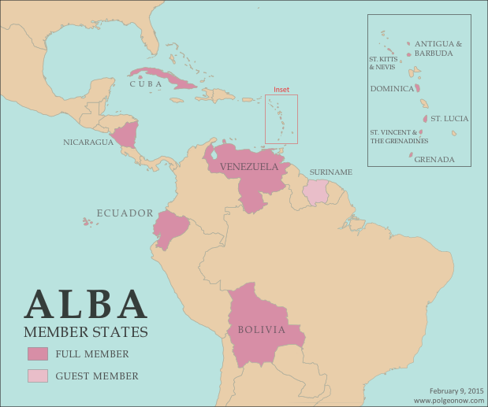
Venezuela and Bolivarian Revolution
Castro joined the ALBA bloc, the Bolivarian Alternative for the Americas that was set up by Chavez in 2004 with Cuban participation as an alternative to the USA’s Free Trade Area of the Americas (FTAA) which is committed to capitalist neo-liberalism and deregulation of economies to allow maximum profits.
ALBA was a socially oriented trade bloc and intended to eradicate poverty.

Slide 41
Africa
Castro also pursued an active foreign policy in Africa. As early as 1961, Cuba was helping Algerians in their independence fights against France, seeing a victory in 1963
For Algerians, Castro sent a medical mission to help establish a nationwide free health service
The foreign policy after this focused on Sub-Saharan Africa, particularly developments in southern Africa
Nelson Mandela publicly acknowledged Cuba’s role in helping bring down the apartheid regime in South Africa
As with other areas of the foreign policy, most Cubans took pride in this achievement and the global recognition achieved

Slide 42
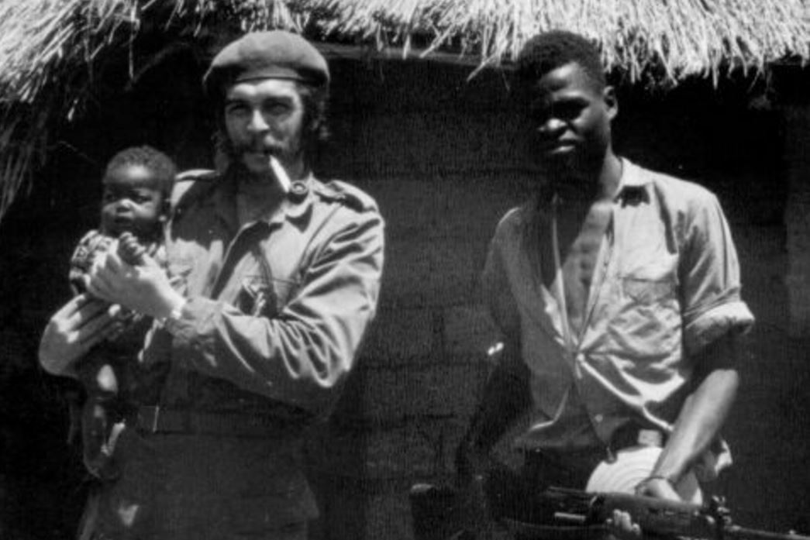
The Congo
In the mid-1960s, guerrilla groups in Portugal’s Africa colonies were fighting independence wars. One such colony was the Congo, which broke out in civil war.
To defend it’s client, the current ruler, the US sent 1,000 mercenaries
In December 1964, Che Guevara went on a three-month trip to Africa, which concerned the US, fearing their influence in the region was being threatened. He returned to Cuba, calling for black volunteers to help the rebels in the Congo.
In April 1965, Guevara and 120 volunteers returned, however in November, Guevara and the surviving volunteers were forced to return to Cuba.

Slide 43
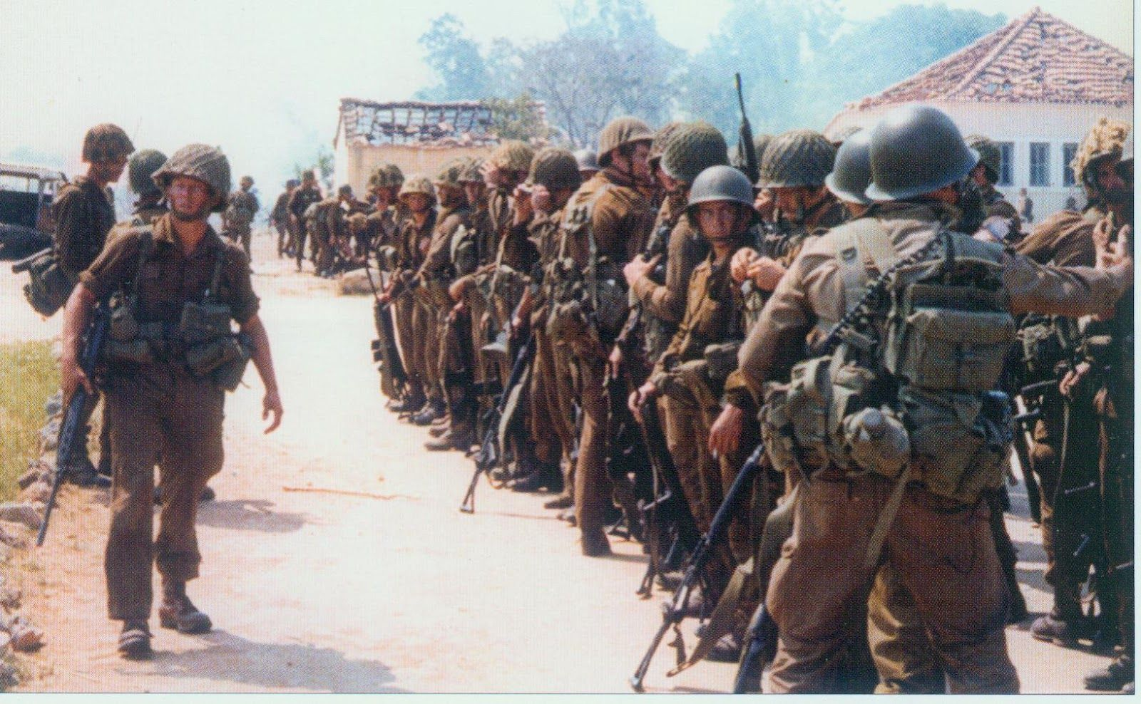
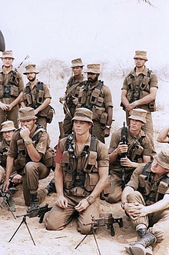
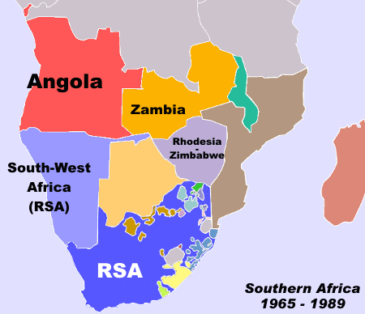
Angola and Southern Africa
The most successful foreign policy interventions in this region began in 1966. This was a response to a request from rebels in the Portuguese colony of Guinea-Bissau in which Castro sent doctors and military instructors. These individuals stayed until Guinea-Bissau won independence in 1974.
The biggest commitment was to Angola. In 1975, a civil war had broken out between three rival independence movements following the collapse of the Portuguese dictatorship the year before.
South Africa and the US were determined to stop the Soviet-backed People’s Movement for the Liberation of Angola (MPLA) from coming to power.
South Africa wanted to ensure its illegal control of South-West Africa (Namibia)

Slide 44
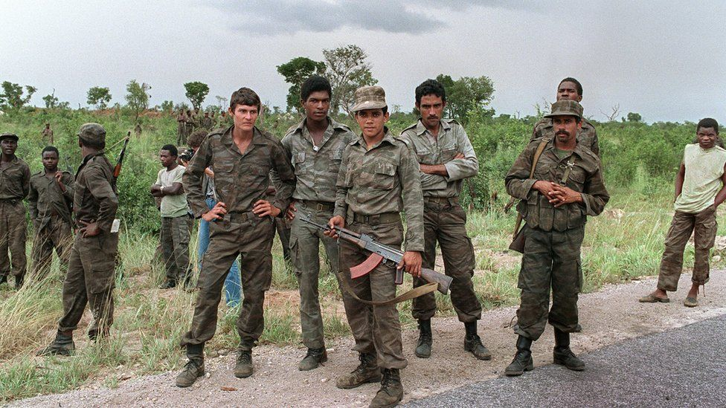
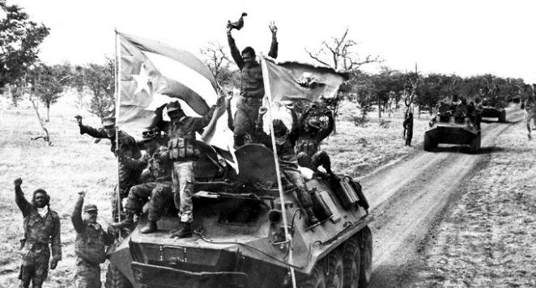
Angola and Southern Africa
The MPLA looked as though they were winning so the US persuaded South Africa to send in troops. In March-April 1976, US secretary of state Kissinger ordered the Washington Special Actions Group to draw up secret plan to ‘crush Cuba’ after Castro’s decision to send troops to Angola, including the air strikes and mining of Cuban harbours. President Ford declared that any action would be taken after the elections that year.

Slide 45
Angola and Southern Africa
Soviet aid for the revolution was limited so Cuba sent in troops to halt the South African advance towards the capitol.
In 1976, there were 25,000 Cuban troops in Angola, and South Africa withdrew.
This decision jeopardised Cuba’s attempts in improving relations with the Organization of American States which lifted its sanctions in 1964 and West European governments that were offering low interest loans and development aid.
Some saw the intervention as helping weaken South Africa’s apartheid system. The victory of the Cuban forces was the first time South Africa was forced to retreat, encouraging those struggling against the apartheid regime and those trying to end South Africa’s control of South-West Africa. Most of Angola was now ruled by the MLPA and independent movements now had a sympathetic government across the border.

Slide 46
Angola and Southern Africa
The troops remained in Angola during the late 1970s and South African forces continued to attack Angola from South-West Africa. US President Carter offered to normalise relations with Cuba and to end sanctions if Castro would agree to withdraw his troops. Castro said it was up to the Angolan government, as it was they who requested his help.
After Reagan replaced Carter in the 1980s, these offers were withdrawn and Cuba paid a high price for its foreign policy. Under Reagan, South Africa was encouraged to step up its actions against Angola.
In September 1987, South Africa launched a major attack in south-east Angola. This was condemned by the UN but the US ensured no sanctions were imposed on South Africa and ensured no international aid was given to Angola.
The South African advance was halted at the Battle of Cuito Cuanavale on the 23rd March 1988 by Cuban troops in Angola.

Slide 47
Angola and Southern Africa
Castro had sent his best troops and most modern weapons. After the victory, Cuban and Angolan troops pushed the South-African troops back across the border with South-West Africa.
In December, the threat of Cuban troops crossing the border forced the US to push SA into agreeing to end its support of Angolan rebels and to UN-supervised elections in South-West Africa. Cuba gradually withdrew its troops from Angola.
Nelson Mandela mentioned that Cuban involvement in Angola had played a big part in the eventual fall of the apartheid regime in South Africa, and that it was an unparalleled example of selfless internationalism. Overall, in this campaign, 2,400 Cubans were killed

Slide 48
Horn of Africa
In 1977, Castro sent 12,000 troops to help the new government in Ethiopia resist an invasion by Somalia.
However, due to helping Angola at the same time, Castro initially only agreed to send doctors and military advisors, refusing the request for combat troops
Cuba’s intervention in Ethiopia resulted in the defeat of Somali forces in 1978. This outcome was supported by most of the members of the Organization of African Unity

Slide 49
Humanitarian aid
Castro’s foreign policy also included significant humanitarian aid, especially after 1975. Primary and secondary school teachers, doctors and nurses, construction workers and technicians went to places such as Nicaragua, Algeria and Guinea-Bissau. The biggest aid programme was in Angola.
In late 1977, 3,500 volunteer Cuban aid workers were in Angola, with their salaries being paid by Cuba, despite it also being a poor country. These volunteers mostly shared Castro’s commitment to internationalism and duty to help others.

Slide 50
Humanitarian aid
In 2010, Cuba, followed by Venezuela was the first country to send help to Haiti after its earthquake.
In return for the impact of their foreign policy, Cubans also received help.
After hurricanes in 2008 and 2012, Chavez’s Venezuela provided humanitarian aid to Cuba including food and prefabricated houses
Over 40,000 Africans, Latin Americans and Asians were given full scholarships to study in Cuba, including medical professionals, educationalists, agriculturalists and scientists
There has been no other instance in which an underdeveloped country has carried out such massive and generous aid programmes

Slide 51
Successes and failures of the foreign ….policy

Slide 52
Successes
Despite its own economic problems, including during the Special Period, the Cuban government has retained the support of large sections of Cuban society. This appears to be due to the widespread support and pride in Cuba’s foreign policy
Cubans took pride in Cuba’s continuing commitment to international solidarity in the struggle against US and Western imperialism. This linked to aim two: maintaining the sentiments associated with the revolution at home.
Despite most guerrilla movements in Latin America failing, Castro succeeded in Africa. In Angola and Ethiopia, he deployed more than 300,000 troops from 1975 to 1990, more than the Soviet Union sent in the same period. Unlike with the United States’ war in Vietnam, Cuba eventually triumphed in all three of the wars in which it intervened in Angola and Ethiopia. It also sent tens of thousands of doctors, teachers, construction workers and other aid workers to African neighbours and trained guerrillas in present-day Zimbabwe.
Cuba had a hand in winning Namibia’s independence, earning it the gratitude of South Africa’s African National Congress.
Castro achieved his first aim successfully. He made his survival of Soviet interest and using this as leverage to secure a pledge by the US which has persisted even after the Cold War. His first aim was achieved in 1962

Slide 53
Failures
Despite one of Castro’s goals being to promote revolution around the world, Castro assailed parties which he regarded as too timid and split with Venezuelan Communists: he jeopardized revolutionary success to maintain his position of influence over leftist movements
The death of Che Guevara, partly due to the lack of sufficient Cuban support in Bolivia can be said to represent the failure of Castro’s efforts to export the revolution in Latin America.
In order to prevent total economic dependence on great-powers, Castro had to sacrifice his forth aim in Latin America to establish economic ties with these countries. His ‘Rule of Bargaining’ undermined his strategic aim of exporting revolution in order for economic concessions.
Castro had overestimated the ability of the Cuban economy to survive without economic support of a great-power or third-world countries
The veterans of Angolan service are commonly referred to as the ‘generation of disenchantment’. They regarded themselves much the way that Vietnam veterans did in the United States in the 1970s.

Slide 54
Failures
The missile crisis showed that Castro could not always count on the Soviets to defend him against the US. Castro tried to be independent in the realm of foreign policy but ultimately failed and had to return to a subordinate relationship with the USSR.
Although Castro continued to export the revolution to countries in Africa, his tangible successes were far from great-power attentions.
Castro achieved the aims that were domestically oriented but did not achieve aims three and four fully. These were attempts by Castro to pursue overly ambitious goals that were unachievable with the finite power and resources available.

Slide 55
Latin American policy problems
In Latin America, despite cultural affinity, Castro failed to achieve his fourth aim. His ambitions in Latin American backfired frequently and caused Castro to be isolated diplomatically from most Latin American governments in the 60s who saw him as threat, as well as Latin American Communist parties who disliked Castro’s insistence on conducting revolutions in his own way.
To fix this, Castro modified his ideology, following the ‘Rule of Bargaining’. Under this, Castro altered his foreign policy stance to prioritize relations with states friendly to Cuba over revolutions in those states
He used support for revolution as a bargaining piece to gain concessions from other states
Castro was able to re-establish economic and diplomatic relations with Chile, Venezuela and Peru by 1969.
He also could participate again in the southern hemispheric political scene, establishing economic ties which Cuba depended on.

Slide 56
To what extent did the foreign policy ….change over time?

Slide 57
Changes in foreign policy over time
Initial period: 1959-1962
Castro focused on achieving his first aim in his foreign policy, breaking free of the domination of the US.
Key events during this period included
- Washington severing all diplomatic ties by October 1960
Bay of Pigs, April 1961
Cuban Missile Crisis, October 1962
Castro also used this period to push the USSR away and pursue an independent political policy
Independent foreign policy phase: 1962-1968
Castro used this time to pursue an independent political and foreign policy.
Cuba’s economy started to suffer: could not survive independently
Ended on 21st August 1968 when Castro gave his support towards the Warsaw Pact invasion and joined the Brezhnev doctrine (formalised 1968). This lasted until the fall of Communism in the 80s and 90s

Slide 58
Changes in foreign policy over time
Spreading revolution and humanitarian aid: 1964-2012
Castro pursued a foreign policy in Latin America, but stopped supporting revolutionaries in nations that were economically important to Cuba
Castro was more successful in the wars he intervened in within Africa
Castro also gave humanitarian aid to countries such as in Nicaragua, Algeria and Guinea-Bissau and offered scholarships to study in Cuba. Cuba received aid from countries such as Venezuela when Cuba was effected by hurricanes
Cuba carried out massive and generous aid programmes despite being undeveloped itself
Special period: 1991-2000
Collapse on the Soviet Union threatened the Cuban economy.
Castro made adjustments signalling a move towards better relations with the US, Europe and China

