Slide 1
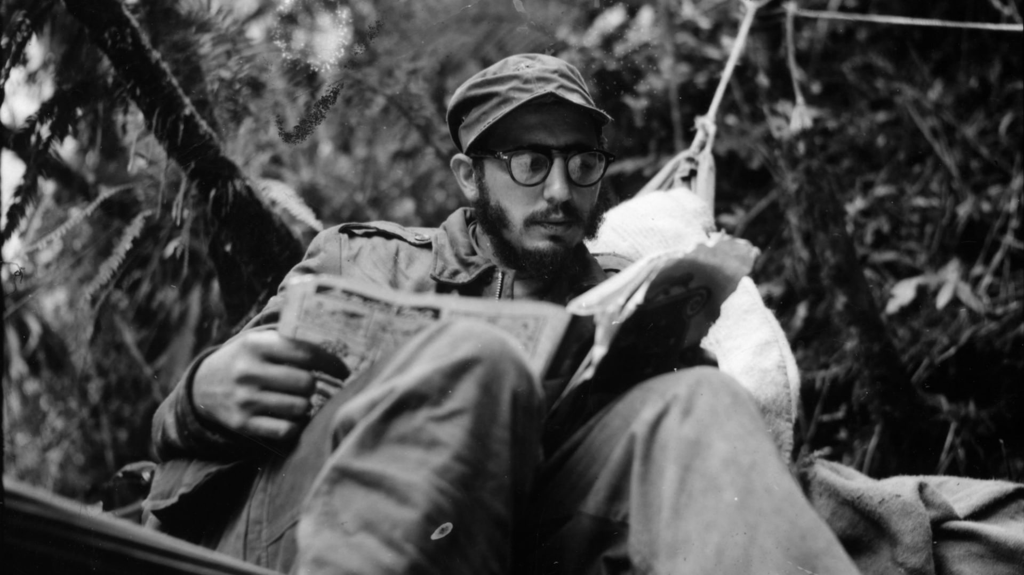
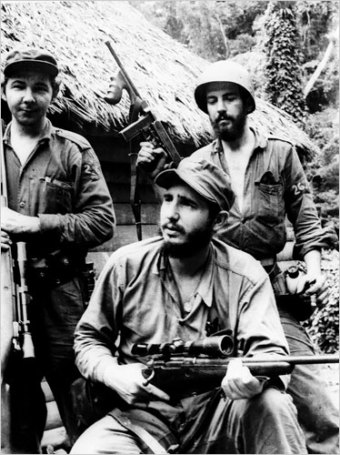
How did Fidel Castro consolidate power?
L/O – To identify and analyse the methods Castro used in his consolidation of power up to 1976

Slide 2
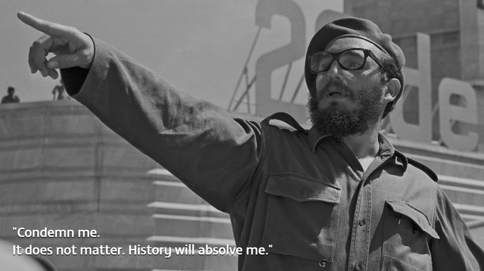
Methods of consolidation - analysis
Legal consolidation of a one party state and centralization of power.
Delivering on promises and popular support
Dealing with opposition
Foreign policy

Slide 3
Legal Consolidation of the one party state
After Castro’s arrival in Havana in January 1959 he immediately established a new government as promised. It was a modertae government with moderate M. Urrutia (president) and Jose Miro Cardona ( PM). There were only 3 members of the Rebel Army in the new cabinet and only one was a member of the 26th July Movement.
F. Castro ( military commander-in-chief) and clearly held the power.
He set up the ORPC ( office of the revolutionary plans and co-ordination) an uofficial group of his closet advisors. This established a dual power systemthat effectively bypassed the cabinet
Cardona was dismissed in Feb 1959; Castro became PM
Suspension of elections, Agrarian reform→ INRA (National Institute of Agrarian Reform) was set up→ later INRA became the effective government.
Feb 7, 1959 – The Fundamental Law of the republic gave all political power to the cabinet.
moderate cabinet members resigned over increasingliy communist policies, Urrutia was forced to leave the presidency→ Oswaldo Dortigos the new president up to 1975.
By the end of 1959 most of the remaining moderates and liberals had either resigned or had been forced out of office. Four more went in 1960.

Slide 4
Revolutionary consolidation
From 1960 onwards
Press and radio stations ”was brought into line”
Centralisation: the cabinet took the legislative and executive powers
political parties banned
Communist-led trade unions got more power
All judges appointed by Castro´s approval
” real democracy is not possible for hungry people”– free elections postponed

Slide 5
Early Opposition
There were many opponents of the regime in the early years.
Some disliked the growing communist influence.
Oct 1959 Matos – leading Revolutionary resigned in protest. Matos and others were arrested and put on trial for ‘rebellion’.
Castro used the crisis to strengthen his position by forming a militia as part of the new power structure.
There was also a rumbling civil war with counter-revolutionaries fighting from a mountain strong hold supported by the US.
The Escambray Rebels (soldiers loyal to Batista operating from the Escambray Mountains 1960-65,
Between 1960 and 1966 the civil war plagued Castro and were active in the 1961 Bay of Pigs invasion. This gave Castro the motive to round up counter revolutionaries – 3,500 were detained in Havana alone.
By 1966 the counter revolutionaries were finished and their actions had helped to maintain the spirit of ‘revolution’ and defense of Cuba. It led to increased nationalism and pride amongst Castro supporters.
Anyone who opposed Castro or the regime would be seen as traitors.
Yet despite the success it seems that increasing centralization of the regime was a response to a growing insecurity. There were over 600 plans to assassinate Castro.

Slide 6
The establishment of the state
The 26th July Movement was mainly a guerrilla army. Castro needed political experience of a political party. This was provided by the PSP (Communist Party).
The PSP had a long history of party politics and organizing mass movements and prior governmental experience.
Castro began negotiations with leading members of the PSP for the creation of a new Communist Party. He hoped to fuse this with the more radical wing of his movement and so strengthen his control.
In July 1961 the 26th July Movement, the DR and the PSP merged into the Integrated Revolutionary Organisations (ORI)

Slide 7
Initially the old PSP came to dominate the ORI. Anibal Escalante – the ORI secretary was particularly powerful – he gave preference to his old PSP comrades who were more likely to be loyal to him.
In March 1962 Castro denounced Escalante and removed him from his post. A massive restructuring of the ORI took place – almost half of the membership were expelled – most from the PSP faction.
Huge efforts were made to recruit new members.
In 1963 the ORI became the United Party of the Socialist Revolution (PURS) and in October 1965 the PURS became the Communist Party of Cuba (PCC).
Thus by the end of 1965 revolutionary power had been consolidated and Castro had established his pre-eminence over all potential rivals.

Slide 8
This did not mean that Castro was in full control of the new party. Between 1965 – 1968 his criticisms of the Soviet Union over peaceful co-existence and revolution in developing countries were opposed by some traditionalist communists in the PCC. In February 1968 their leaders were put on trial for factionalism.
The result of this ‘micro-faction’ affair was even greater control for Castro. After 1968 the party posed no serious challenge to Castro.
Between 1965 and 1968 some traditional communists tried to challenge Castro´s approach, result was their elimination and by 1968 Castro´s control was complete

Slide 9
The PCC had never functioned as a mass party and did not hold its first congress until 1975.
In 1972 it was given a new structure with a 100 strong central committee, as well as a smaller politburo and secretariat.
It also produced new party statutes and a new programme.
Membership rose steadily from 50,000 in 1965 to 500,000 in 1980. By then over 9% of all Cuban citizens aged over 25 belonged to the party.
These changes turned it into more of a typical ruling party. At the same time the proportion of military personnel in the leading bodies dropped making it a more civilian party.

Slide 10
Channels for opposition
Federation of University Students – Oct 1959 Castro intervened in the election and his candidate Cubelas was elected and aligned the union with the regime.
The trade Unions ; Confederation of Cuban Workers (CTC) held a congress in Nov 1959. The leaders aligned with the regime.
In 1970 opposition against poor productivity→ Castro admitted mistakes and argued for more democratic reforms.
CDR – Committee for the defense of the Revolution
A created militia of tens of thousands of supporters given the task to build support, intimidate internal opponents and to defend Cuba against external enemies.
Sept 1960 CDR set up in every city district, large building and factory. They identified enemies of the revolution, supress counter revolution. Members were over 7 million – helping build support and identification of the revolution.

Slide 11
Elimination of opposition& formation of the new communist party
Matos (one of the leading figures of the revolution)
Urrutia ( president)
Escalante, a communist leader ( ORI, integrated revolutionary organisations = The 26 movement, PSP, DR- revolutionary leaders)
Between 1960-66 counter-revolutionary guerilla war against Castro ( supported by USA)→ opposition defeated by 1966
According to US senate reports, the CIA´s second largest station in the wolrd was based in Florida
- 600 plans to assassinate Castro
” no country has suffered from terrorism as long and consistently as Cuba” (Balfour S, 2009)

Slide 12
How Castro was able to maintain his power?
By 1975 Cuba had a well established and well organised communist state.
New constitution 1976 ( economic problems, opposition..)
Identity the new constitution of 1976

Slide 13
US´role
Varela Project, early 2000
Mass organisations
Committees for defence of the revolution
Emigration and exile
Castroism

Slide 14
interpretations
Saney; the role of the workers´assemblies on the decision making
Spalding; influence of the PCC was suffocating
Roman: The party does not meddle in the operation of people´s power
Bengelsdorf; Cuban citizens exercise political sovereignity

Slide 15
Reforms
During the first five months, Castro issued land reforms.
May 17, 1959 – The First Agrarian Reform Law created the National Institute for Agrarian Reform (INRA), which placed a 1000-acre limit on land holdings
Cattle ranches and sugar and rice plantations could have over 3000 acres.
Any excess land was turned into cooperatives that were run by the INRA.
Tariffs were increased to protect domestic businesses.
Smaller sugar mills and rice growers were encouraged to export more.
The desire to do away with the corruption of the Batista era resulted in making it a capital crime to steal from the government. Prostitution and gambling were outlawed.

Slide 16
Opposition to Reforms
U.S-owned businesses lost land and money due to land reforms and the nationalization of industries.
The upper class (large plantation and ranch owners and industrialists) opposed the reforms.
Workers were given higher wages, and peasants were given land.
The more moderate and non-communist members of the central government left as the government became more radical.
The loss of many skilled advisors helped lead to Cuba’s turn to the USSR for assistance.

Slide 17
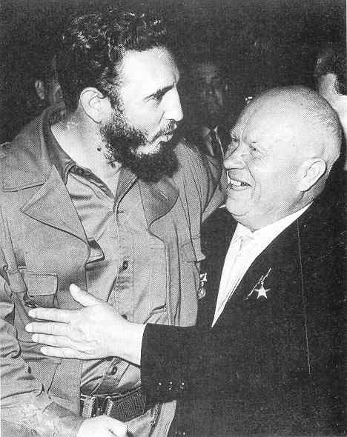
An agreement between Soviet deputy premier Anastas Mikoyan and Castro was reached – The Soviet Union would purchase 425,000 tons of sugar from Cuba in 1960 and 1,000,000 tons in 1961.

Slide 18
Economic Policies
Unemployment was virtually eliminated, and wages rose by as much as 40%.
The cost of rent dropped, and other services became free.
Issue – more Cubans had too much extra income and there were not enough consumer goods and food to buy because Cuba had ceased importing them.
The government had to begin rationing food (like cattle) by March 1962.
The new government wanted to diversify agriculture and become less dependent on imports.
Sugar fields and empty fields were used to produce cotton, vegetable oils, rice, soybeans, and peanuts.

Slide 19
Cont.
The government also tried to manage privately-owned farms through the National Association of Small Farmers (ANAP).
Result – the government couldn’t efficiently organize and manage agriculture, and Castro often ignored the advice of JUCEPLAN (a central planning agency)
Cuba attempted to industrialize between 1959 and 1961
The government began with taking over the U.S-owned telephone company. U.S-owned refineries and factories, banks, and Cuban-owned businesses were nationalized.

Slide 20
Any further industrial development proved to be too difficult for the government to carry out.
1963-1970 – The government turned to emphasizing sugar production again, and faced a series of bad harvests.

