Slide 1
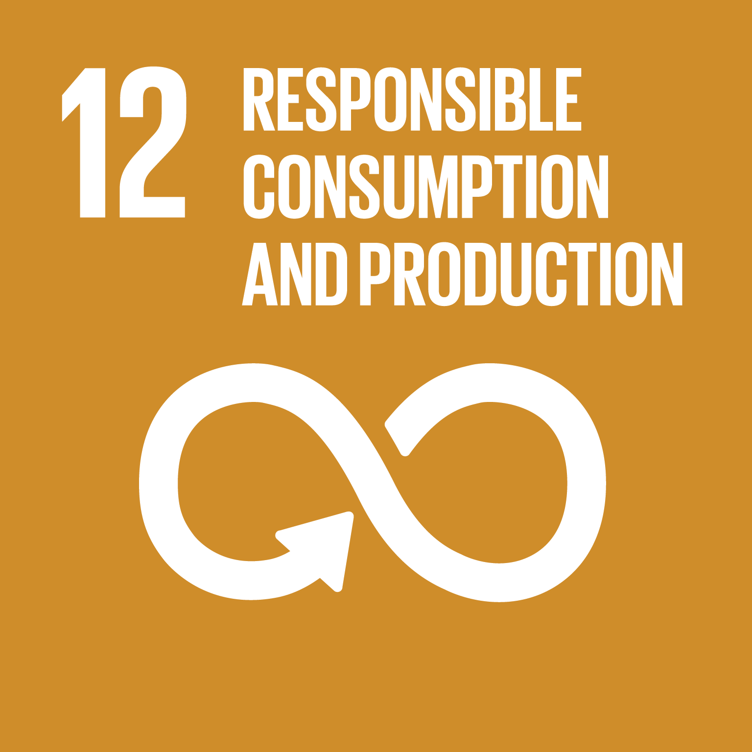
Can fashion be made more sustainable?
LO:
To evaluate the social and environmental costs of fashion
To look at ways in which fashion brands are becoming more sustainable

Slide 2
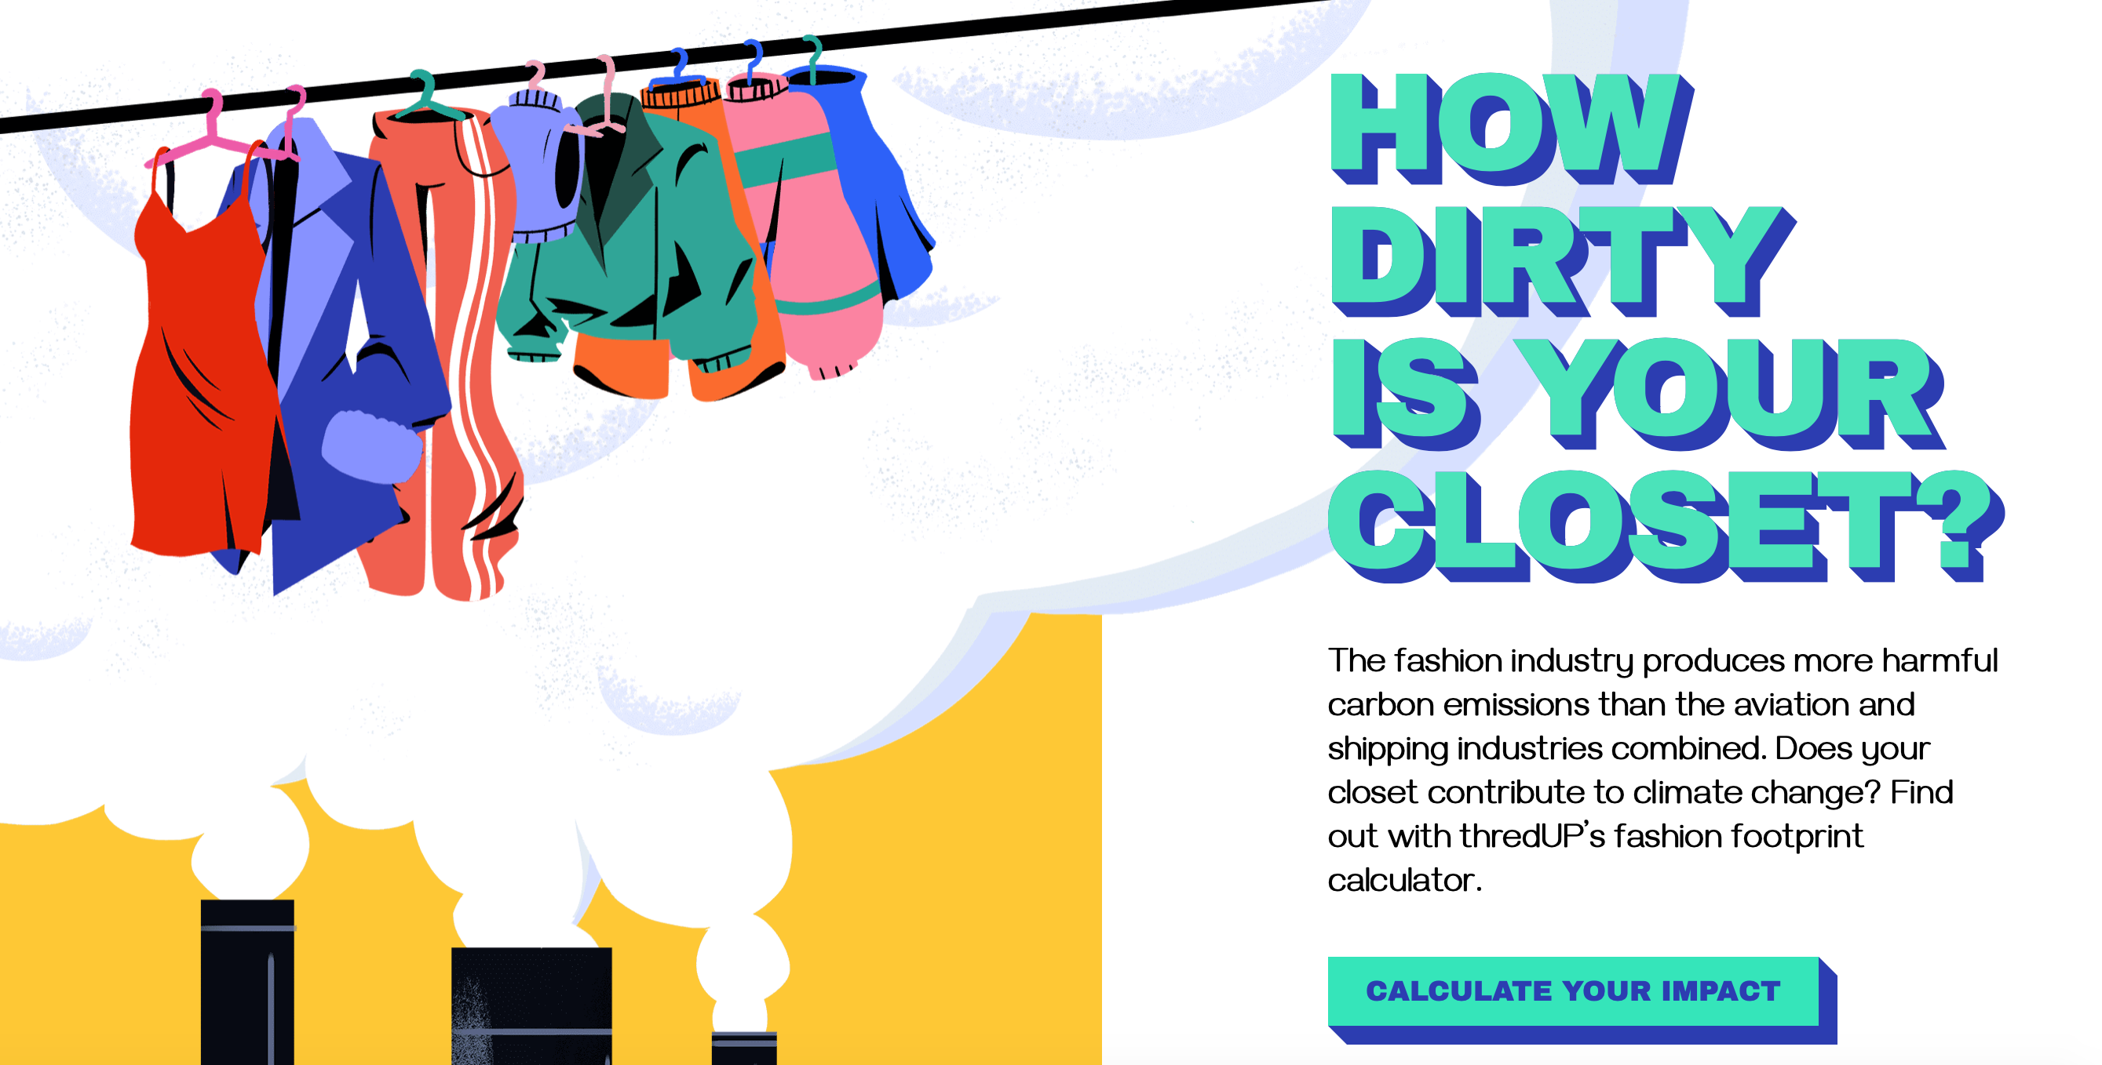
What is your fashion footprint?
https://www.thredup.com/fashionfootprint

Slide 3
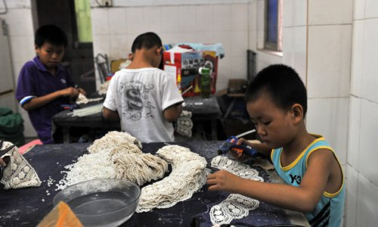
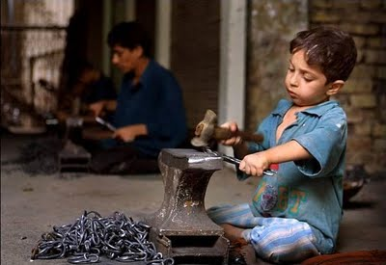
India’s sweatshop child workers
Task: As we watch the short clip, write the answers to the questions down.
Where does Stacey Dooley visit?
What is the average age of the children found working in the factories?
What caused Muhammed to run away from the factory?
https://www.youtube.com/watch?v=xGQceWoqVpA (from 25-30 mins)
Notes:
ANSWERS
A school set up by a local charity to meet some of the kids that have been rescued from factory work
9-12 years old
His adult factory boss worker beat him up

Slide 4
What drives child labour overseas?
Task: Match the pairs. Match each statement to its correct description by shading it the same colour. One has been done for you.
Employers lose money when, by law, they have to pay employees at weekends or during holidays | Legally allowed to pay women and girls less | There are organisations that exist to fight for better pay for workers (which turn costs firms money and reduces their profits). In some countries, trade unions are still illegal and workers have nobody to turn to in order to help them improve their pay and working conditions | Fewer health & safety rules
Little requirement to pay for medical insurance and sick pay | Employers must pay workers overtime (more money) if they work more than the agreed number of hours. | Special clothing or safety features in the workplace can cost employers a lot of money to buy and install, especially in dangerous industries, such as mining. | A lack of trade unions
It costs a firm money to keep paying wages to an injured worker at the same time as paying wages to his/her replacement | In countries where men and women have equal rights, it costs more to employ women. In countries where discrimination is allowed, women can be paid less and so firms save money. | Maximum number of working hours per week | No holiday pay/fewer days off

Slide 5
What drives child labour overseas?
ANSWERS
Employers lose money when, by law, they have to pay employees at weekends or during holidays | Legally allowed to pay women and girls less | These are organisations that exist to fight for better pay for workers (which turn costs firms money and reduces their profits). In some countries, trade unions are still illegal and workers have nobody to turn to in order to help them improve their pay and working conditions | Fewer health & safety rules
Little requirement to pay for medical insurance and sick pay | Employers must pay workers overtime (more money) if they work more than the agreed number of hours. | Special clothing or safety features in the workplace can cost employers a lot of money to buy and install, especially in dangerous industries, such as mining. | A lack of trade unions
It costs a firm money to keep paying wages to an injured worker at the same time as paying wages to his/her replacement | In countries where men and women have equal rights, it costs more to employ women. In countries where discrimination is allowed, women can be paid less and so firms save money. | Maximum number of working hours per week | No holiday pay/fewer days off

Slide 6
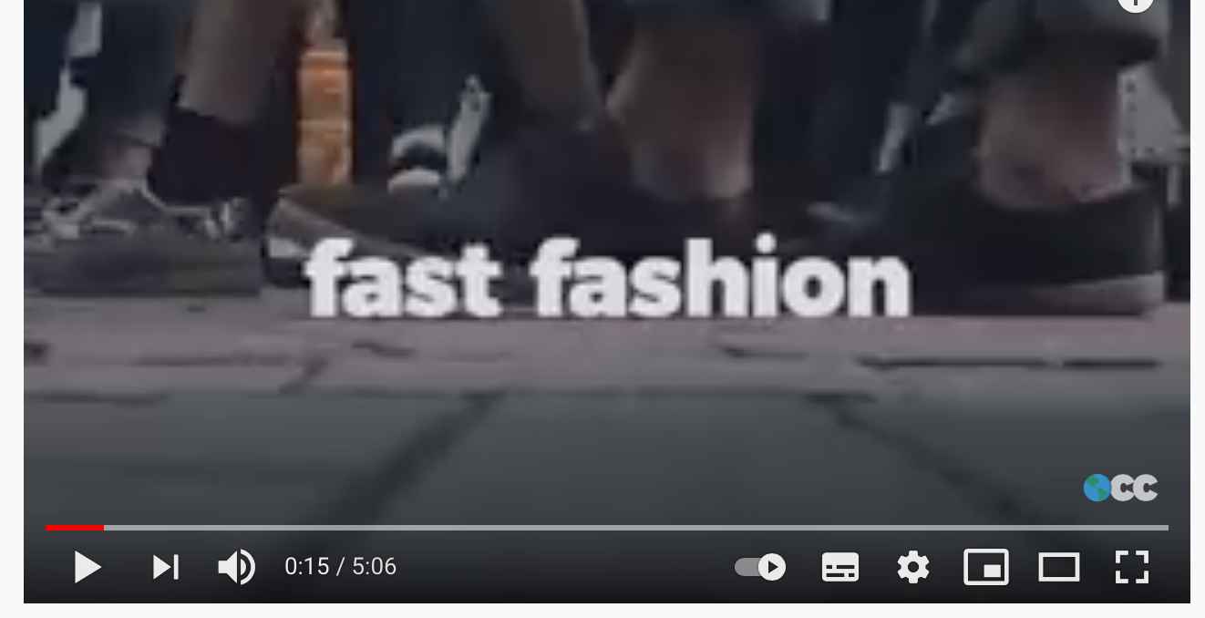
How is fashion destroying our environment?
Watch this video and list the ways in which fashion is having an environmental impact
https://www.youtube.com/watch?v=YOA0D0i5-fA&t=4s

Slide 7
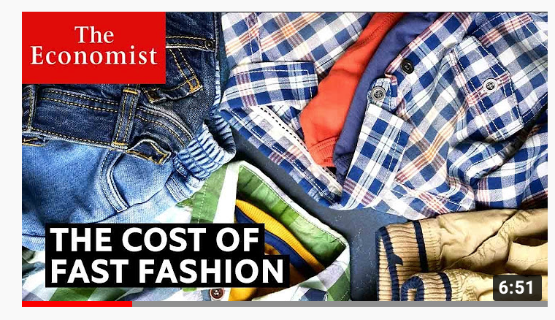
How are brands responding?
Watch this video and make notes on the different ways in which fashion companies are trying to be more sustainable
https://www.youtube.com/watch?v=tLfNUD0-8ts&t=88s

Slide 8
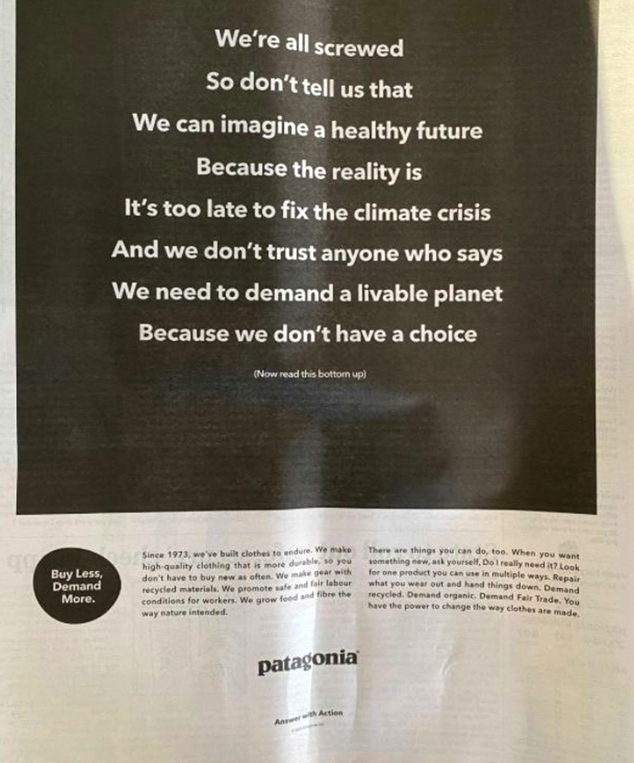
How are brands responding?
https://www.patagonia.com/our-footprint/

Slide 9
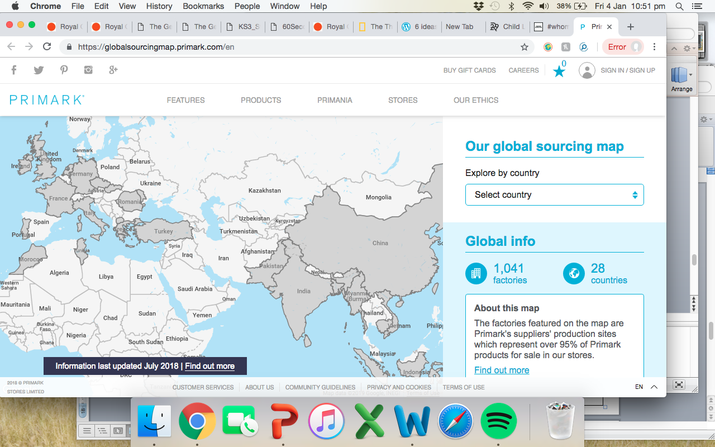
How are brands responding?
Primark now publish their factory locations on their website, including details of who works in each factory. Explore the link below!
https://globalsourcingmap.primark.com/en

Slide 10
How are brands responding?
Fashion Revolution published a report on the ‘Fashion Transparency Index 2018’. Some key findings:
“55 of the 150 brands (37%) included are publishing a list of their factories at the first tier, where clothes are typically cut, sewn and trimmed.”
Supplier lists have become a lot more detailed, including information such as factory street address, types of products they make and the number of workers.
Only one brand in the Fashion Transparency Index 2018, ASOS, discloses where they source raw materials. However, no brands were disclosing this information last year.
https://www.fashionrevolution.org/tag/whomademyclothes/

Slide 11
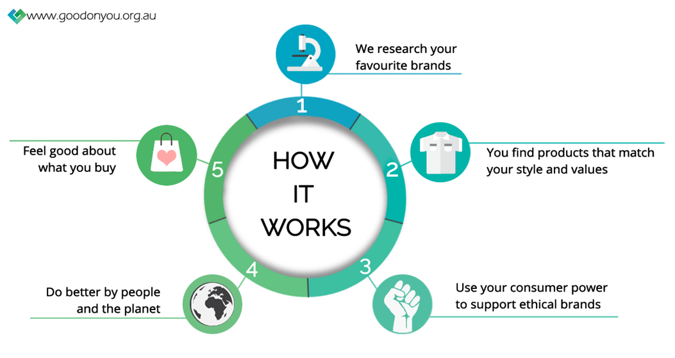
What can you do?
Check whether the clothing brand you're shopping is connected to or a member of a certification of sustainability initiative. The app ‘Good On You’ that makes clocking a brand for its impact on people, animals, and the planet easy.
https://www.refinery29.com/en-gb/2018/04/197022/child-labor-fashion-checklist

Slide 12
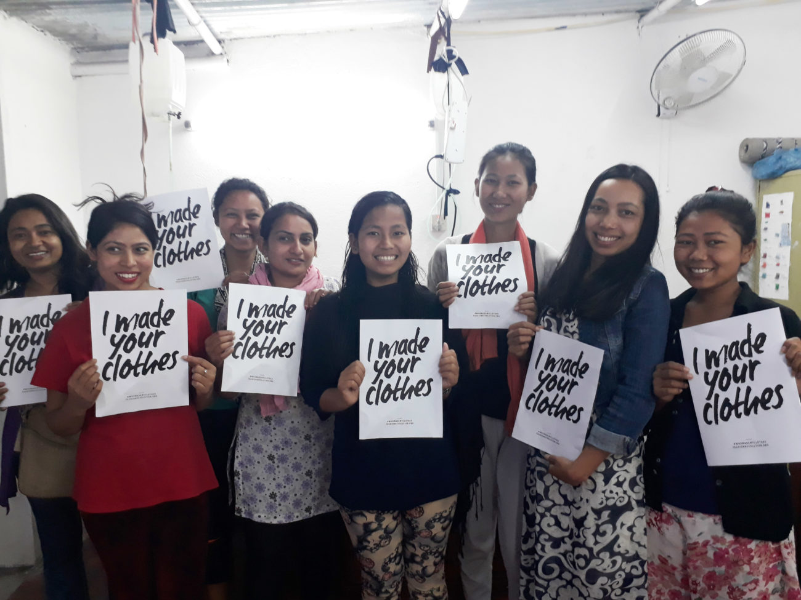
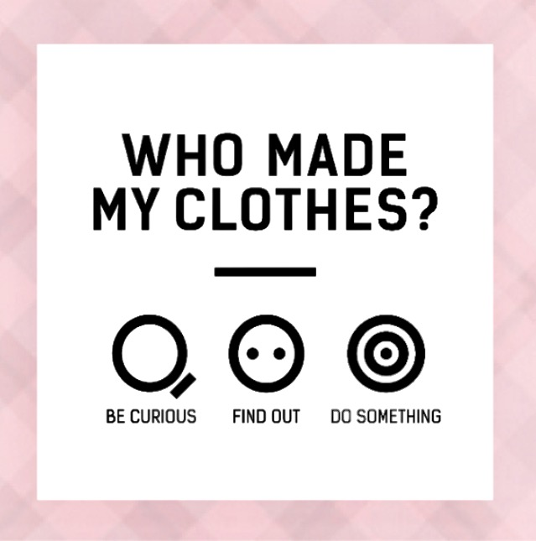
What can you do?
2. Check the hashtag #whomademyclothes – from the answers the user can determine if they are satisfied that what they are buying is made in dignified conditions. It also puts increased pressure on brands to be transparent and accountable for their workers throughout the supply chain.
https://www.refinery29.com/en-gb/2018/04/197022/child-labor-fashion-checklist

Slide 13
Task: Responsible clothing consumer
Research two other ways that you can be a more responsible clothing consumer.
You have a choice of how you present your findings. You may present your findings in any one of these three ways:
As a poster, which must be a persuasive advert encouraging a more responsible fashion industry. | As a piece of writing, which clearly explains the two methods you have found and how they help. | As another creative piece (could be a piece of art/cartoon/song/rap/video – you can be as creative as you wish!)

