Slide 1
Who?What?Why?Where?When?

Slide 2
Learning Outcomes
By the end of this lesson you….
Will know how bushfires affects people and the environment.
Should know the causes of bushfires
Could examine whether climate change has made the hazard worse.
Your learning will be assessed by…
Your annotated Australia map.
https://www.bbc.co.uk/news/world-australia-50951043

Slide 3
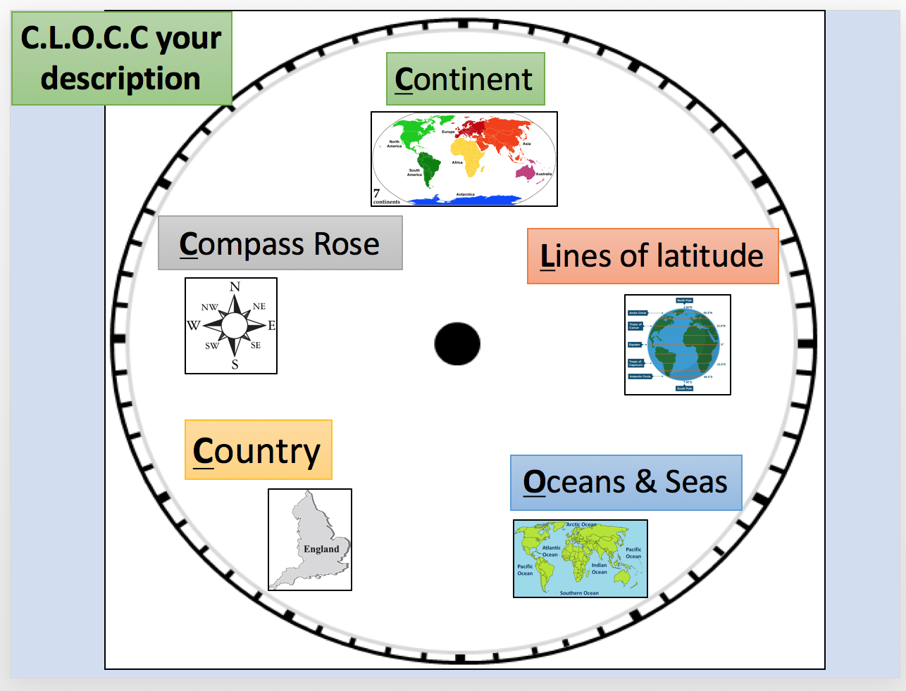
Where in the World?

Slide 4
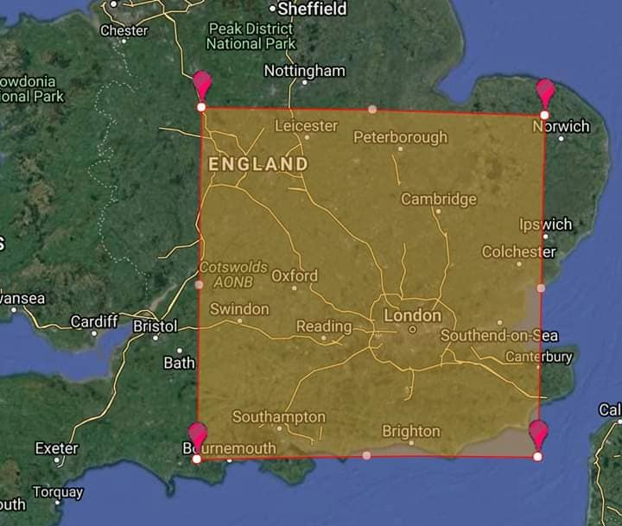
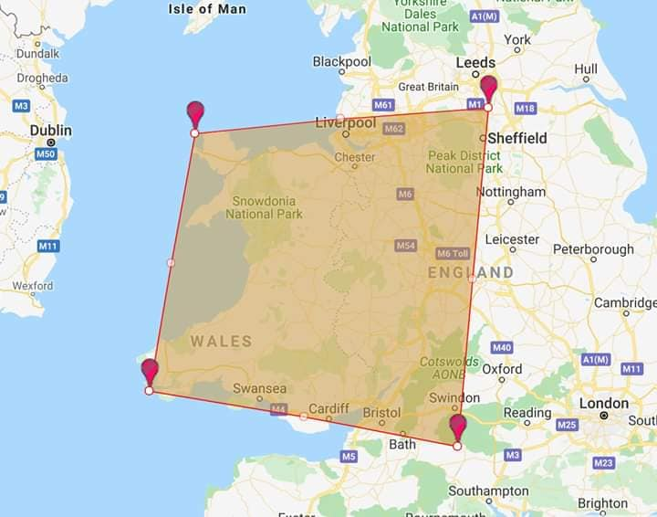
Now for some perspective!

Slide 5
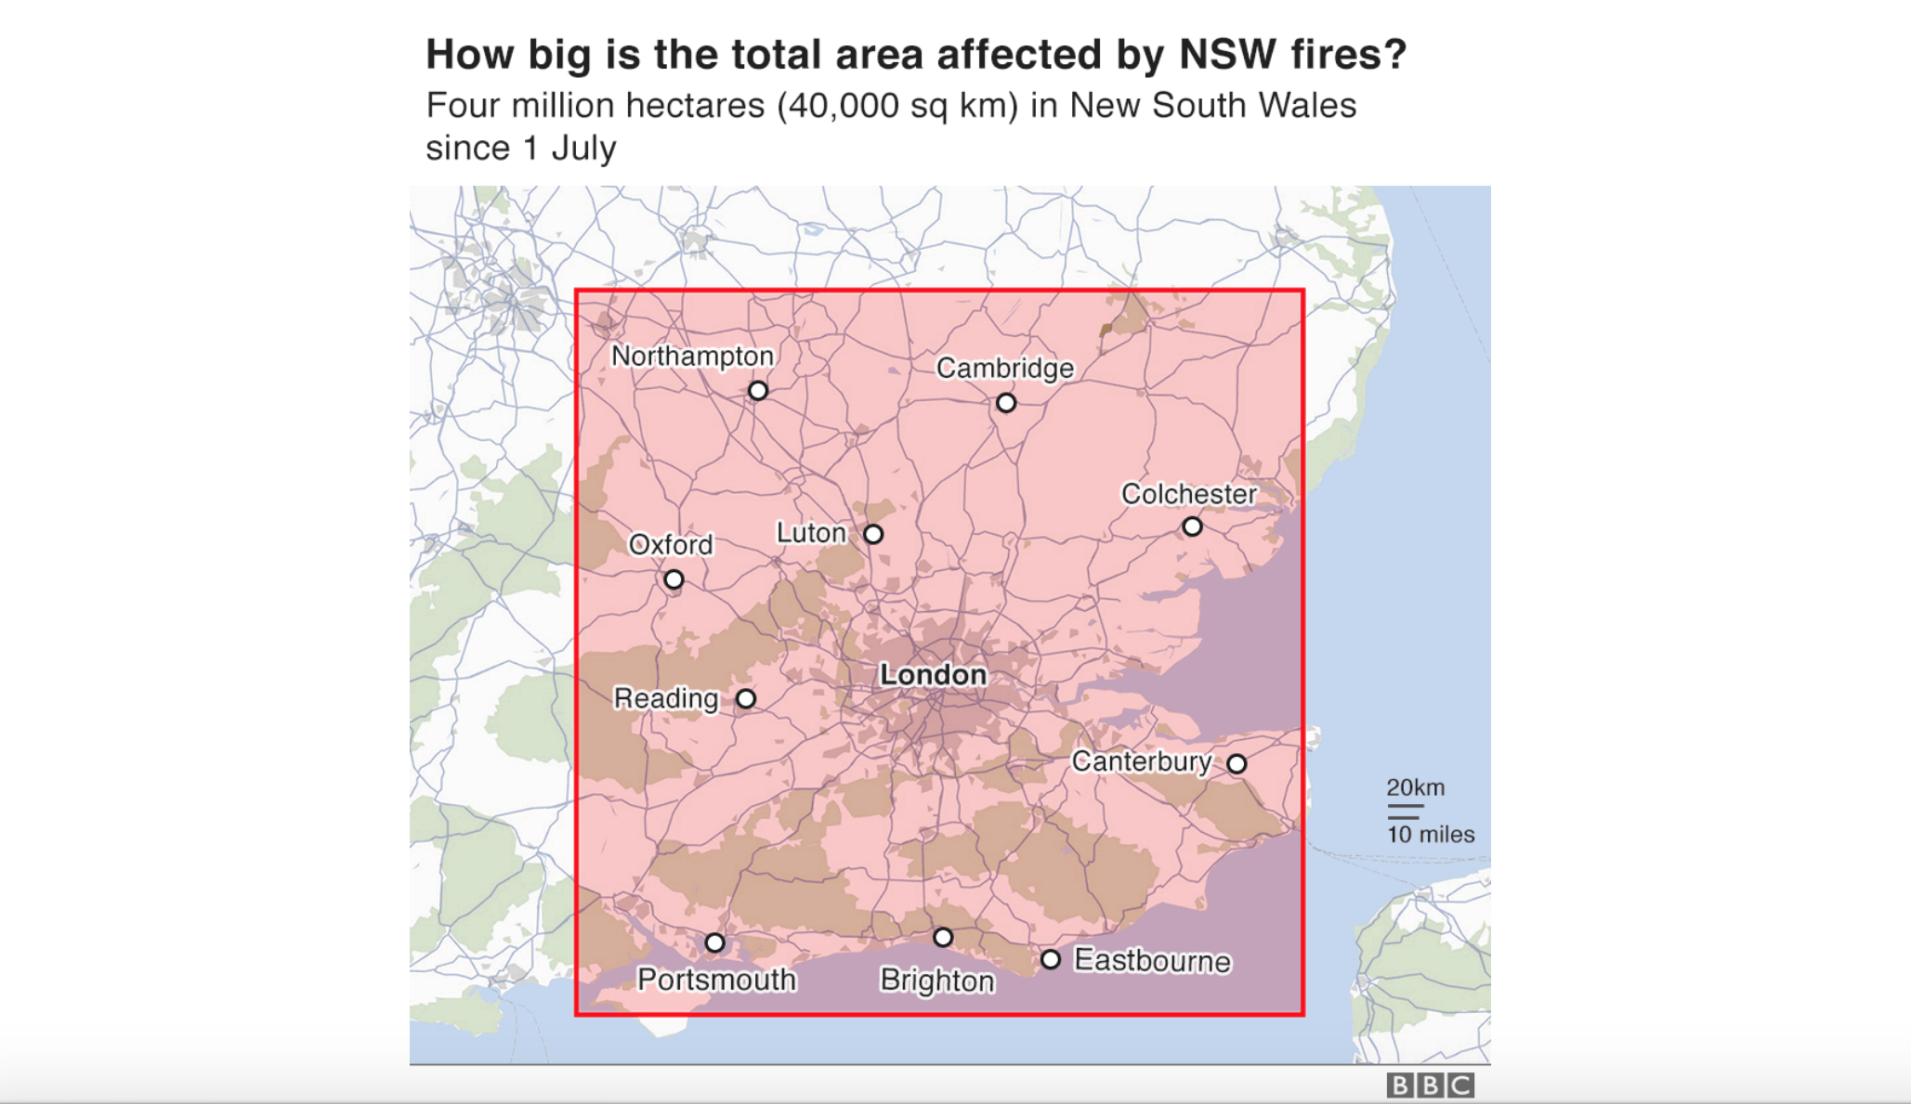
A little easier to see?

Slide 6
What are bushfires?
A bushfire is an unplanned fire in an area of natural vegetation. During a bushfire three elements are involved:

Slide 7
What causes bushfires?
Bushfires are common throughout Australia. They're made more likely when the weather is very hot and dry. The higher the temperature the more likely it is that a fire will start or continue to burn.
They can start from human activity - either accidently or deliberately - or can start by natural causes like lightning. Bushfires often pass in just a few minutes but can smoulder for days.
High winds are a real threat as they can fan the flames and spread the blaze.

Slide 8
What causes bushfires?

Slide 9
How common are they?

Slide 10
And then to make matters worse!!

Slide 11
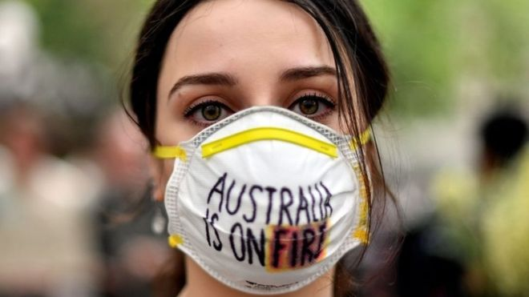
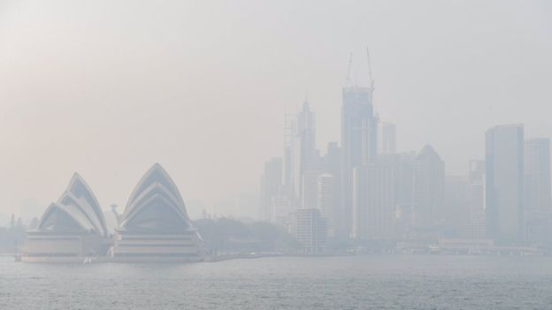
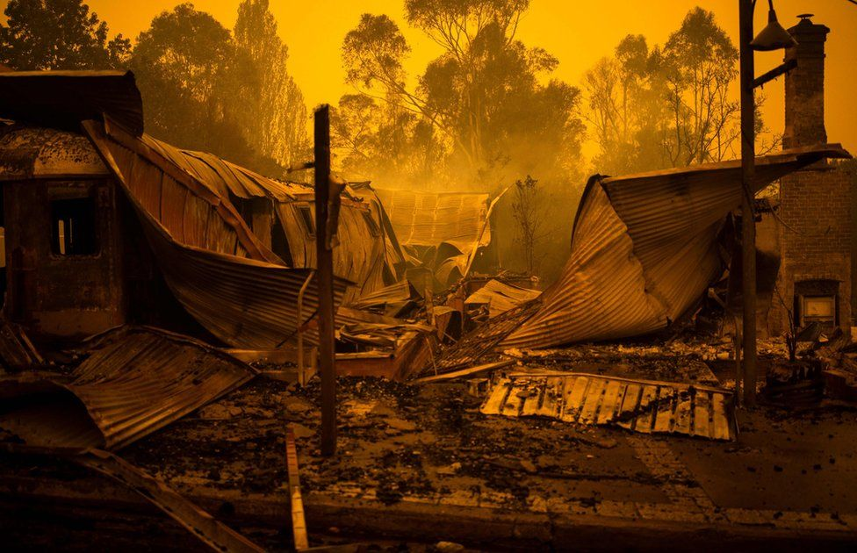
What are the impacts?
https://www.bbc.co.uk/news/in-pictures-50971879

Slide 12
What are the effects on ecosystems?
GCSE Challenge - What are the impacts on ecosystems?

Slide 13
Why is it so bad this year?

Slide 14
What does this graph show us?

Slide 15
What does this graph show us?

Slide 16
Extra Challenge- Is it natural?
https://www.theguardian.com/global-development/2019/nov/19/global-heating-supercharging-indian-ocean-dipole-climate-system
https://www.youtube.com/watch?v=J6hOVatamYs

Slide 17
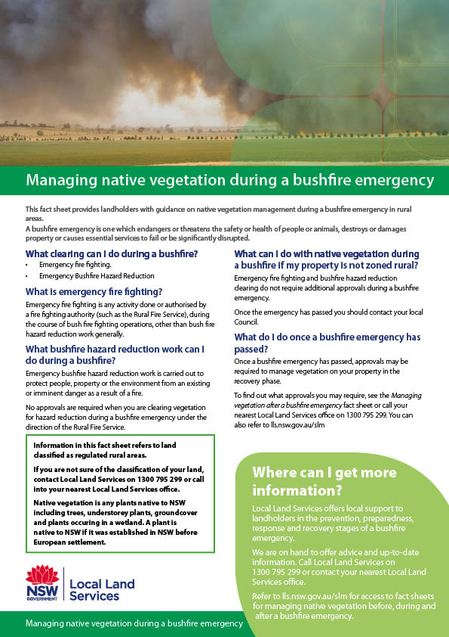
How can this hazard be managed?
https://www.youtube.com/watch?v=IHgWXPm7Bz4

Slide 18
How can we help?

Slide 19
Annotate Australia
Your task is to create an annotated bushfire map of Australia that provides a viewer with ideas of what, where, when and how bushfires exist, their impacts and how they can be managed.
Things to include are:
What is a bushfire? How are they caused?
Where are the bushfires happening in 2019?
What have the impacts been on people and the environment?
Why do people believe that 2019’s fires are so bad?
How are the fires being managed?
https://www.youtube.com/watch?v=yNdWtNlJEzw

Slide 20
