Slide 1
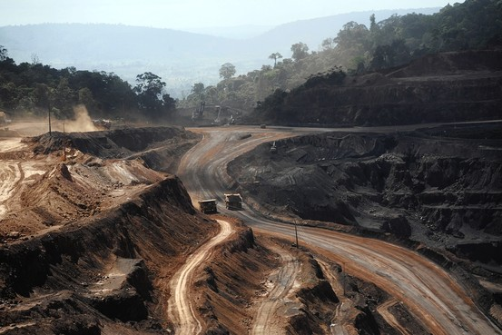
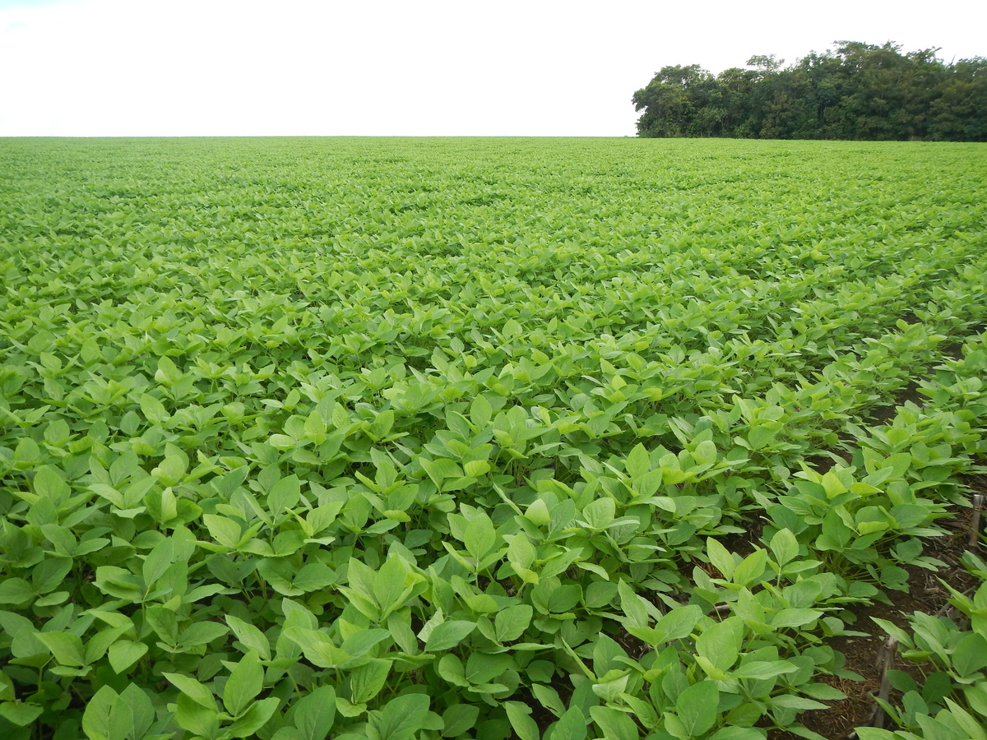
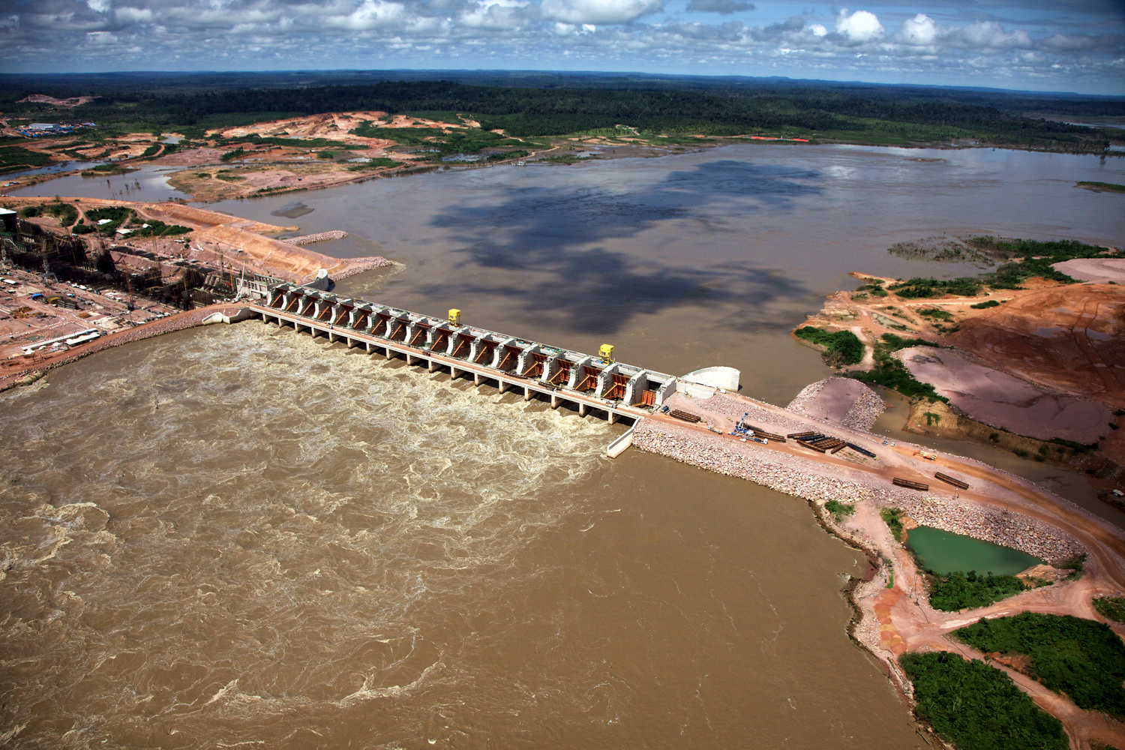
What are the causes of deforestation in Brazil?
Lesson objectives- What:
To develop a greater understanding of the scale of deforestation in the Amazon rainforest.
To develop a greater knowledge of the causes of deforestation in the Amazon rainforest.
Why: To understand that for most geographical issues there are a range of complex reasons

Slide 2
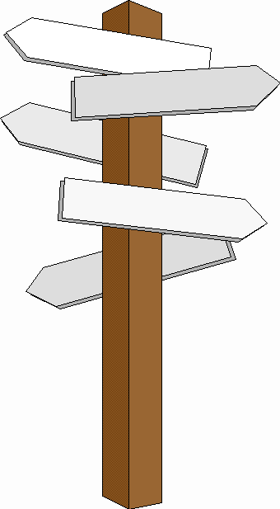
Starter
Decide where you stand on the decision line in relation to the statement. Be prepared to justify!
Yes
Maybe
“All development in the Rainforest should be stopped”
No
Yes!
Maybe?
No!
Why is it the best way?
What are the most influential reasons?
What should we worry most about?
What is making you unsure?
What would it take for you to make a decision?
What are both sides of the argument?
Why not?
What is a better way?
Which negatives particularly outweigh the positives?
What are the advantages of development in the tropical rainforest?
What are the disadvantages of development in the tropical rainforest?
What are the conditions like in the tropical rainforest?
What examples can you use to illustrate the advantages and disadvantages?
How can you decide?

Slide 3
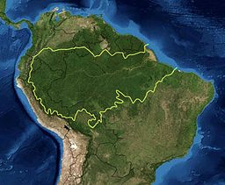
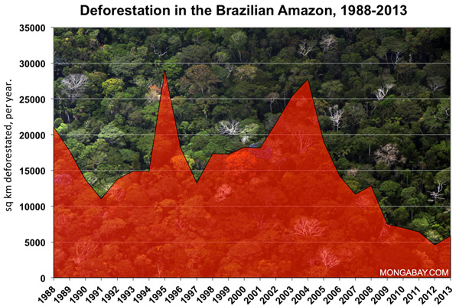
What’s the scale of the issue?
There are 62 countries with a tropical rainforest within their borders. It is estimated about half the world’s tropical rainforest has now been cleared.
As the graph below shows during the first decade of the twenty first century rates of deforestation increased. However, the rates are now decreasing, most encouragingly this happened in Brazil, where the rate of deforestation has fallen to a record low. This is most likely the result of the fact that half of Brazil’s remaining rainforest now has some form of protection. The clearance that is still occurring in the Amazon is mostly to the south. This is the part of the rainforest that is most accessible from Brazil’s cities.
For centauries the rainforest has been used and lived in by indigenous tribes, however their uses do not do lasting damage to the forest. Human use of the rainforest does not always lead to deforestation. In many cases it leads to forest degradation, where the forest ecosystem is change in a negative way and its supply of resources declines.
Cattle ranching
Describe and explain the how the rate of deforestation is changing using the Amazon as an example.
Logging
Commercial agriculture
Small scale agriculture
Other

Slide 4
What’s the scale of the issue?
__________________________________________________________________________________________________________________________________________________________________________________________________________________________________________________________________________________________________________________________________________________________________________________________________________________________________________________________________________________________________________
___________________________________________________________________________________________________________________________________________________
________________________________________________________________________________________________________________________________________________
Cattle ranching
Logging
Commercial agriculture
Small scale agriculture
Other

Slide 5
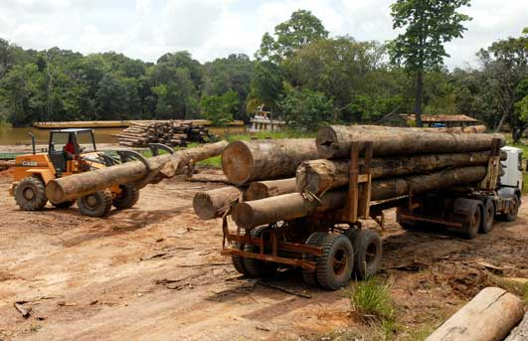
Logging and mineral extraction
The percentage figure for logging in Brazil’s amazon rainforest is small. Logging is the first step in the conversion of forest land to other uses. So it is the eventual use that the cleared land is put to that is recorded. Timber companies are most interested in trees such as mahogany and teak, and sell them to other countries to make furniture (selective logging). Smaller trees are often used as wood for fuel or made into pulp or charcoal. Vast areas of rainforest are cleared in one go (clear felling).
It so happens that some of the minerals that developed countries need are found beneath stretches of tropical rainforest. In the Amazon, mining is mainly about gold. In 1999, there were 10,000 hectares of land being used for gold mining. Today, the area is over 50,000 hectares. The rainforest suffers badly as it is clear-felled. The same applies to the extraction of another mineral, bauxite from which aluminum is made.

Slide 6
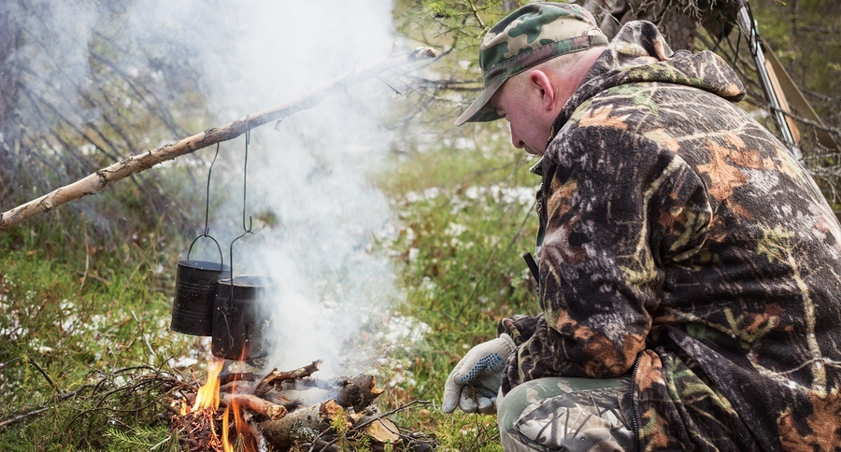
Energy development and illegal trade in wildlife
An unlimited supply of water and ideal river conditions have encourage dams to be built to generate hydroelectric power (HEP). This involves flooding vast areas of rainforest for the construction of the reservoir. Often the dams have a short life. The submerged forest gradually rots, making the water very acidic. This then corrodes the HEP turbines. The dams also become blocked with soil washed down deforested slopes by the heavy rain.
Hunting, poaching and trafficking in wildlife and animal parts are still big business in Brazil. Although this is not a direct cause of deforestation, it is endangering species such as the jaguar, the golden belled capuchin and the golden lion tamarind. It is also upsetting the natural balance of the rainforest ecosystem and therefore degrading it.

Slide 7
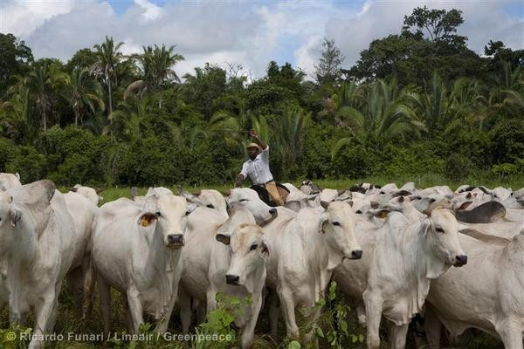
Commercial farming: Cattle and crops
Large areas of the amazon rainforest have been cleared to make way for livestock rearing. The rearing of cattle is believed to account for 80% of tropical rainforest destruction in Brazil. However, the land cannot be used for long. The land cannot be used for long. The quality of pasture quickly declines. The cattle farmers then have to move on and destroy more rainforest to create new cattle pastures.
The forest is being cleared to make way for vast plantations, where crops such as bananas, palm oil, pineapple, sugar cane, tea and coffee are grown. The cultivation of soybean has also caused much forest clearance in Amazonia. The amount of rainforest cleared for this crop doubled between 1990 and 2010. As with cattle ranching, the soil will not sustain crops for long. After a few years, the farmers have to cut down more rainforest for new plantations. Growing sugar can for biofuel is beginning to become a major crop.

Slide 8
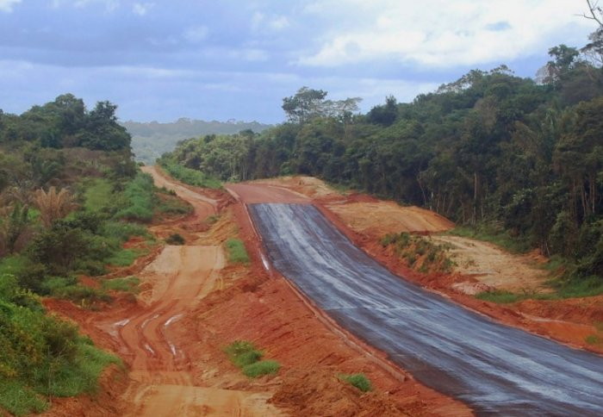
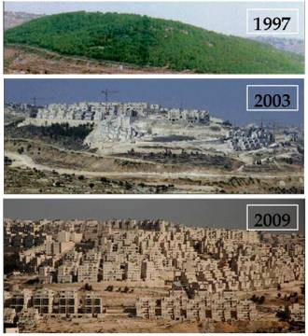
Road building and settlement and population growth
Roads are needed to bring in equipment and transport products to markets, but road building means cutting great swathes through the rainforest. Additionally a road built for one commercial activity makes the forest accessible to other exploiters of the tropical rainforest resources. The Trans Amazonian Highway began construction in 1972 and is 4,000 kilometers long. Although only a small part of it is paved, it has played an important part in opening up remote areas of the Amazon rainforest.
All the above activities have a common knock-on effect. They need workers, and workers and their families need home and services. That, in turn, means clearing the forest to build settlements where these people can live.
The huge challenges presented by these causes of deforestation are their scale, speed and wasteful use of the forest’s land and resources.

Slide 9
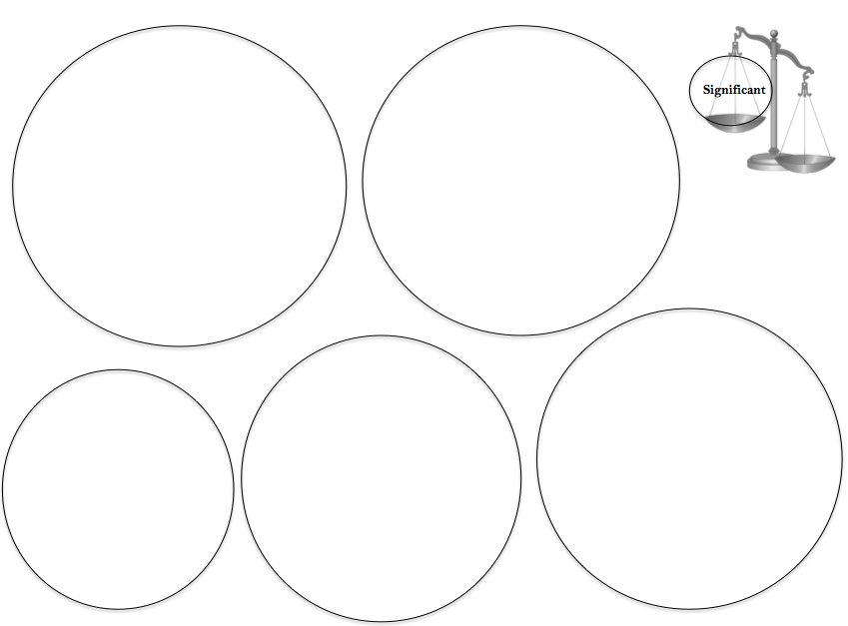
Which cause is the most significant?
Extension
Explain the factors which influenced your choices for the most and the least influential causes of deforestation.
How do you think the rainforest could be protected from these causes?
Literacy
Can you use these key terms:
Agriculture
Settlement
Population growth
Biodiversity
Energy
Hydroelectric power
Logging
Mining
Grades 1-3
Describe the top 5 most significant causes of deforestation in the Amazon rainforest.
Grades 4-6
Give reasons and justification for the top 5 most significant causes of deforestation in the Amazon rainforest.
Grades 7-9
Make links between the top 5 most significant causes of deforestation in the Amazon rainforest.

Slide 10
Starter
Decide where you stand on the decision line in relation to the statement. Be prepared to justify!
Yes
Maybe
“All development in the Rainforest should be stopped”
No
Yes!
Maybe?
No!
Why is it the best way?
What are the most influential reasons?
What should we worry most about?
What is making you unsure?
What would it take for you to make a decision?
What are both sides of the argument?
Why not?
What is a better way?
Which negatives particularly outweigh the positives?
What are the advantages of development in the tropical rainforest?
What are the disadvantages of development in the tropical rainforest?
What are the conditions like in the tropical rainforest?
What examples can you use to illustrate the advantages and disadvantages?
How can you decide?

Slide 11
Exam question
What are the reasons for cutting down the trees?
Structure
Describe two causes of deforestation in a rainforest you have studied. (7 marks)
Paragraph structure:
A brief description of the case study you are going to use.
An detailed description of one of the causes.
A detailed description of another cause
Use specific facts place names and locations to support your points.
Use therefore to develop your points
Focus on the Amazon rainforest.
Describe two causes with specific place details.
Levels1 (Basic) 1-2
You demonstrate limited knowledge of global ecosystems.
Purple pen
Literacy
Level 2 (Clear) 3-4
You demonstrate specific and accurate knowledge of the distribution of global ecosystems.
Command word is ‘describe’.
Can you use these key terms:
Deforestation
Settlement
Population growth
Energy development
Commercial farming
Level 2 (Clear) 5-7
You demonstrate specific and accurate knowledge of the distribution of global ecosystems.

