Slide 1
How are all of these things linked?

Slide 2
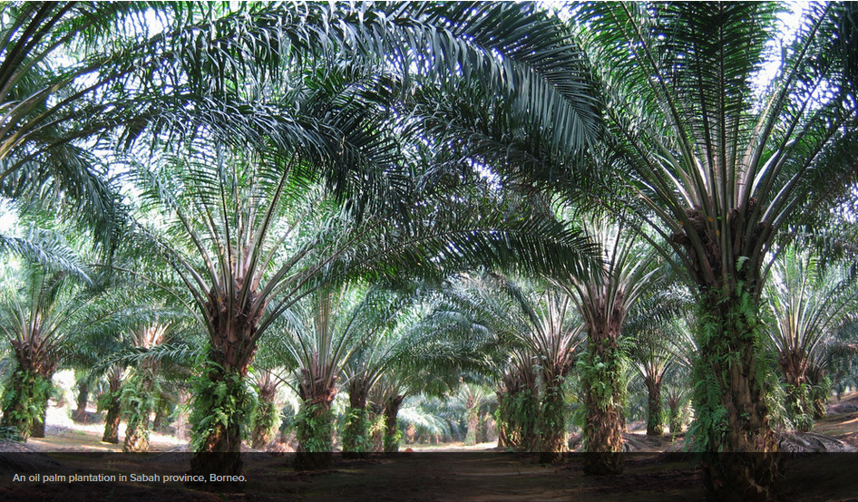
Palm Oil

Slide 3
CASE STUDY - PALM OIL IN INDONESIA and MALAYSIA
https://www.youtube.com/watch?v=0o6WHN4NDTk

Slide 4
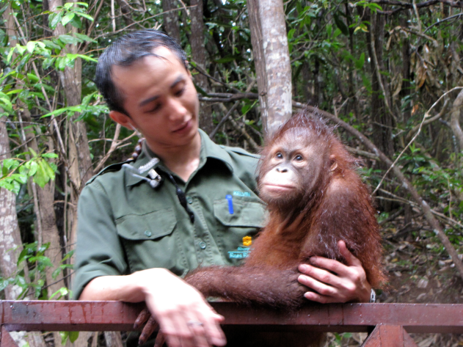
Palm Oil extraction in Indonesia and Borneo
The vast majority of the worlds palm oil comes from Malaysia and Indonesia where the expansion of the industry has destroyed millions of hectares of rainforest. This deforestation is said to be far greater than the rate of deforestation due to logging in the Amazon rainforest.

Slide 5
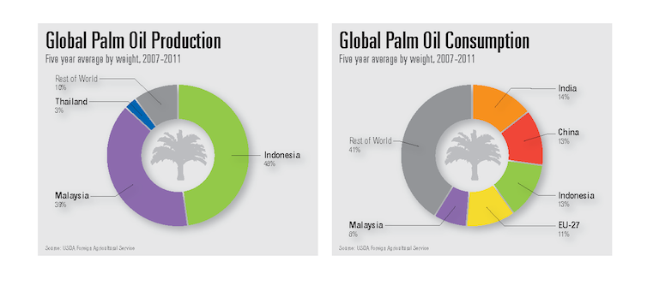

Slide 6
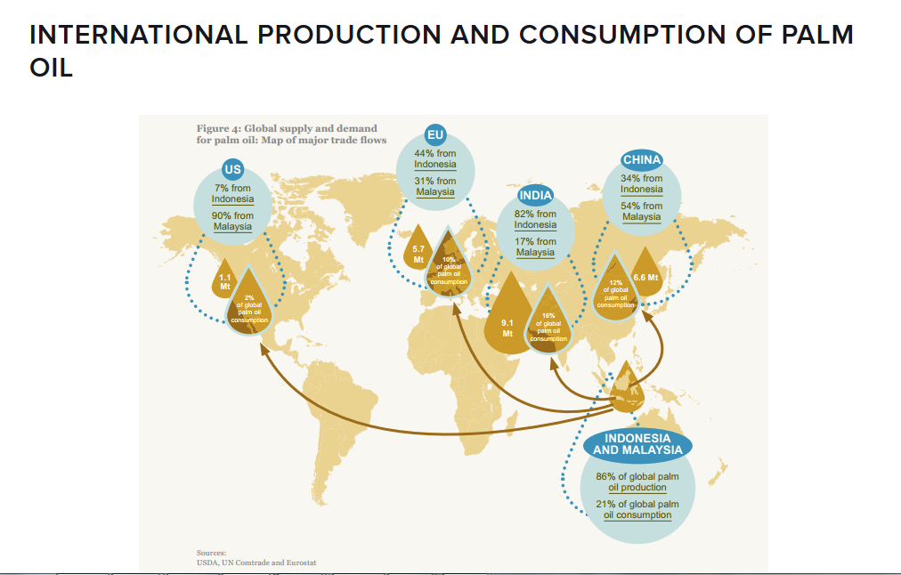
Links to food miles and our growing global interactions related to food/ trade

Slide 7
What is Palm Oil?
Palm oil is used by virtually every one of us in one form or another. In its basic form it is used in processed or prepared foods such as bread, cakes, breakfast cereals and ready meals, as well as ice cream, margarine and crisps. Unlike oil seed rape and sunflower oils palm oil is valued because it is solid at room temperature. Palm oil is also cheaper than other types of oils.

Slide 8
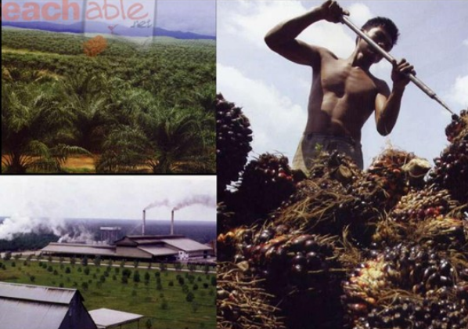
Environmental impacts of palm oil
In the past the majority of palm oil production has been for food and cosmetics but now the European Union have agreed to cut greenhouse gasses by 20% by 2020 we are having to find a new source of fuel for our transport. The answer is said to be bio-fuels however this will mean that Indonesia and Malaysia will produce more palm oil which will result in further destruction of some of the most valuable rainforest on the planet. The effect of this destruction will mean that many species of plants and animals that live in these rainforests will be lost forever. Examples of species that will be lost are the Sumatran tiger, Asian Elephant and the Orangutans of Borneo

Slide 9
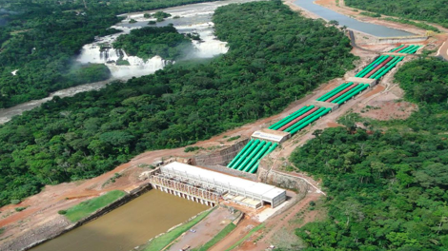
Other reasons for deforestation in Borneo
Population pressures
Road building
Mining
HEP
Logging
Make notes from Borneo case study information in the textbook scan on each of these

Slide 10
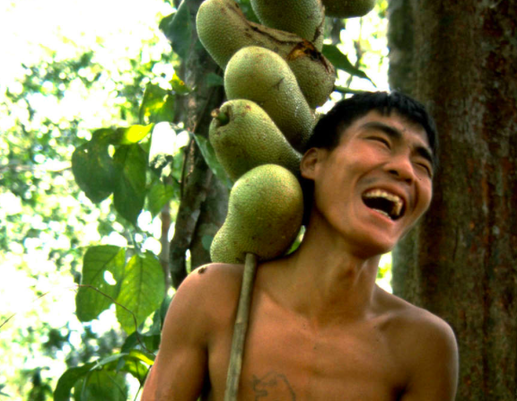
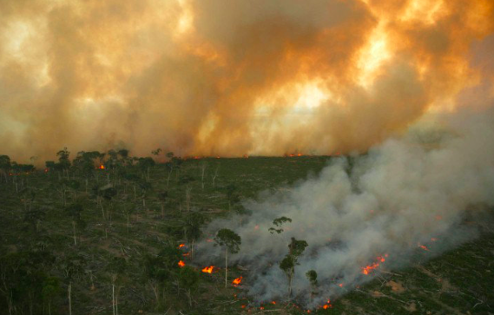
Effects- global and local
Local effects | Global effects
Use the textbook scan, videos on the Weebly and card sort to complete this table

Slide 13
7 mark Exam question

Slide 14
Mark scheme

Slide 15
Managing rainforests

Slide 16
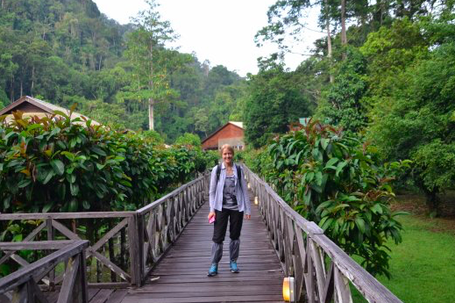

Slide 17
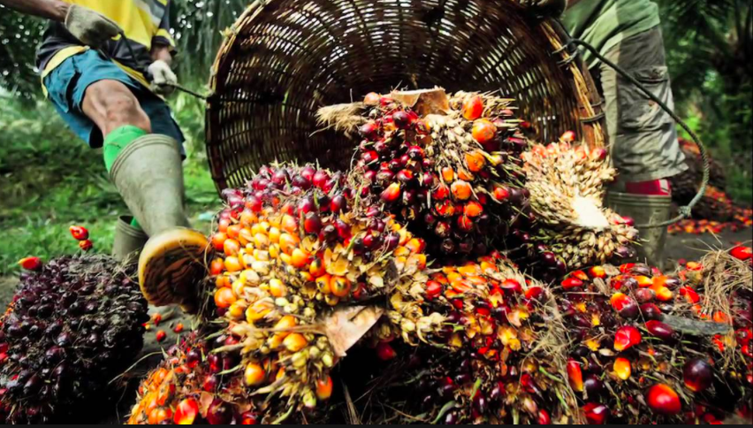
Sustainable PALM OIL

Slide 19
The solution: Sustainable palm oil
https://www.youtube.com/watch?v=UGFmP_wWztU What approximate % of our shopping contains Palm Oil? We must put an end to Palm Oil right? - Why might this not be the best solution & give an example. So, how do we protect peoples livelihoods and the environment? Give examples from the video.

Slide 20
Certified Sustainable Palm Oil
Industry efforts to bring this deforestation under control have come through the Roundtable on Sustainable Palm Oil (RSPO). It was set up in 2001 to establish clear ethical and ecological standards for producing palm oil, and its members include high-street names like Unilever, Cadbury's, Nestlé and Tesco, as well as palm oil traders such as Cargill and ADM. Together, these companies represent 40 per cent of global palm oil trade.

Slide 21
Other protection measures: Ecotourism- Danum Valley conservation area

Slide 22
Danum Valley conservation area
https://www.youtube.com/watch?v=E4Uku2CwbDY
Read the embedded sheet on the weebly about Danum Valley nature area…
Make notes on:
What is the Danum Valley area like
How is the area being managed?
What benefits has the management had?

Slide 23
Other protection methods in Borneo
Selective logging
National parks
Debt for nature swaps
Promoting responsible use
Make notes on these from resource on weebly

Slide 24
7 mark Exam questions
For a named area of tropical rainforest you have studied, explain why deforestation has taken place.
For a named area of tropical rainforest, describe the impacts of deforestation on the local natural environment and the local people.
For an area you have studied explain how the environment is at risk from economic activity
For an example of an economic activity in a named area you have studied, describe how the threats to the natural environment are being managed.

