Slide 1

Big Era Four
Expanding Networks
of Exchange and Encounter
1200 BCE – 500 CE

Slide 2


Welcome to Big Era Four!

Slide 3
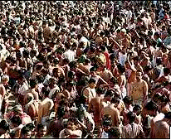
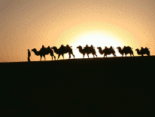
Let’s focus on two key developments of this era.
Population Growth
Expanding Networks of Exchange

Slide 4

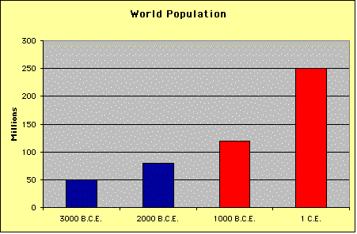
Population Growth
• Between 1000 BCE and 1 CE world population rose from about 120 to about 250 million.
• This rise was fueled by an acceleration in the rate of growth during this time.
• Between 3,000 and 1,000 BCE, it took about 1,600 years for world population to double.
• Between 1,000 BCE and 1 CE the doubling time was less than 1,000 years.

Slide 5

Population Growth
What caused this surge in population?

Slide 6
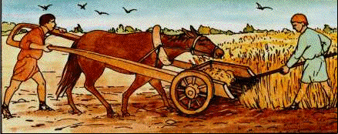
Population Growth
#1
The invention of iron!
In Afroeurasia, iron axes, hoes, spades, and plows enabled farmers to clear and cultivate millions of acres never before used for farming.

Slide 7
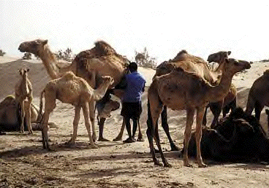
Population Growth
#2
Farming and pastoral nomadism!
Farming and pastoral nomadism replaced hunting and gathering in some regions.
People moved into previously uninhabited areas.

Slide 8
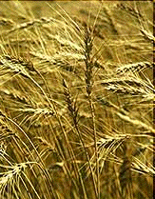

Population Growth
#3
Improved species of crops produced more food per acre!

Slide 9
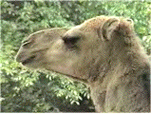
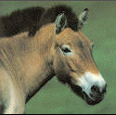
Population Growth
#4
Horses and camels were used for work!
#4
Work animals made farms more productive.

Slide 10
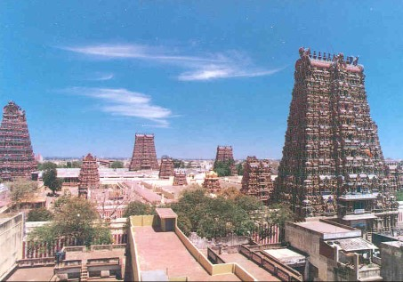
Population Growth
It was connected to the build-up of natural immunities to local infectious diseases.
#5
People now lived in denser populations!

Slide 11
Population Growth
In Summary:
In Afroeurasia, the invention of iron enabled farmers to clear and cultivate millions of acres never before used for farming.
Farming and pastoral nomadism replaced hunting and gathering in some regions. People moved into previously uninhabited areas.
Improved kinds of crops produced more food per acre.
Horses and camels began to be used more as work animals, making farms more productive.
People began to live closer in denser populations. This led to the build-up of natural immunities to local infectious diseases but left people vulnerable to epidemics caused by diseases new to the region.

Slide 12
What were the consequences of population growth?
Population Growth
Consequences

Slide 13
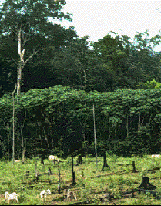
Population Growth
Consequences
Over time, the clearing of forests led to soil erosion, shortages of wood for fuel, and the extinction of some local animal and plant species.
#1
Deforestation!

Slide 14
Population Growth
Consequences
#2
More complex societies!
As populations grew and communities grew larger, more complex, and closer together, organization became more important. New political, social, and economic systems emerged.
The Indian Caste System

Slide 15
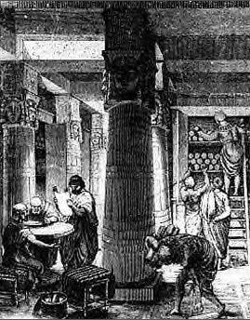
Population Growth
Consequences
#3
Collective learning increased!

Slide 16
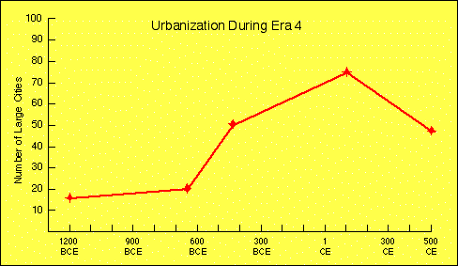
Population Growth
Cities
#4
More people began living in large cities!

Slide 17
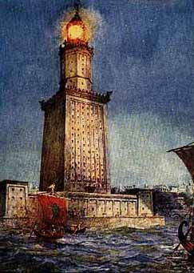
Alexandria
• Founded by Alexander the Great in 331 BCE
• Important trade center
• Its library home to many famous scholars
There were not only Greeks and Italians, but also Syrians, Libyans, Cilicians and yet others from farther countries—Ethiopians, Arabs, as well as Bactrians, Scythians, Persians, and a few Indians.
A Greek orator writing about Alexandria
The Pharos Lighthouse in Alexandria

Slide 18
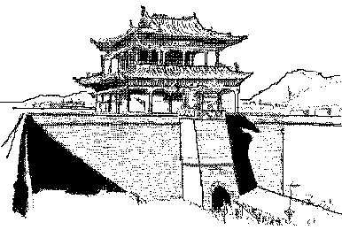
Changan (Xian)
• Capital of China during the Han dynasty
• Located at the eastern end of the silk road
• Merchants and diplomats brought trade goods and new ideas

Slide 19
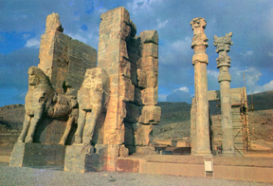
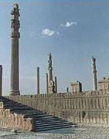
Persepolis
• Founded in the 6th century BCE by Darius I
• Capital of the Achaemenid Empire of Persia
• Destroyed by Alexander the Great in 330 BCE

Slide 20
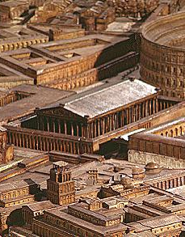
Rome
• Political and economic hub of the Roman Empire
• World’s largest city in Big Era Four, with nearly one million residents
• Elaborate water and sewer systems made Rome livable despite its size
Not without good reason did gods and men choose this spot as the site of a city.
Livy, a Roman historian

Slide 21
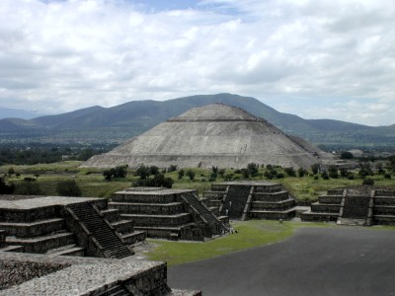
Teotihuacan
• Major city of the Americas located in the valley of Mexico
• From 400 to 600 CE, a thriving commercial and agricultural center with 200,000 residents
• The Pyramid of the Sun covered as much ground as the pyramid of Khufu in Egypt
Photo: University of Arizona
The Pyramid of the Sun, Teotihuacan

Slide 22
Population Growth
In Summary:
Over time, deforestation led to soil erosion, shortages of wood for fuel, and the extinction of some local animal and plant species.
When communities grew larger, more complex, and closer together, new political, social, and economic systems became necessary.
Collective learning increased, further fueling advances in technology.
Although the vast majority of people still inhabited rural farming villages, more people than ever before began living in large cities.

