Slide 1
Big Era 4

Slide 2
Welcome to Big Era Four!

Slide 3
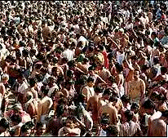
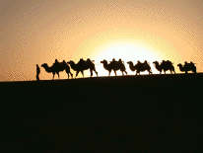
Let’s focus on two key developments of this era.
Population Growth
Expanding Networks of Exchange

Slide 4
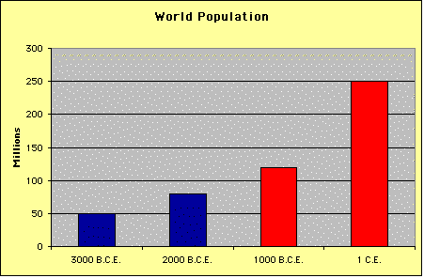
Population Growth
• Between 1000 BCE and 1 CE world population rose from about 120 to about 250 million.
• This rise was fueled by an acceleration in the rate of growth during this time.
• Between 3,000 and 1,000 BCE, it took about 1,600 years for world population to double.
• Between 1,000 BCE and 1 CE the doubling time was less than 1,000 years.

Slide 5
Population Growth
What caused this surge in population?

