Slide 1
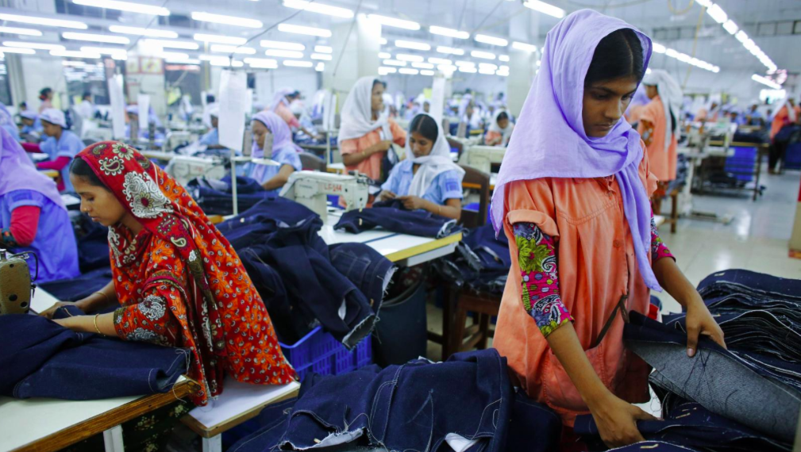
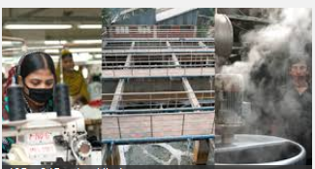
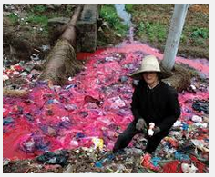
Garment manufacturing in Bangladesh

Slide 2
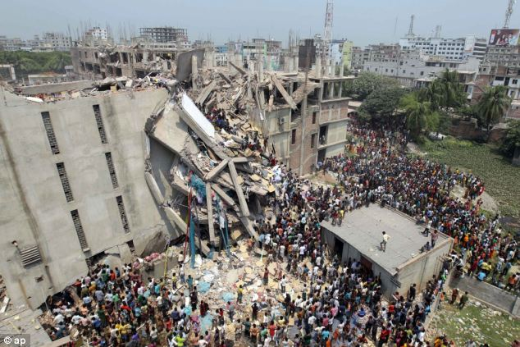
or
What is the connection?
Play the unfair factory game

Slide 3
Links to syllabus:
Reasons and impacts of globalisation
Environmental risks of economic development
What you need to know: Success criteria
Why has manufacturing industry located in Bangladesh?
What are the positive impacts for Bangladesh?
What are the negative social impacts?
What are the negative environmental effects?
What is being done to reduce the negative social impacts?
What is being done to reduce the negative environmental impacts?

Slide 5
Negative externalities usually affect poor people the most. Poor people tend to be people who are forced to live near polluting factories because they can't afford to live anywhere else. The old/young and sick are also vulnerable to pollution caused by industry. Many polluting industries also choose to locate in LEDCs for a number of reasons including: More relaxed environmental regulations
Less enforcement of environmental regulations (this might be because they can't afford to enforce, because they are being paid to overlook (corruption), or they are worried about losing FDI.
Access to a new potential marketplace
Access to raw materials (which again might be extracted using polluting methods)
Availability of cheap labour
Cheap land and building materials (possibly relaxed building regulations)

Slide 6
AIR pollution
According to the dictionary, air pollution is the contamination of air by smoke and harmful gases, mainly oxides of carbon, sulfur, and nitrogen. Some examples of air pollution include: Exhaust fumes from vehicles
The burning of fossil fuels, such as coal, oil, or gas
Harmful off-gasing from things such as paint, plastic production, and so on
Radiation spills or nuclear accidents

Slide 7
WATER pollution
Water pollution is the contamination of any body of water (lakes, groundwater, oceans, etc). Some examples of water pollution: Raw sewage running into lake or streams
Industrial waste spills contaminating groundwater
Radiation spills or nuclear accidents
Illegal dumping of substances or items within bodies of water
Biological contamination, such as bacteria growth
Farm runoff into nearby bodies of water

Slide 9
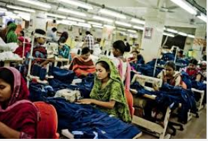
Case study: the textiles Industry in Bangladesh
What you need to know: Success criteria
Why has manufacturing industry located in Bangladesh?
What are the positive impacts for Bangladesh?
What are the negative social impacts?
What are the negative environmental effects?
What is being done to reduce the negative social impacts?
What is being done to reduce the negative environmental impacts?

Slide 10
Water pollution in Bangladesh
https://www.nytimes.com/2013/07/15/world/asia/bangladesh-pollution-told-in-colors-and-smells.html
Bangladesh’s garment and textile industries have contributed heavily to what experts describe as a water pollution disaster, especially in the large industrial areas of Dhaka, the capital. Many rice paddies are now inundated with toxic wastewater. Fish stocks are dying. And many smaller waterways are being filled with sand and garbage, as developers sell off plots for factories or housing.
Some factories treat their wastewater, but many do not have treatment plants or chose not to operate them to save on utility costs.
Task: Use the interactive ‘water pollution in Bangladesh’ and make notes on the causes and issues of water pollution

Slide 11
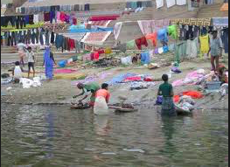
Is controlling pollution a simple matter?
Now explain in about 500 words whether further pollution controls in Bangladesh
would bring benefits or problems.

Slide 13
7 mark questions
Name an area which you have studied and state an economic activity which is causing the environment to be at risk and explain the risks it is causing
For an example of an economic activity in a named area you have studied, describe how the threats to the natural environment are being managed.
Name an area which you have studied and state an economic activity which is causing the environment to be at risk. Explain how it is being managed so that it is more sustainable.

