Slide 1
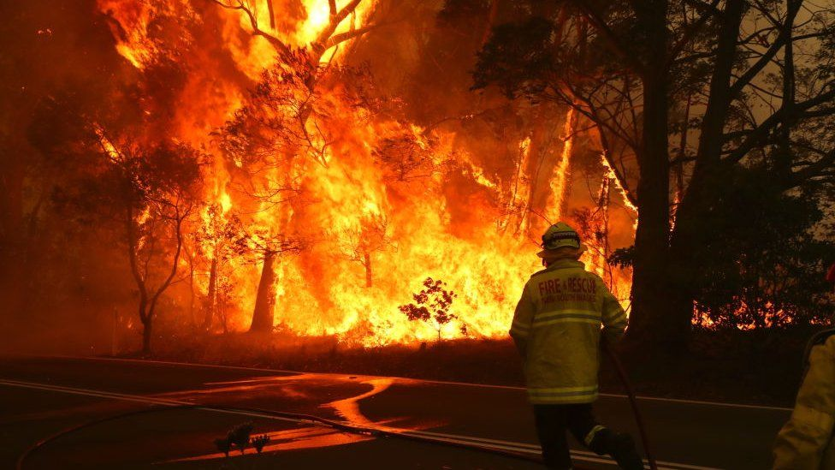
What are the cause and consequence of the Australian bushfires? Winter 2019

Slide 2
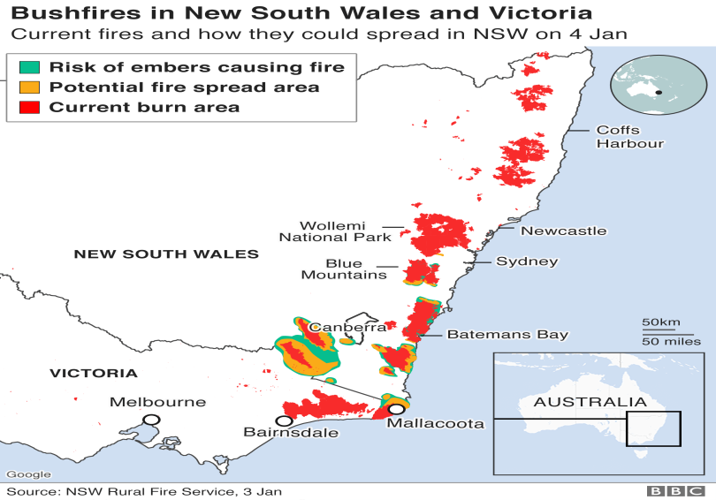
Using the map – describe the location of the bushfires in Australia (2 marks)

Slide 3
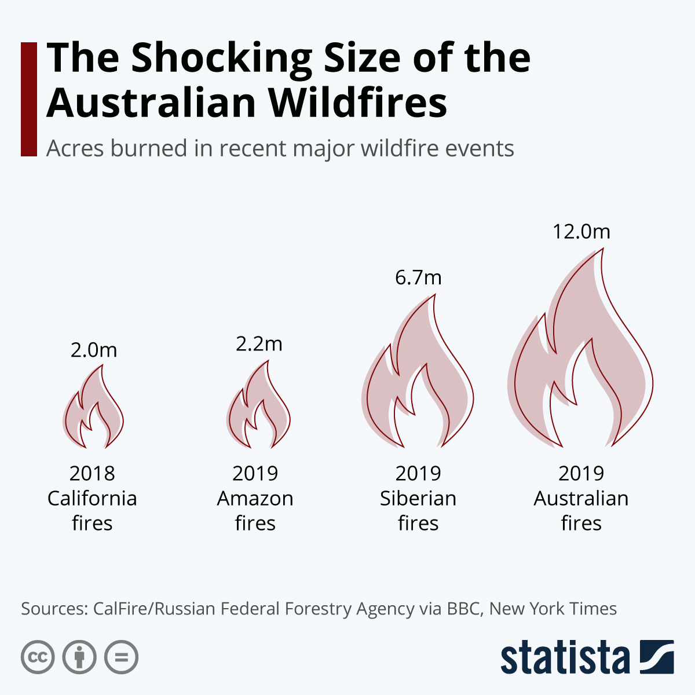
How bad are the fires in Australia?
https://www.youtube.com/watch?v=2TcbIgmQxDA

Slide 4
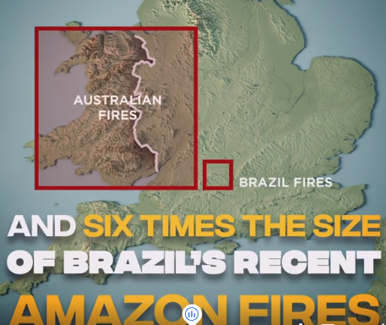
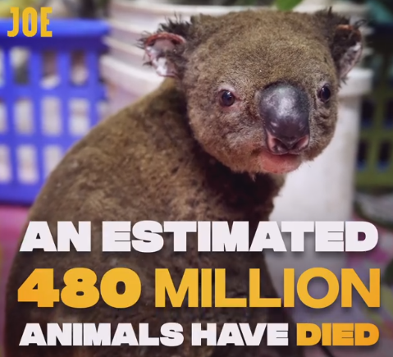
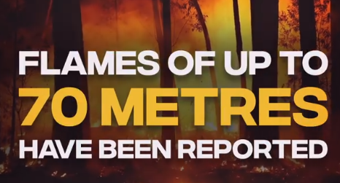
How bad are the fires in Australia?

Slide 5
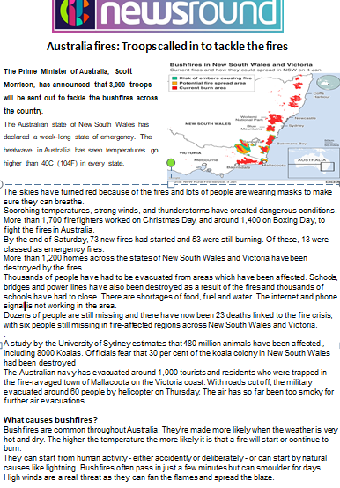
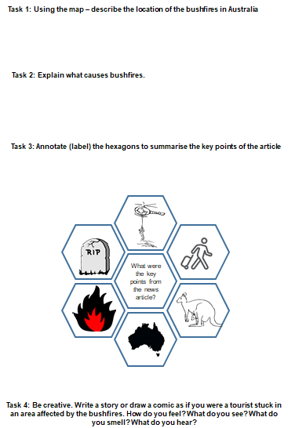
Complete the task sheet on the fires

