Slide 1
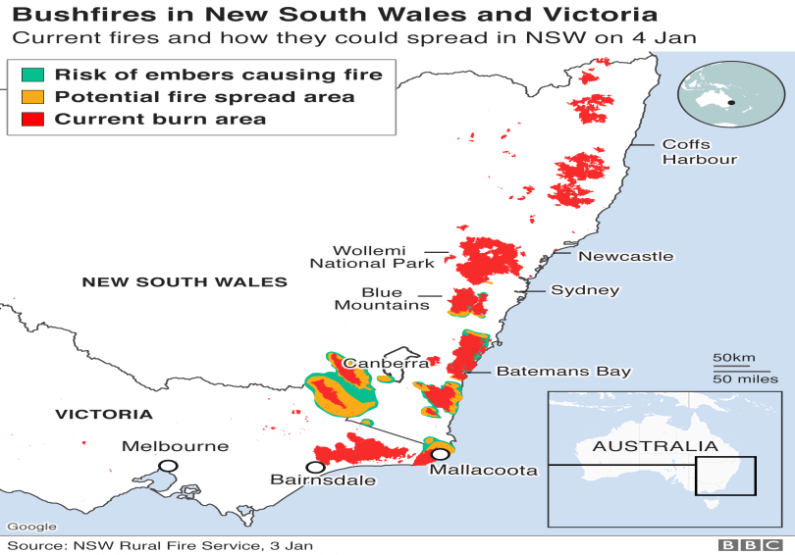
Australia fires: Troops called in to tackle the fires
The Prime Minister of Australia, Scott Morrison, has announced that 3,000 troops will be sent out to tackle the bushfires across the country.
The Australian state of New South Wales has declared a week-long state of emergency. The heatwave in Australia has seen temperatures go higher than 40C (104F) in every state.
The skies have turned red because of the fires and lots of people are wearing masks to make sure they can breathe.
Scorching temperatures, strong winds, and thunderstorms have created dangerous conditions. More than 1,700 firefighters worked on Christmas Day, and around 1,400 on Boxing Day, to fight the fires in Australia.
By the end of Saturday, 73 new fires had started and 53 were still burning. Of these, 13 were classed as emergency fires.
More than 1,200 homes across the states of New South Wales and Victoria have been destroyed by the fires.
Thousands of people have had to be evacuated from areas which have been affected. Schools, bridges and power lines have also been destroyed as a result of the fires and thousands of schools have had to close. There are shortages of food, fuel and water. The internet and phone signal is not working in the area.
Dozens of people are still missing and there have now been 23 deaths linked to the fire crisis, with six people still missing in fire-affected regions across New South Wales and Victoria.
.
A study by the University of Sydney estimates that 480 million animals have been affected., including 8000 Koalas. Officials fear that 30 per cent of the koala colony in New South Wales had been destroyed
The Australian navy has evacuated around 1,000 tourists and residents who were trapped in the fire-ravaged town of Mallacoota on the Victoria coast. With roads cut off, the military evacuated around 60 people by helicopter on Thursday. The air has so far been too smoky for further air evacuations.
What causes bushfires?
Bushfires are common throughout Australia. They're made more likely when the weather is very hot and dry. The higher the temperature the more likely it is that a fire will start or continue to burn.
They can start from human activity - either accidently or deliberately - or can start by natural causes like lightning. Bushfires often pass in just a few minutes but can smoulder for days.
High winds are a real threat as they can fan the flames and spread the blaze.

Slide 2
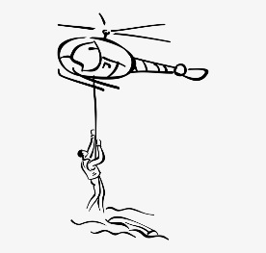
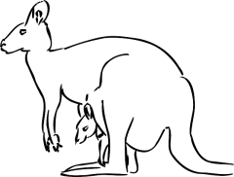
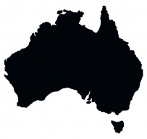
Task 1: Using the map – describe the location of the bushfires in Australia
Task 2: Explain what causes bushfires.
Task 3: Annotate (label) the hexagons to summarise the key points of the article
What were the key points from the news article?
Task 4: Be creative. Write a story or draw a comic as if you were a tourist stuck in an area affected by the bushfires. How do you feel? What do you see? What do you smell? What do you hear?

