Slide 1
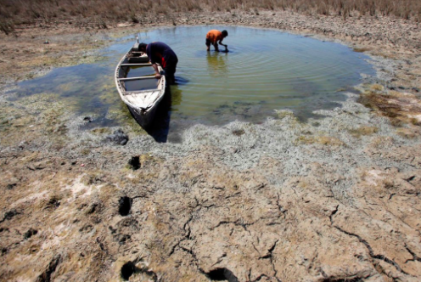
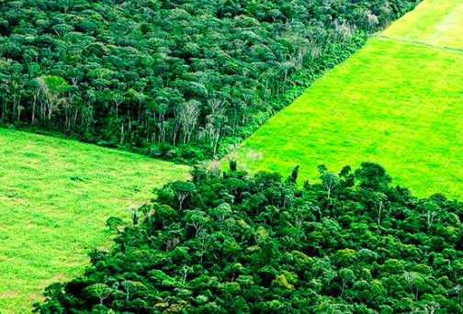
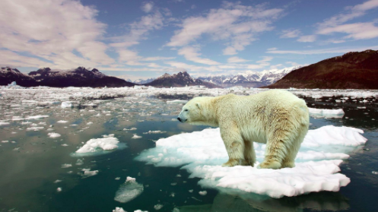
Core Unit 2: Global Climate Vulnerability and Resilience

Slide 2
What will our world be like in 2045?
What world do you want to live in the future?
Watch video…..
https://www.youtube.com/watch?v=TUDdciCNWWk
https://vimeo.com/189766984
What do you think about the different future scenarios?
Explaining the video:
http://brutalsimplicity.se/earth2045/

Slide 3
What: The atmospheric system, including the natural greenhouse effect and energy balance (incoming shortwave radiation and outgoing longwave radiation)
How: Investigate changes in the global energy balance, and the role of feedback loops, resulting from: • terrestrial albedo changes and feedback loops • solar radiation variations, including global dimming due to volcanic eruptions • methane gas release and feedback loops The enhanced greenhouse effect and international variations in greenhouse gas sources and emissions, in relation to economic development, globalization and trade
Why: To understand the complexity of the dynamic climate system and the spatial interactions of different processes and feedback mechanisms

Slide 5
What was the earth’s early atmosphere like?
The composition of the Earth’s atmosphere has not always been as it is now.
When the Earth formed 4.6 billion years ago the atmosphere (such as it was) was predominantly made up of hydrogen and helium with no free oxygen.
As time passed volcanic activity and the evolution of life changed the atmospheric composition to what it is today.
The following video, Earth and early atmosphere by Big History Project, provides a summary of the changes that have occurred to the Earth’s atmosphere. It includes the phenomenon called snowball Earth.

Slide 6
Starter – can you draw a diagram to show the greenhouse effect???

Slide 7
The Greenhouse Effect
The greenhouse effect is a naturally occurring process that aids in heating the Earth's surface and atmosphere.
It results from the fact that certain atmospheric gases, such as carbon dioxide, water vapor, and methane, are able to change the energy balance of the planet by absorbing longwave radiation emitted from the Earth's surface.
Without the greenhouse effect life on this planet would probably not exist as the average temperature of the Earth would be a chilly -18° Celsius, rather than the present 15° Celsius.
https://www.youtube.com/watch?time_continue=39&v=ZzCA60WnoMk

Slide 8
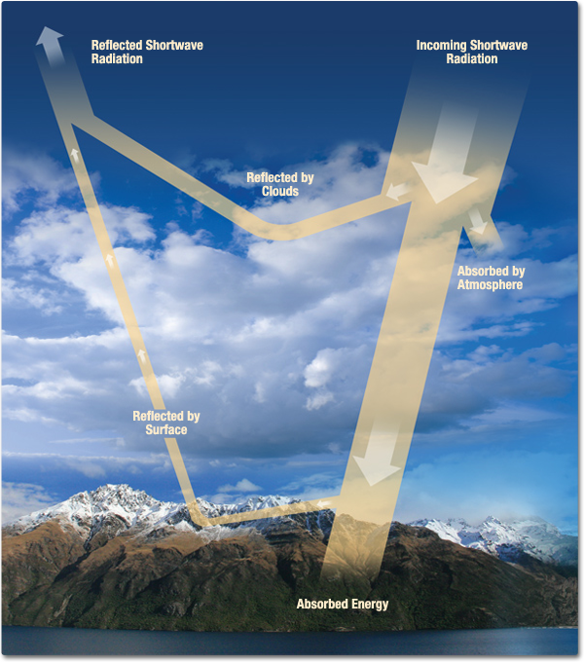
Describe the functioning of the atmospheric system
The energy balance is the balance between incoming energy from the sun and outgoing energy from the atmosphere.
Energy released from the sun is in the form of shortwave light and ultraviolet energy.
The earth releases long wave infrared energy.
https://www.youtube.com/watch?v=sTvqIijqvTg

Slide 9
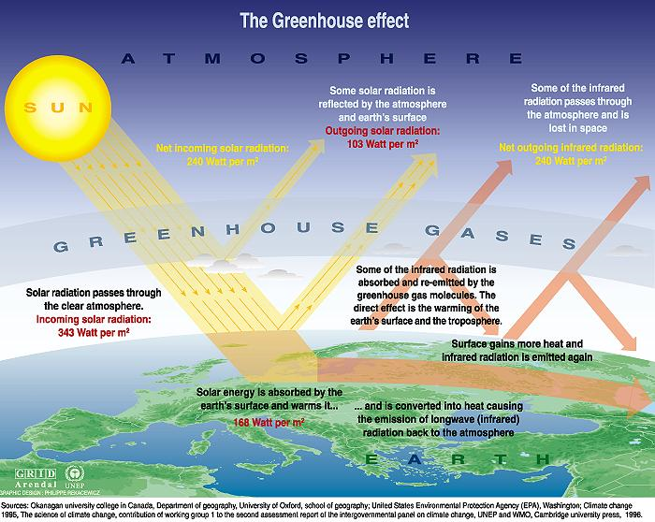

Slide 10
The Radiation Balance Key: purple shortwave, red long wave

Slide 11
The functioning of the atmospheric system
The atmosphere is an open system, receiving radiation from both the sun and the earth itself. The energy of the earth is very small, but it does have an effect. Incoming solar radiation is referred to as insolation.
The main energy that drives all of our weather systems and our climate comes from the sun. The vast majority of this energy is absorbed at the equator whereas energy is generally lost in the polar regions. However, this energy is redistributed to higher latitudes by wind and air circulations.

Slide 12
The earth’s energy budget
The source of energy for planet Earth is the sun.
Incoming short-wave solar radiation (light) hits the Earth’s surface and is radiated back out as long-wave heat radiation, which warms the atmosphere.
This natural greenhouse effect ensures that life on Earth can continue.
However, the global energy budget varies over time and space and a variety of feedback mechanisms have maintained balance in the past. This may not be the case any longer as numerous changes are pushing the atmospheric system too hard and it may not be resilient enough to cope.
The changes to the global energy budget are both natural and human-induced.
Natural factors include variations in solar output, global dimming, volcanic eruptions and changes to the composition of the atmosphere itself.
Changes have occurred for millennia but the current speed of change is the problem.

Slide 13
Watch the following video, Aerosols: airborne particles in Earth’s atmosphere by Bad Astronomer, which illustrates the amount and type of material that is moved around the plant.
List the different materials that are transported within the atmospheric circulation system.
Which are from natural processes and which are from human processes?
How do you think these movements impact the global energy budget and global climate change?
https://www.youtube.com/watch?time_continue=201&v=YtJzn8A725w

Slide 15
Key terms:
Radiation- energy that is radiated or transmitted in the form of rays or waves or particles
solar radiation - radiation from the sun (short wave)
Longwave radiation- Radiation emitted from Earth is called longwave radiation
https://www.youtube.com/watch?v=DOAqECd70Ww

Slide 16
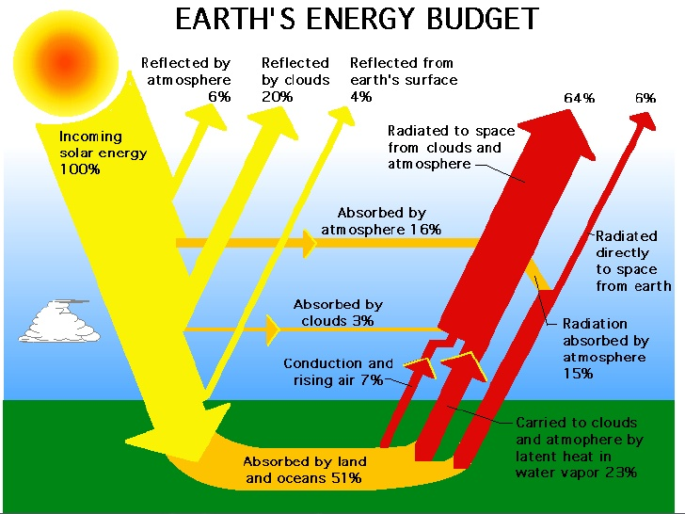
https://www.youtube.com/watch?v=ZqJ1D6lqVgo
Of the total received insolation, how much is absorbed vs reflected?
What are the different ways in which heat energy can be added to OR leave the Earth’s atmosphere?
Animation (no audio)

Slide 17
Source: https://earthobservatory.nasa.gov/Features/EnergyBalance/page6.php

Slide 19
Systems diagram
Cut out the cards. Categorize the cards in inputs, stores/processes and outputs. Add any necessary definitions to the cards. Stick the cards to a large sheet of paper (A3). Label inputs, stores/processes and outputs. Add lines to show the flows of energy in one colour Add lines to show the flows of gases in another colour Create a key

Slide 20
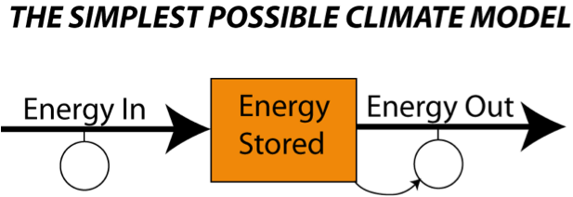
Task: in groups reproduce the Earth’s energy budget using an annotated system diagram.
FLOWS
STORES
Resources:
Systems diagram words from Geography All The Way, information in the ppt, Planet Geograhpy, Kognity and independent research

Slide 22
Task: in groups reproduce the Earth’s energy budget using an annotated linear system diagram. Further resources below:
Video Clips:
https://www.youtube.com/watch?time_continue=157&v=dg_DOM1OQoo
https://www.youtube.com/watch?v=ZqJ1D6lqVgo
http://www.youtube.com/watch?v=D_Qmue54W14
Website: https://earthobservatory.nasa.gov/Features/EnergyBalance/page6.php

Slide 23
Exam practice and mark scheme:
Draw an annotated diagram to show the atmospheric system in terms of the relationship between INPUTS (solar radiation) and OUTPUTS (longwave radiation). (6 marks)
Should include…..
Incoming shortwave (solar) radiation (1mark)
Some outgoing longwave (infrared) radiation (1 mark)
Some of the outgoing radiation being reflected and absorbed (1 mark)
A layer of greenhouse gas (1 mark)
A further 2 marks for the further detail and accuracy of the diagram (annotations? )

Slide 24
The Radiation Balance
The radiation balance of the Earth system is an accounting of the incoming and outgoing components of radiation.
These components are balanced over long time periods and over the Earth as whole.
If they weren't the Earth would be continually cooling or warming. However, over a short period of time, radiant energy is unequally distributed over the Earth.
Why is radiation unequally distributed?

Slide 25
Describing the earth’s energy balance
Shortwave radiation from the sun passes through the earth’s atmosphere.
Some of it is reflected by the clouds or scattered by the air back to space, some of it is absorbed by dust and gases and the remainder is absorbed by the earth itself.
The earth then reflects a small amount of short wave radiation back to space.
Areas with a light surface have a high albedo meaning they reflect more of the sun’s energy e.g. snow and ice covered regions.
Areas with a dark surface e.g. oceans and forests absorb more heat.

Slide 26
Describing the earth’s energy balance
Most of the energy emitted from the earth is in the form of longwave radiation.
Some of this energy is retained for awhile by greenhouse gases (this is the natural greenhouse effect) warming the earth.
The earth temperature would be 33 degrees C lower without it.

Slide 27
What happens as energy from the sun passes through the atmosphere?
A portion of the energy (26% globally) is reflected or scattered back to space by clouds and other atmospheric particles.
About 19% of the energy available is absorbed by clouds, gases (like ozone), and particles in the atmosphere.
Of the remaining 55% of the solar energy passing through the Earth's atmosphere, 4% is reflected from the surface back to space.
This energy is then used in a number of processes, including the heating of the ground surface, the melting of ice and snow and the evaporation of water, and plant photosynthesis.

Slide 28
Summary question
Describe the energy balance between solar and longwave radiation in the atmospheric system. (5)

Slide 29
Describe the energy balance between solar and long wave radiation in the atmospheric system (5)
The earth receives 342 Wm2 of short wave radiation from the sun, we call this insolation, and it is mainly comprised of visible light and infrared heat.
When the sun’s energy reaches the earth it is dispersed in different ways. 32% (107 Wm2) is immediately reflected the clouds, dust particles and the earth’s surface back in to space; this is known as the albedo or reflectivity of the earth.
This leaves 235Wm2 of solar energy to be absorbed by the earth. To achieve a stable climate the earth must radiate the same amount of heat back into space.
The earth emits longwave radiation, however, some of this trapped for a period of time by greenhouse gases present in the earth’s atmosphere, e.g. carbon dioxide, methane and water vapour. This process allows the earth to warm to a temperature that supports life on earth and it is known as the natural greenhouse effect.
The greenhouse gases re-emit the radiation, which is then returned to space, creating radiative equilibrium.
Wm2 = watts per square metre

Slide 30
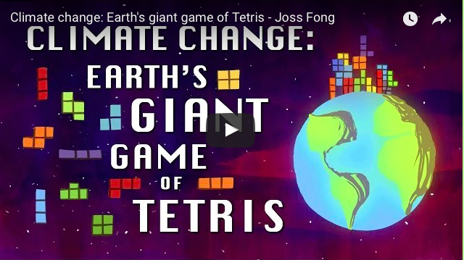
Context
The knowledge of the physical systems and processes that you have developed during this lesson needs to be viewed in the context of climate change and the 'enhanced greenhouse effect'.

Slide 31
Global warming
However, greenhouse gases e.g. co2 have increased since the industrial revolution (co2 by 30%/ nitrous oxide 15% and methane 100%).
As a result global temperatures have risen by 0.5 C over the last century – this is global warming.

Slide 32
What’s the difference between global warming, greenhouse effect and enhanced greenhouse effect?
Global warming
Refers to the increase in temperature around the world noticed in the last 50 years, especially since 1980
Greenhouse effect
Process by which certain gases (water vapour, carbon dioxide, methane and CFC’s allow short wave radiation to pass through and heat up the earth but trap longwave radiation on its way out of the atmosphere causing Earth to maintain its heat.
Enhanced greenhouse effect
Increase amount of green houses gases in the atmosphere as a result of human activity. This is having an impact on atmospheric systems including global warming.

Slide 33
Past exam question
Draw a labeled diagram to show the radiation inputs and outputs in the atmosphere which result in the enhanced greenhouse effect.
[5 marks]

