Slide 1
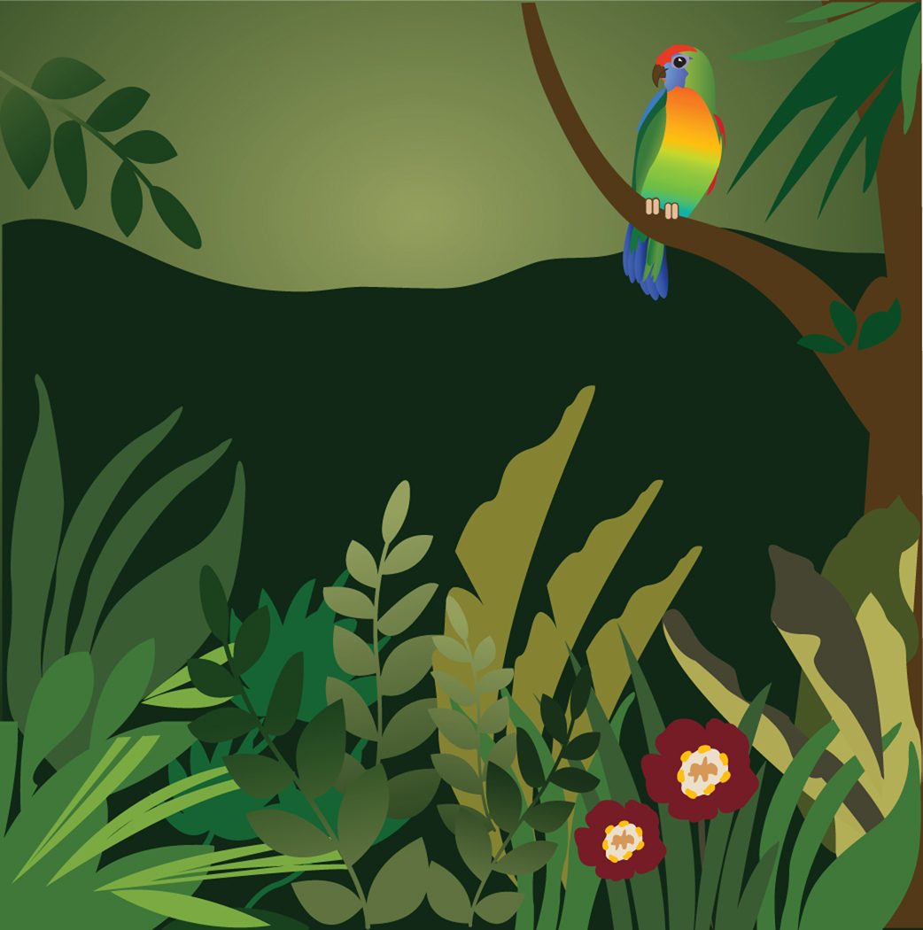
Adaptation
“Something that is changed or changes to become suitable to a new or special situation.”
Think
Pair
Share

Slide 2
What: Animal adaptions in the rainforest Why: To show your understanding of the characteristics of the rainforest How: Design an animal that is adapted for rainforest conditions and explain the adaptions

Slide 3
Can you find any adaptations on the animals shown on the following slides?

Slide 4
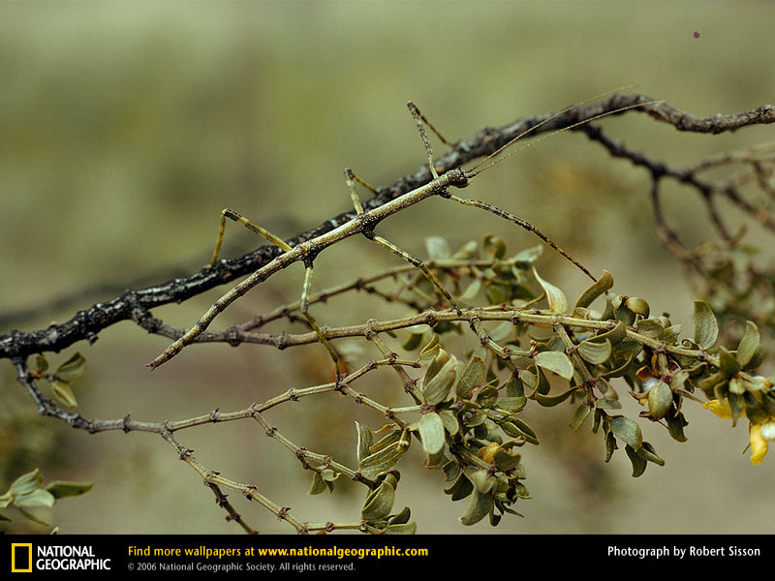
Stick Insect

Slide 5
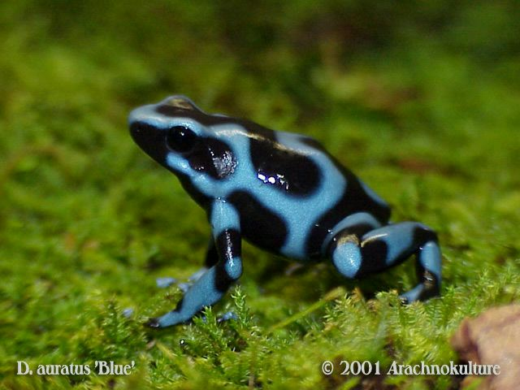
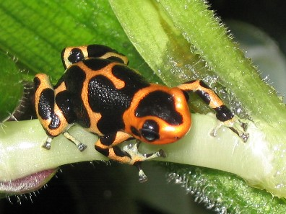
Poison Arrow Tree Frog
Mimic Poison Arrow Tree Frog

Slide 6
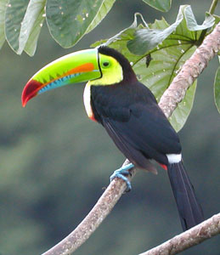
Toucans

Slide 7
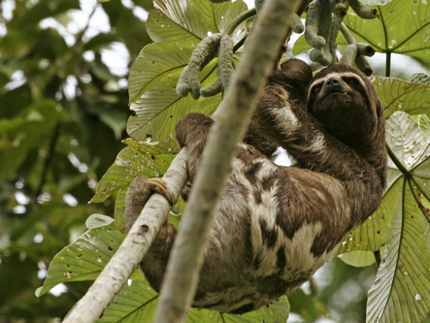
Three-toed Sloth

Slide 8
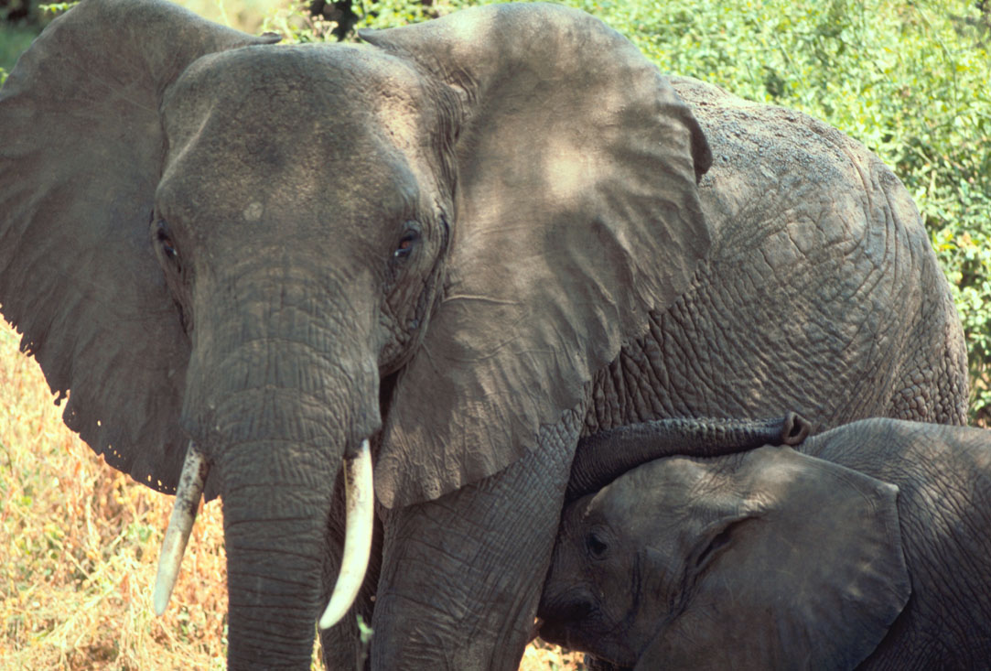
African Forest Elephant

Slide 9
Imagine that a new species of plant or animal has been discovered in the rainforest…. Your task is to design the plant or animal and suggest the adaptations they might have to suit the rainforest environment

Slide 10
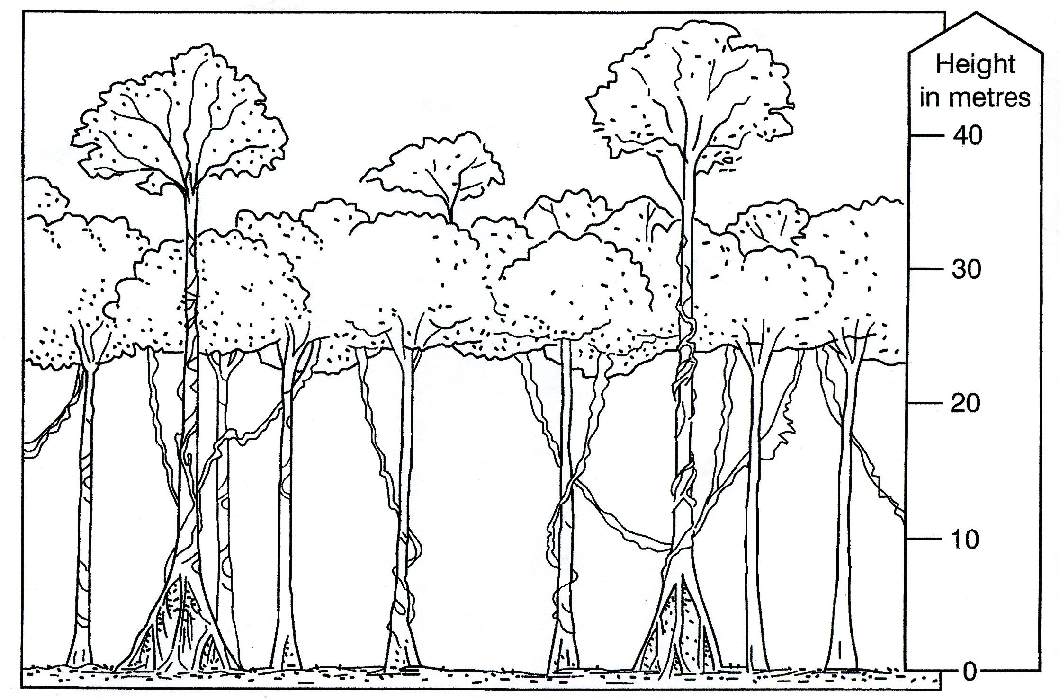
Decide what part of the rainforest your animal will live in

Slide 11
Imagine a new species of plant or animal has been discovered in the rainforest.
Draw an annotated sketch of your plant/animal.
Success criteria...
Use at least 3 adaptations for the animal
Describe your plant/animal, giving reasons for its adaptations linked to the conditions within the forest
Give your plant/animal a name
Describe your plant/animal’s environment and the layer of the rainforest that it lives in
Put your plant/animal in a food chain, using other species from the rainforest.

Slide 12
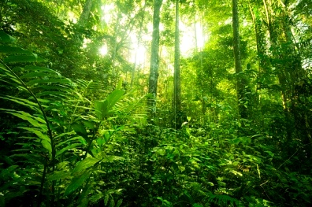
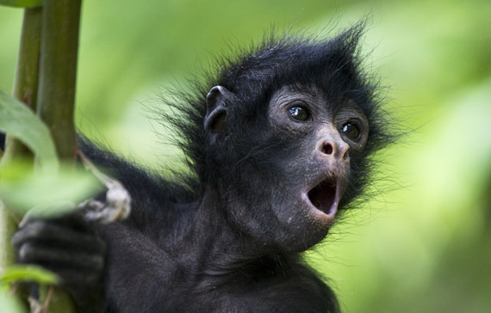
How have animals adapted to survive the Amazonian rainforest?
Success criteria
Use at least 3 adaptations for the animal- annotate these on your design
Give your plant/animal a name
Use key terminology- Describe your animal’s environment and the layer of the rainforest that it lives in
Structure using PEEL- Describe your animal, giving reasons for its adaptations linked to the conditions within the forest
Put your plant/animal in a food chain, using other species from the rainforest.
Explain what defence/ attack methods your animal may use.
Oi, PEEL me a banana now!
You should be able to investigate the different characteristics of Amazonian animal adaptions (Level 5).
You could associate adaptions to the different rainforest layer (Level 6).

Slide 13
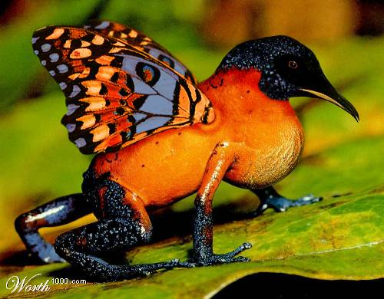
Annotation example: Butterhummingfrog
It has a pointed beak to drink nectar from flowers.
It cannot fly, but uses its wings to attract insects and butterflies to eat
Its toes have suction cup pads to help in climbing and clinging to leaves and branches.
It likes to live in dark, moist environments like a pond or stream.

Slide 14
The Amazonian adaptation write-up!
Activity
Create a PEEL structure to explain your animals adaptions
Explain how your animal has adapted to survive the Amazonian rainforest.
How has your animal adapted to survive the Amazonian rainforest?
EXAMPLE: The butterhummingfrog has various adaptions to be able to move between the forest floor and canopy layer- the forest floor is dark and damp and the canopy is where most of the food is in the rainforest . Its toes have suction cup pads . This helps to to climb and cling to leaves and branches. As a result, they are able to move from the forest floor where it likes the moist environment of the stream to the canopy layer where it can collect the nectar of the flowers and insects and butterflies to eat.
Point Example Explain Link

