Slide 1
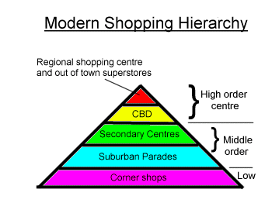
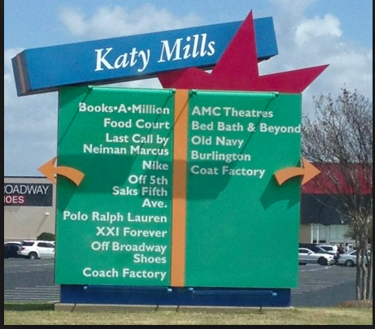
How to write your Geography coursework analysis
Learning Objective:
Know what an analysis is
To understand what makes an good analysis
Practice analysing data
Peer assessment

Slide 2
To what extent does Katy display a shopping hierarchy?
What is an analysis?

Slide 3
Link to other data
Describe
Explain
Link to question

Slide 4
Analysis mark scheme
Poor
(0- 4 marks )
OK
(5-8 marks)
Excellent
(9-12 marks)
Suggested word count

Slide 5
Practice analysis: group work
Practice sub-questions
Is there a larger sphere of influence where there are more high order shops?
Are there more high order shops at Katy Mills than other shopping centers?
Does a high environmental quality attract people to buy high order goods?
Focus for the sub questions
What data that we have collected could you use to help you answer this?
What does the data show? i.e. describe your results
Why does the data show this?
What other data does this link to?
What to do….
These sub-questions have been placed around the room on big paper
In 4 groups you will go to the paper and discuss the answer first answer to the sub-question and note down the answer using the colour key- you will then move to the next question and answer second focus using colour key….and so on.
At the end we will discuss the results as a class

Slide 6
Self assessment: checklist
Have you? | Tick when completed
I have described results in detail
I have used evidence in my description such as data and referred to figure numbers
I have made analytical comments
I have drawn together my findings and made comparisons between different types of data
I have answered all of the sub questions and the main task question
I have used locational specific information to help explain the results
I have referred to appropriate geographical theory and key terminology where appropriate
I have tried to keep my writing concise and within approx 1000 words

Slide 7
Peer assessment
What feedback would you give this student?
What have they done well?
Have they describe the data (referring to figures numbers and stating values?)
Have they explained the data?
Have they made links between the data?
Have they linked their findings to their question?
What could they do to improve?
What grade would they get?
What have you learnt about analysis from the peer assessment?

