Slide 1
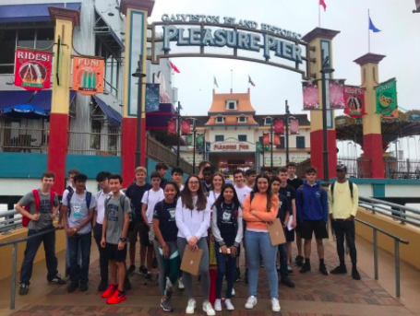
How to write your Geography coursework analysis
Learning Objective:
Know what an analysis is
To understand what makes an good analysis
Practice analysing data
Peer assessment

Slide 2
Has tourism had both positive and negative environmental
impacts on Seawall Boulevard in Galveston, TX?’
What is an analysis?

Slide 3
Link to other data
Describe
Explain
Link to question

Slide 4
Analysis mark scheme
Poor
(0- 4 marks )
OK
(5-8 marks)
Excellent
(9-12 marks)
Suggested word count

Slide 5
Self assessment: checklist- what else could you add?
Have you? | Tick when completed
I have described results in detail
I have used evidence in my description such as data and referred to figure numbers
I have made analytical comments
I have drawn together my findings and made comparisons between different types of data
I have answered all of the sub questions and the main task question
I have used locational specific information to help explain the results
I have referred to appropriate geographical theory and key terminology where appropriate
I have tried to keep my writing concise and within approx 1000 words

Slide 6
Peer assessment
What feedback would you give this student?
What have they done well?
Have they describe the data (referring to figures numbers and stating values?)
Have they explained the data?
Have they made links between the data?
Have they linked their findings to their question?
What could they do to improve?
What grade would they get?
What have you learnt about analysis from the peer assessment?

