Slide 1
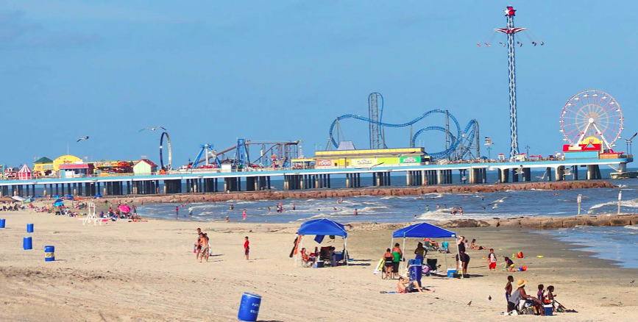
Writing the analysis, evaluation and conclusion

Slide 2
Background information- theory and locational context

Slide 3
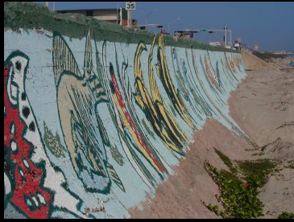
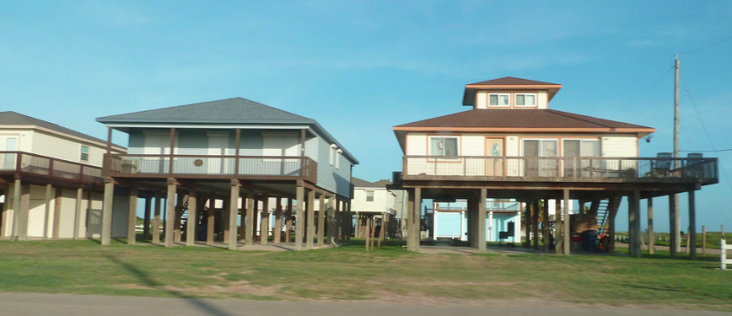
Coastal Management in Galveston
The Sea Wall was built after the 1900 hurricane to protect against future hurricanes.
The sea wall is 10 miles long. Cost/ benefit analysis- only built where there is business interest- residential areas need to use other methods of protection.
A proposal has been put forth to build an "Ike Dike," a massive levee system which would protect the Galveston Bay, and the important industrial facilities which line the coast and the ship channel, from a future, potentially more destructive storm.
Houses built on stilts and have concrete floors instead of wood

Slide 4
The Natural environment of Galveston
https://tpwd.texas.gov/state-parks/galveston-island/nature

Slide 5
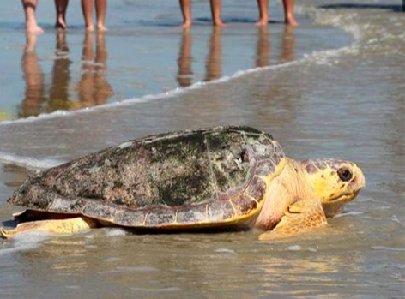
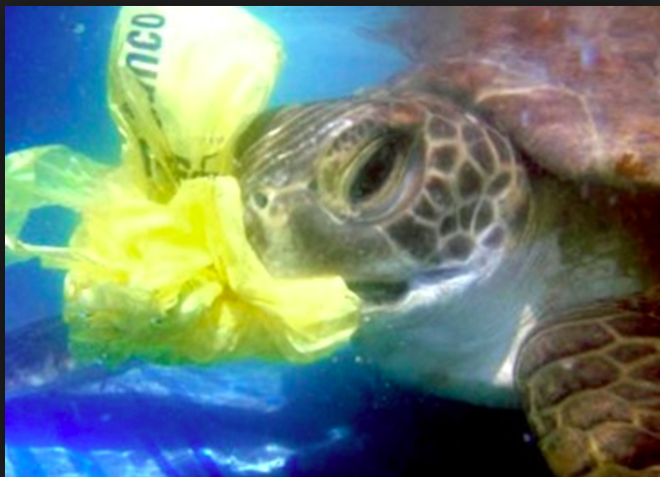
Sea Turtles & Marine Mammals
The Kemp’s Ridley sea turtle is commonly found on Galveston Island. During nesting season, female sea turtles swim ashore to lay their eggs on the island’s sandy beaches, in areas fortified by seaweed for camouflage. When the eggs hatch, the young turtles make their way to the ocean to begin their journey. The NOAA facility in Galveston offers unique educational opportunities for the public to learn about sea turtles, including free tours.
https://www.galvestonbeachinfo.com/nature.asp

Slide 6
Economic impact of tourism in Galveston
6.4 million visitors in 2015
$766 million spent by all visitors
Galveston had 400,000 more tourists in 2015 than 2014, a 6.4 percent increase according to the report by Tourism Economics. About half of that increase came from cruise line passengers, up from 642,000 passengers in 2014 to 837,000 last year.
Galveston tourism has grown since a dramatic dip after Hurricane Ike devastated the city in September 2008.
https://www.houstonchronicle.com/news/houston-texas/houston/article/Galveston-scores-record-tourism-year-7446641.php

Slide 7
Mark scheme

Slide 8
Writing an overall conclusion
Here you answer summarise the 2-3 sub-questions to answer the big question ‘To what extent does Katy show a shopping hierachy’
Success criteria
Should be about a paragraph long
Don’t bring in any new information
Ensure you answer the question
Checklist: | COMPLETE
Refer back to your research question, in one simple sentence try to provide an overview of your findings.
Refer to each of your three hypothesis, did you prove or disprove them? (briefly summarize your findings from the analysis section
Ensure that your hypothesis is consistent with what you are saying in your analysis.

Slide 10
Checklist for evaluation
Evaluation | Done?
I have explained the positives and negatives of the sites chosen
I have explained the positives of my data collection (primary and secondary)
I have explained any issues/ limitations with my data collection
I have give examples how these problems could be overcome
I have given suggestions for extensions to the study

Slide 11
Suggested format for completing the evaluation: a table
Method | Positives of data collection method | Limitations of data collection method | How could method be improved or extended?
Sites selected
Questionnaire
Land use mapping
People count

Slide 12
What were the issues with our data collection?

Slide 13
Reminder:
Full draft deadline Tuesday 15th January

