Slide 1
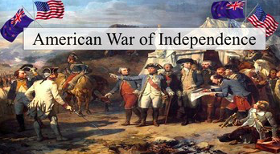
Why did the thirteen British colonies rebel against Great Britain?

Slide 2
The American War of Independence
Make a list of:
- The things you know about the American War of Independence
- The things you think you know
- And things that you’d like to know
Show your partner and then be ready to share with the class

Slide 3
House challenge
What would become the United States of America in 1776 was made up of just 13 British colonies (which would become states). Can you name them?
No devices. You will get one mark for each colony/state that you name correctly.
Alternatively you can decide to use an atlas. This will mean that you get half a point for each colony/state you name

Slide 4
The 13 Colonies
1. Connecticut
2. Delaware
3. Georgia
4. Maryland
5. Massachusetts (Boston)
6. New Hampshire
7. New Jersey
8. New York
9. North Carolina
10. Pennsylvania
11. Rhode Island
12. South Carolina
13. Virginia

Slide 5
The causes of the American War of Independence
Watch the 6 minute video which identifies and explain six causes of the American War of Independence. At the bottom of this sheet you will need to list these six causes but you will also need to answer the 10 questions (so some pausing and replaying will probably be needed!)
https://www.youtube.com/watch?v=Xp8wpNYYm_M

