Slide 1
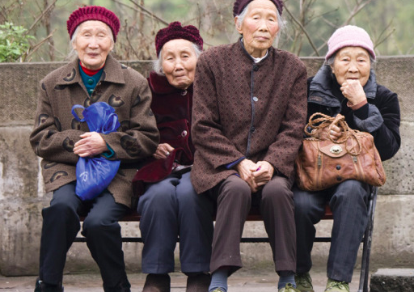
Ageing populations What: Challenges and opportunities Population possibilities and power over the decision making process
Why: To understand how population projections can predict population decline and so can help us manage future issues
How:
To understand the causes of an ageing population
To understand the impacts of an ageing population
To understand the policies for managing an ageing population
To relate this the Japan case study

Slide 2
Ageing population
Ageing population: a population in which the median and mean age are high and increasing. It is generally attributed to falling fertility rates and increasing life expectancy.

Slide 5
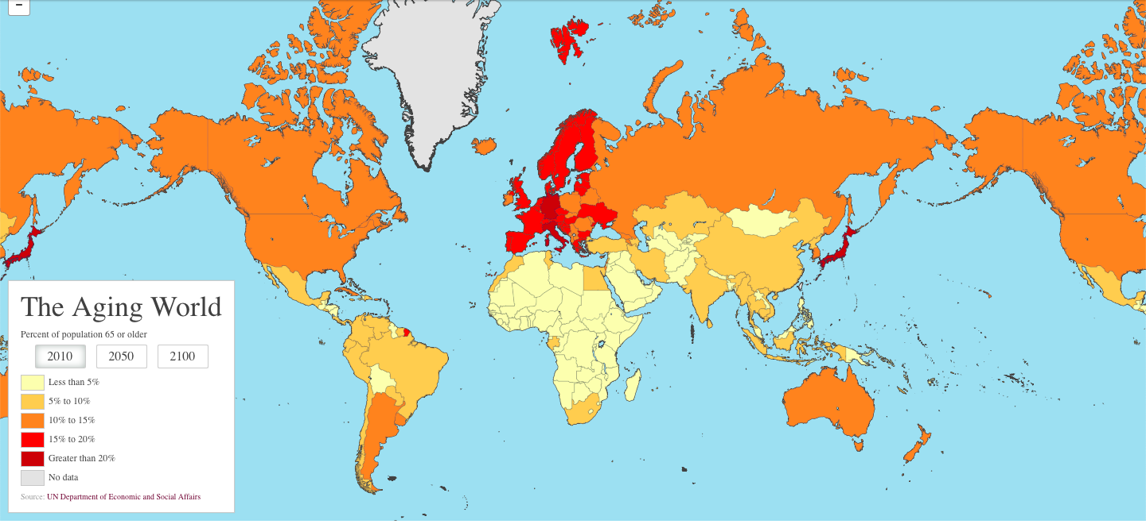
Click here to be taken the The Slate website and an excellent article on Ageing Populations. Check out the different characteristics (2010, 2050, 2100) and then complete a piece of commentary describing the spatial distribution of ageing / greying and explaining this spreading trend. Take a note of the data for both France, Ethiopia, Japan and China for the three different date ranges.

Slide 6
Ageing populations
Watch the video: note down 3 interesting facts

Slide 7
Describe the pattern shown on the map (4)
See Kognity: 1.3.3
Ageing populations

Slide 8
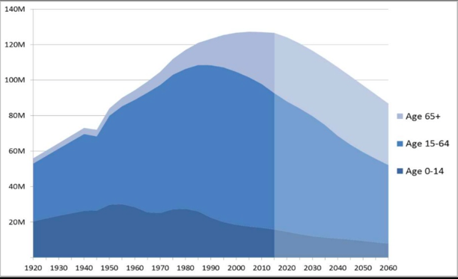
Ageing Populations: case study Japan

Slide 9
Describe the trends shown on the graph (4)
See Kognity: 1.3.3
Ageing populations

Slide 11
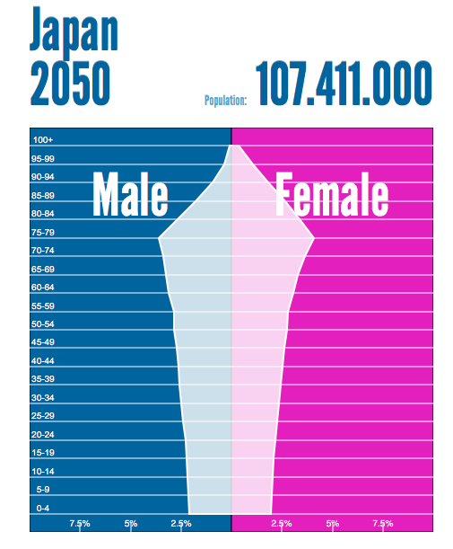
Changing population structure: Japan
Country with a high level of economic development - Japn
Take a screen shot of the population pyramid of Japan in 1950, 2015 and 2080
Describe the changes of the structure of the pyramid over these years?
ii. What was the population of Japan in 1950?
iii. What is the population of Japan now?
v. What are the key population issues facing Japan today?
vi. What percentage of the population will be over the age of 60 years old in the year 2050?
vii. Is Japan becoming a country with a youthful or ageing population?

Slide 12
Watch one of the videos….
Why has Japan got an ageing population?
What are the issues of an ageing population?
What are the solutions?

Slide 13
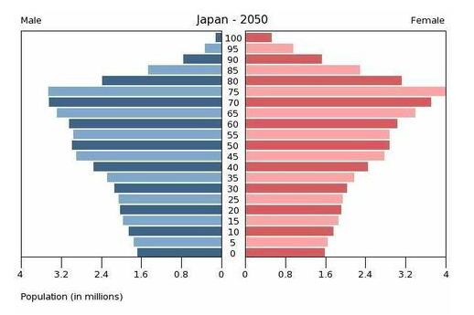
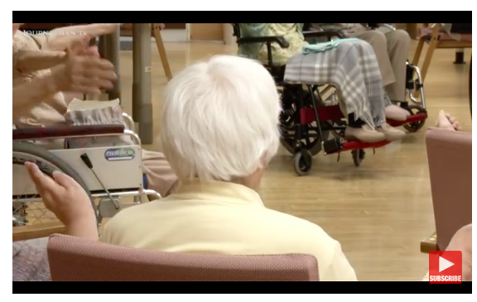
Take notes on the issues faced in Japan and how the country aims to effectively deal with this demographic issue.

Slide 14
I
Identify what can you see?
D
Describe why may this help an old person?
E
Explain- what are the advantages and disadvantages?
Complete the IDEAL analysis
A
Apply- how does this create a solution to the ageing issue in Japan?
Literacy
Challenge
Can you now answer the following question using the IDEAL analysis to help you:
To what extent can technology solve Japan’s ageing issue?
Can you use these key terms:
Dependency
Technology
Ageing population
L
Link- to what extent is this a sustainable solution to the issues in Japan?

Slide 15
Dealing with an ageing population in Japan
Solutions:
ü Increase birth rates (but, social attitudes and trends difficult to change)
ü Reforms à increasing child benefits, providing tax allowances for families, making child care more accessible
ü Encourage immigration (to solve labor shortages—but, difficult for country to accept foreigners)
ü Offer part time jobs for elderly population (less demanding)
ü Increase retirement age so they can contribute to economy
The issues of an ageing population:
Read page 26. Make detailed notes about the issues that area created in Japan because of their ageing population structure. What are they doing to solve issue.

Slide 16
Solutions in Japan
https://www.theglobeandmail.com/globe-investor/retirement/retire-planning/how-japan-is-coping-with-a-rapidly-aging-population/article27259703/

Slide 17
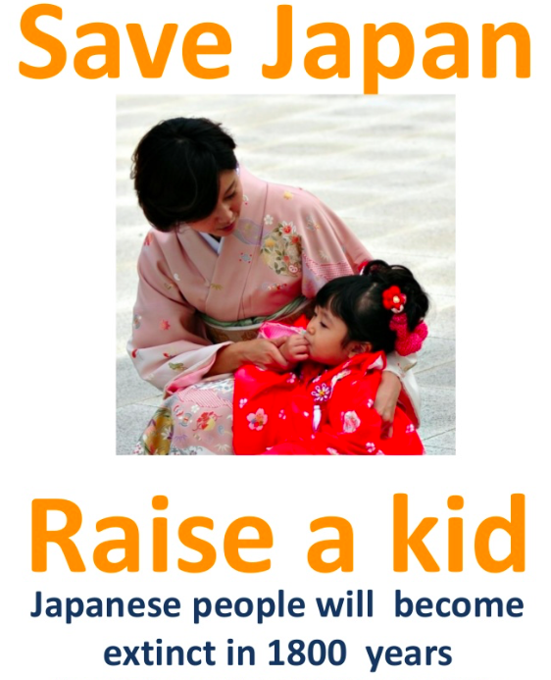
Pro- natalist policy in Japan
The Goverment has introduced new laws like the 'Child Care' and 'Family Care Leave' Laws. In which parents can receive: -8 Weeks paid leave from work -Shorter Working hours -A maximum of 24 hours overtime a month -Economic Incentives e.g. Yamatsuri, a town of 7,000 just north of Tokyo, offers parents $4,600 for the birth of a child and $460 a year for 10 years. -Businesses have been urged to give their employees more time off to procreate. -Shops offer discounts to larger families. -Child allowance
Despite government efforts and various incentives put in place the scheme was not a success. This is because the fertility rate only rose by 0.14% from 2005 to 2013.
Extra information:
https://www.theguardian.com/environment/2011/oct/25/japan-birthrate-decline

Slide 18
Dementia towns
https://www.theguardian.com/world/2018/jan/15/dementia-towns-japan-ageing-population
'Dementia towns': how Japan is evolving for its ageing population

Slide 19
Assessment: Infographic question

Slide 20
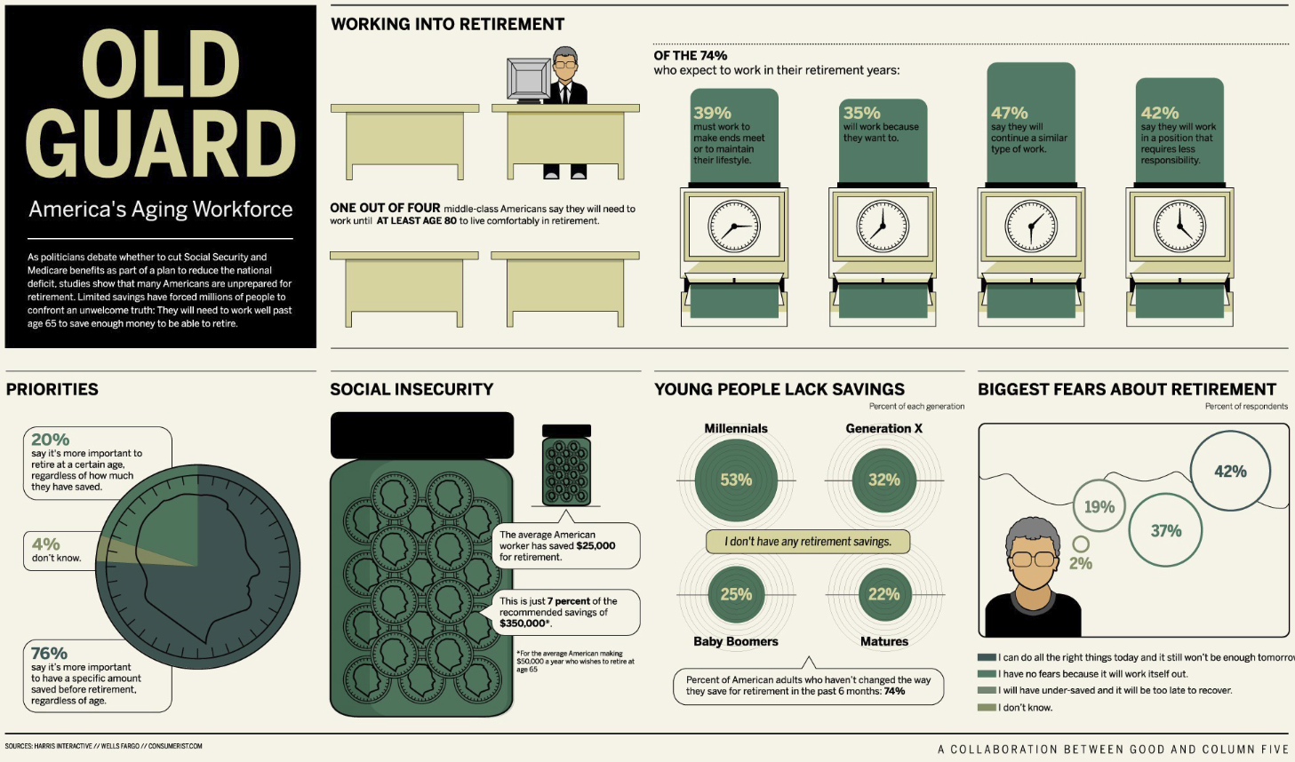
1. Refer to the infographic above. The infographic shows characteristics of an aging workforce.
State the age group that is the least prepared for retirement. (1)
State the percentage of people who expect to continue working in a similar line
of work in their retirement years.
Suggest one strategy the American government can employ to ease fears
about retirement. (1+1)
Examine two ways a lack retirement savings will contribute to the pressures of
an aging population. (3+3)

