Slide 1
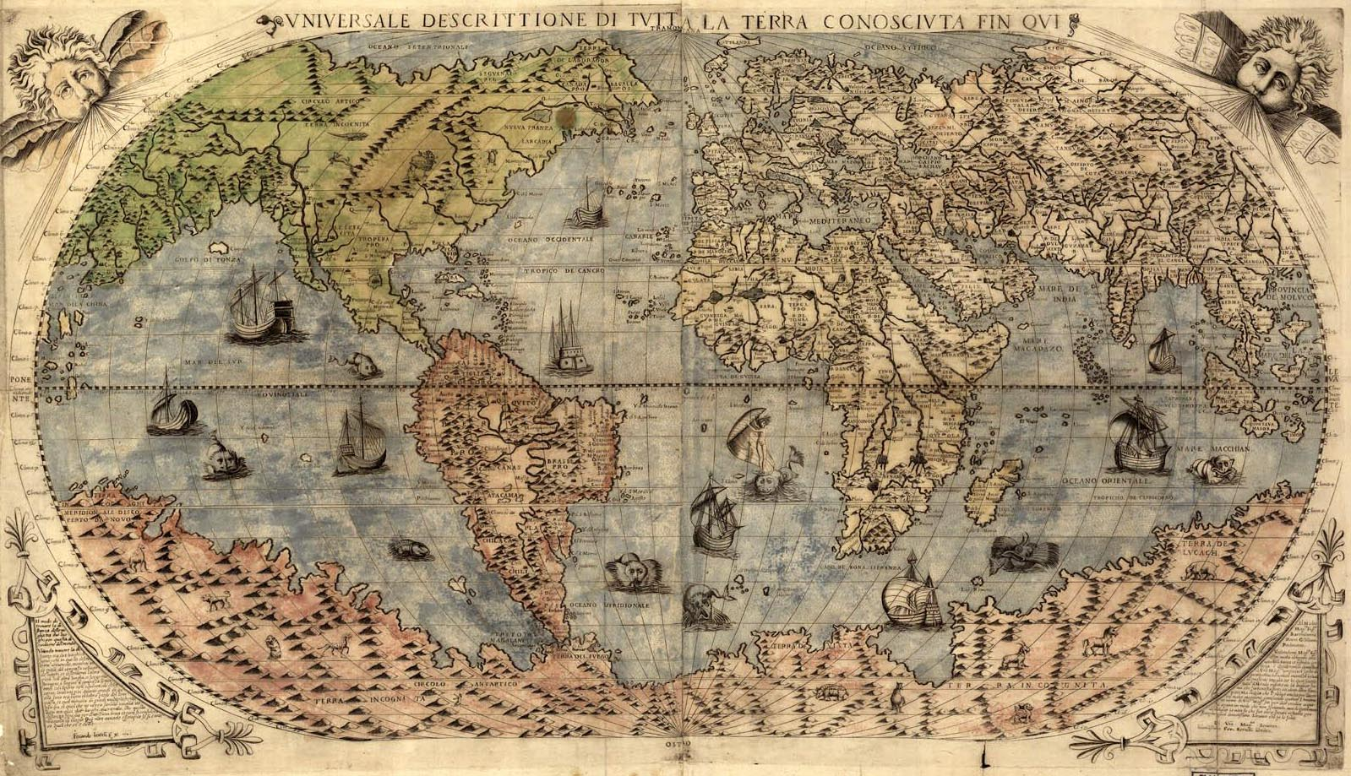
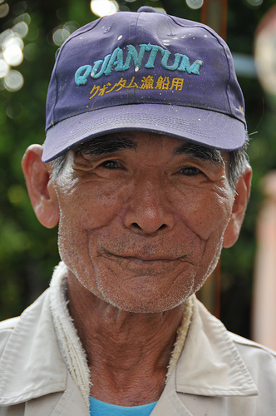
Why did this 77 year old Japanese man, who had never broken a law before in his life, end up in prison?
Answers on a post it note

Slide 2
Big question:
Is development a good thing?

Slide 3
Opinion line
To what extent is an ageing population a good thing?
Ageing population
Total opportunities
Total challenges

Slide 4
What: Ageing populations
Why: As the world develops this will become a growing issue
How: Case study detail on the causes and impacts
Evaluations of solutions

Slide 5
Coping with ageing populations: Japan
Key questions
What are some of the more unexpected positive and negative effects of ageing populations?
What do we mean by a country’s population not being sustainable?
How can we assess further the way in which ageing populations are managed?
Learning Outcomes
All: With reference to one or more case studies, outline some of the effects of ageing populations and suggest ways to respond to these effects Level 5
Most: the above in more detail, but also with reference to why an unsustainable population structure is the root of some of these problems Level 6
Some: Evaluate which strategies are the most reasonable and realistic to help reduce or stop these problems Level 7

Slide 6
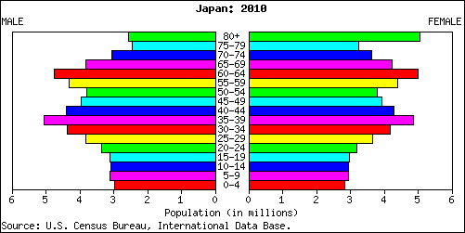
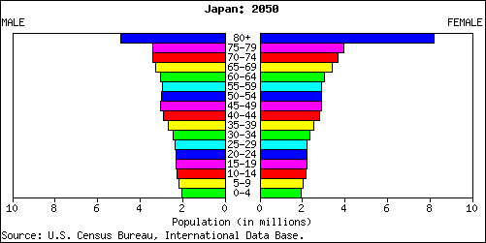
What can we tell about the life expectancy and birth rates?
Who is works and pays tax?
Who is dependent?
Is it sustainable?
Write a tweet (140 characters maximum) to the Japanese government @Japangovt explaining why their country is in trouble.

Slide 7
1.
2.
3.
4.
5.
What do old people need to survive?
Which of these can a prison provide?

Slide 8
Why did this 77 year old Japanese man, who had never broken a law before in his life, end up in prison?
Answers on a post it note

Slide 9
Japan struggles with elderly crime wave
Japan has traditionally enjoyed low levels of crime and government statistics show that overall figures are falling, except among the elderly.
The Japanese government is spending Y8.3 billlion (£39 million) on constructing three new prison wards that are specifically designed to cater to the rising number of elderly inmates.
Many are repeat offenders who commit another minor crime shortly after their release simply to get back into a community where they are comfortable, warm, fed and have friends of their own age.

Slide 10
Watch the following video on the ageing population in Japan
http://www.youtube.com/watch?v=oG67vfjjT24
Make notes on…
Why there is an ageing population?
What issues (positives and negatives) this creates
What is being done about the issue

Slide 11
Imagine you are Yuki, sat in his prison cell. Write a diary entry explaining why you chose to go to prison and why you like it there.
Include these key terms;
Life expectancy
Birth rate
Dependent population

Slide 12
Write a second tweet (140 characters) to the Japanese government @Japangovt detailing how they could fix the problems caused by an ageing and unsustainable population in their country.

Slide 13
What solutions have the Japanese government designed to deal with the issue?
http://www.youtube.com/watch?v=KlZ4-LZcVcg
http://www.youtube.com/watch?v=G5Vd9k3-3LM
Extension: read this Guardian news report
Solving Japan's age-old problem

Slide 14
Assessment question: What are the consequences of an ageing population in Japan (7 marks)
Success criteria:
You use case study detail (e.g. statistics and named places)
Use geographical terminology
You look at both the positives and negatives of the issue
Have well structured points (see next slide)

Slide 15
Exam question
What are the consequences of an ageing population in Japan? (7)
B
ox the command word (s)
Step 2: On one hand...
Step 3: On the other hand...
Opportunities of an ageing population:
Challenges of an ageing population:
U
nderline the key words
M
Because
Challenge
Because
arks- How many?
This means
Example
Example
Can you explain what conclusion you would reach?
This means
Level 4 (Basic)
You describe the main features of an ageing population in Japan
Link
Point
Link
Point
Level 5-6(Clear)
You explain the opportunities of an ageing population in Japan
Literacy
Level 7 (Detailed)
You fully evaluate the opportunities and challenges and ageing population in Japan
Can you use these key terms:
Whereas
However
On the other hand

Slide 16
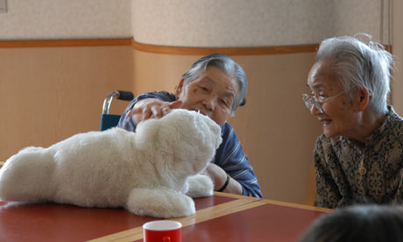
Task: design a product to help the elderly in Japan
Assessment criteria:
Design your product that will help an elderly person
What issue will it solve
Write a description of what it will do and how it will help the issue
Research- what innovations have already been created?
http://www.telegraph.co.uk/technology/6502466/Japans-inventions-for-the-elderly-four-of-the-best.html

Slide 17
Opinion line
To what extent is an ageing population a good thing?
Ageing population
Total opportunities
Total challenges

