Slide 1
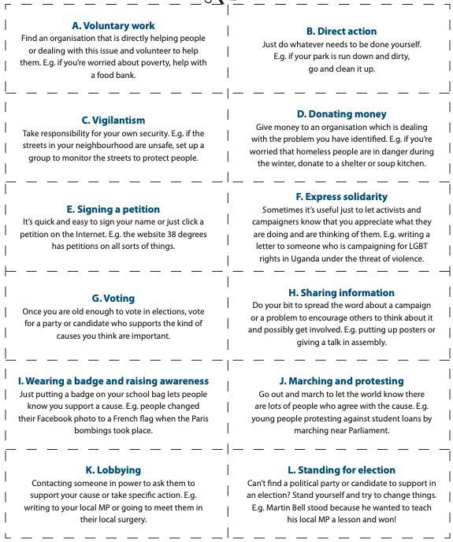
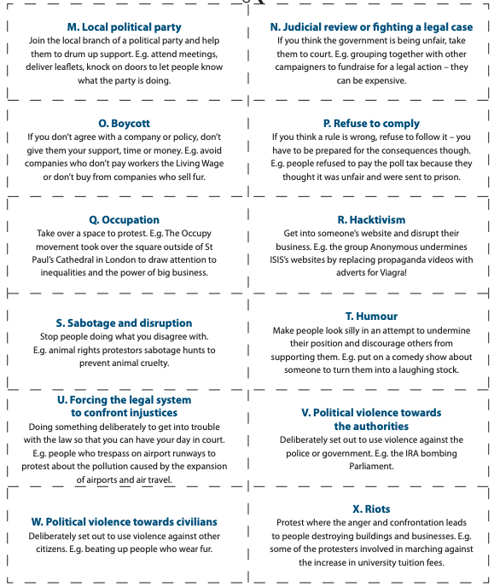
Below are 24 actions that you can take to try and bring about change on a local, national or global level..
Read each one carefully and decide if each action is legal or illegal. Plot them on the chart below.

