Slide 1
Theory of the Firm: Monopolistic Competition

Slide 2
Model Assumptions
Large number of firms
No barriers to entry and exit
There is product differentiation:
Physical differences (size, materials, packaging etc)
Quality differences
Location (easy access, convenience, airport, city center)
Services ( home delivery, product demonstrations, free support etc)
Product Image (celebrity endorsement brand names, packaging)

Slide 3
Examples
Book publishing
Clothing
Processed food
Jewellry
Gas stations
restaurants

Slide 4
Elements of Competition and monopoly
Substitutes across the industry
But Adidas is a Monopoly in Adidas shoes
Elasticities

Slide 5
Price and non-price competition exist
Product differentiation (see all examples)
R and D
Branding
In general:
The more differentiated the product is from other substitutes
And the more successful its advertising and branding
The greater the monopoly power the more likely the firm will have and the more inelastic it’s demand curve

Slide 6
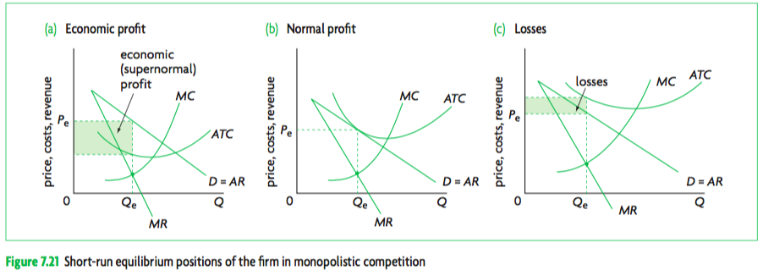

Slide 7
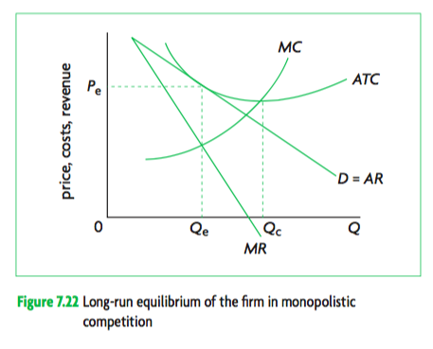

Slide 8
Evaluation
Under allocation of resources
Productive inefficiency
Excess capacity

