Slide 2
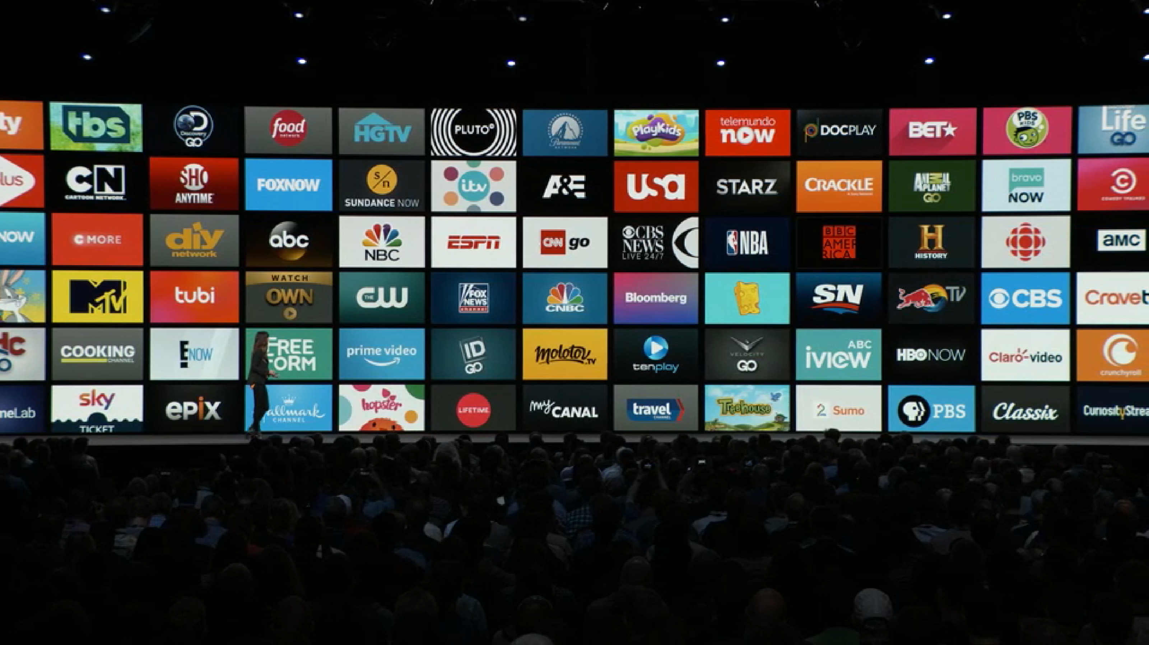
SECTORS

Slide 3
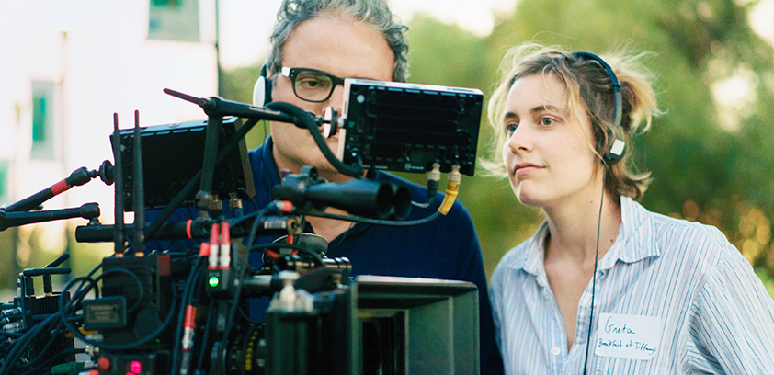
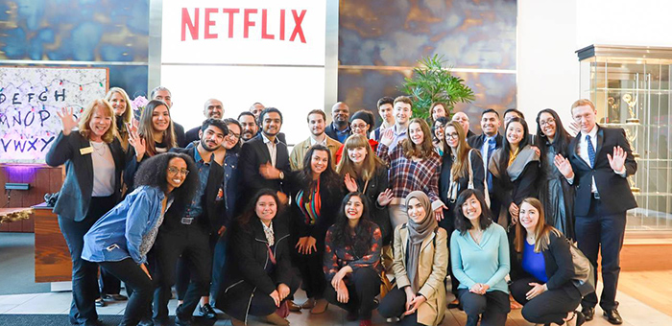
EMPLOYEES
8600 FULL TIME +
CONTRACTORS SUCH
AS DIRECTORS AND
ACTORS

Slide 4
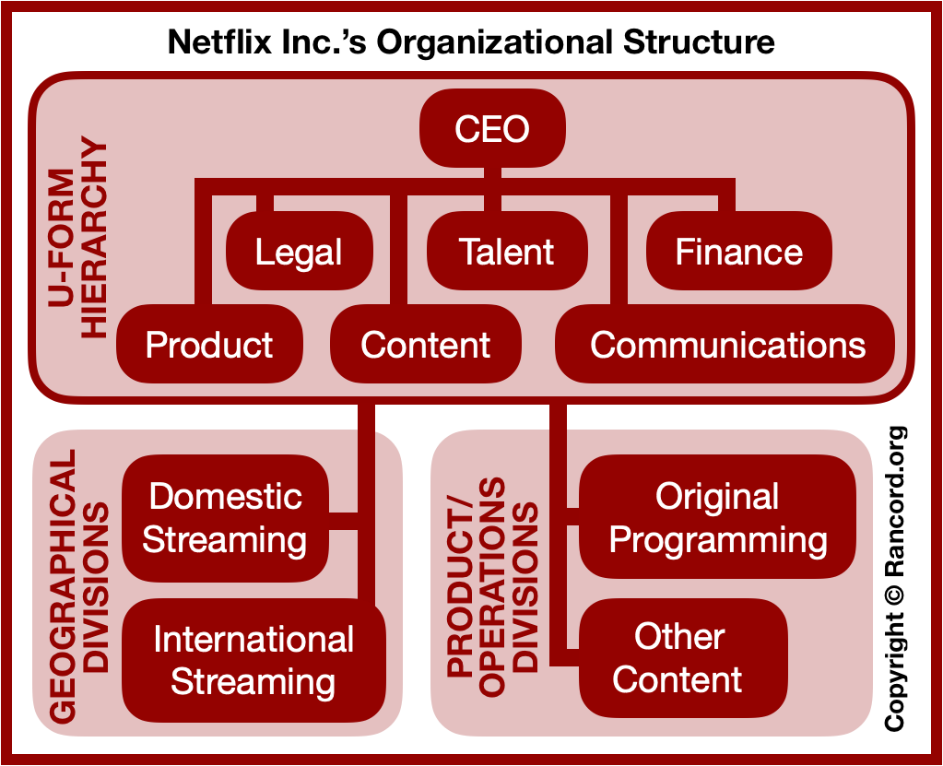
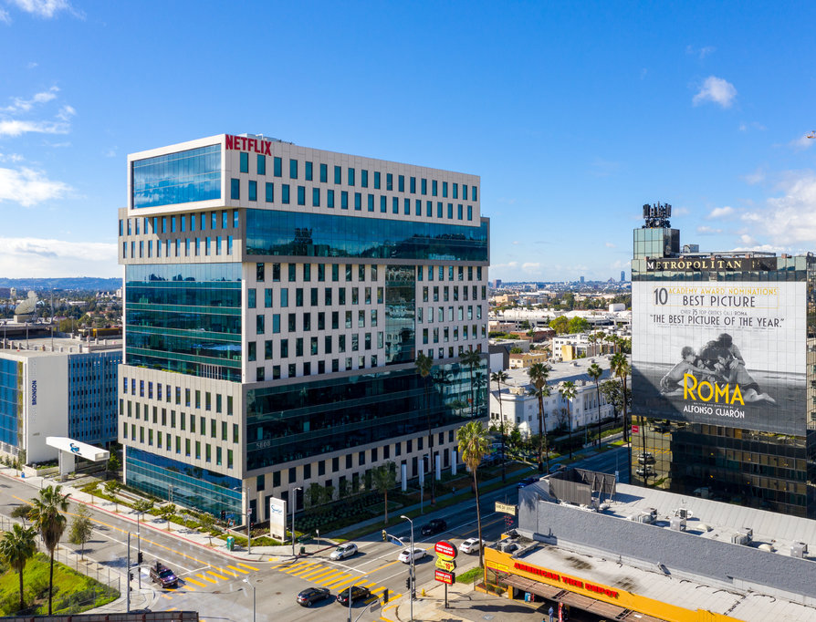
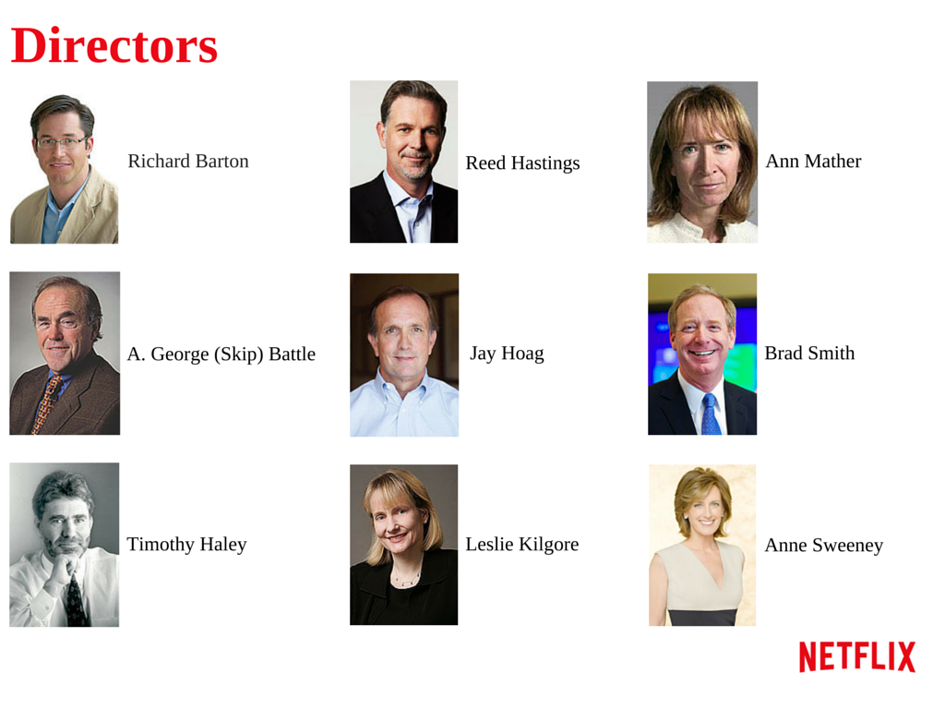
ORGANIZATION

Slide 5
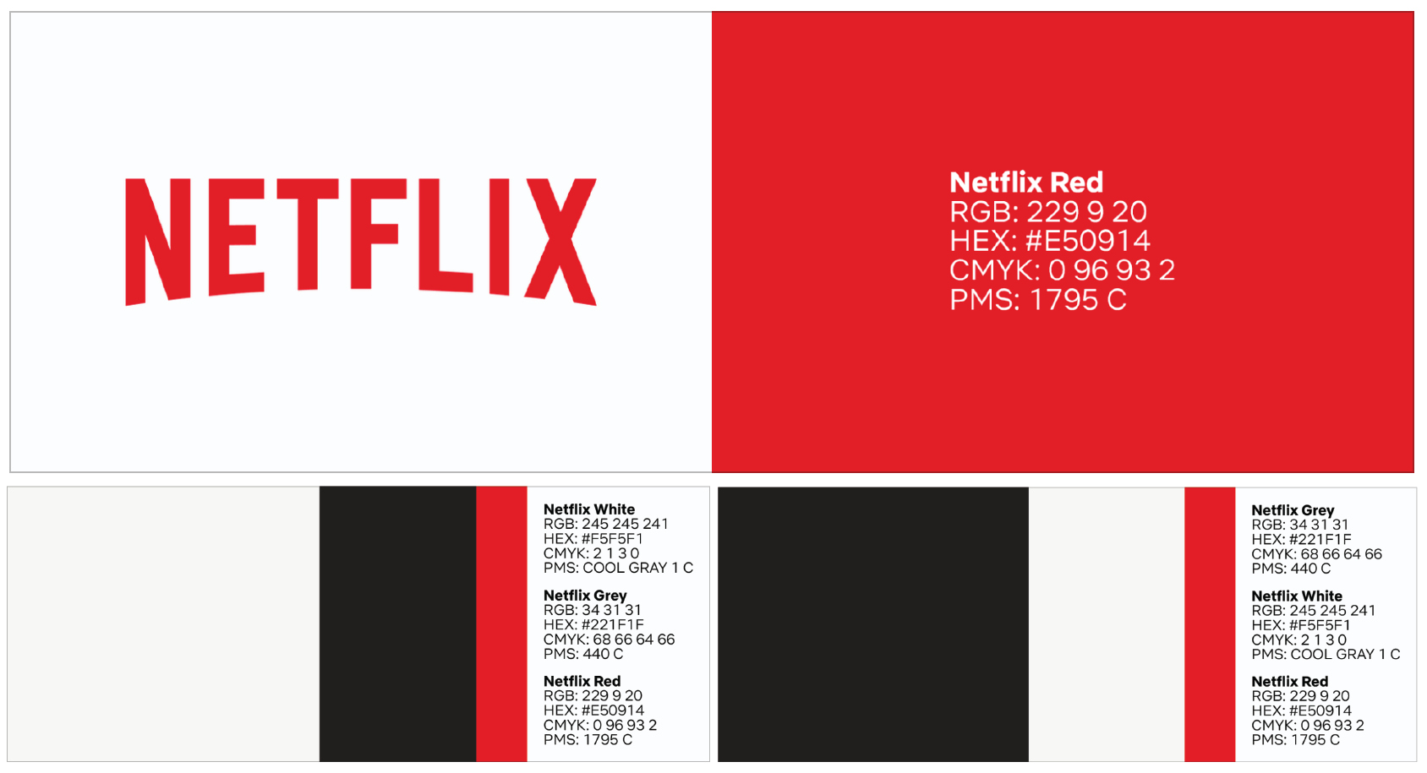
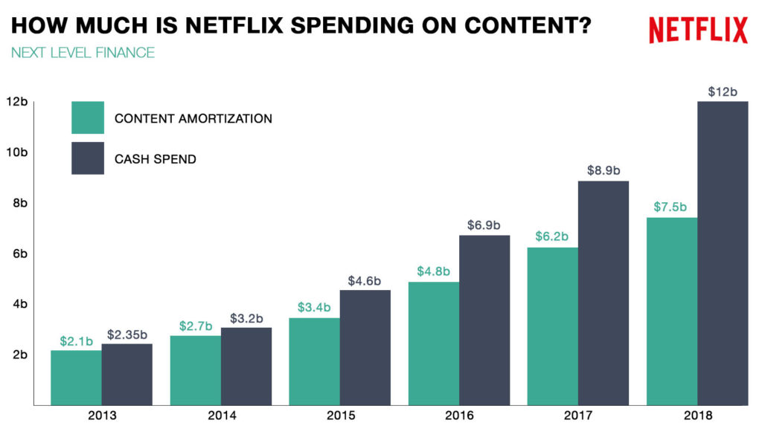
C
A
P
I
T
A
L

Slide 6
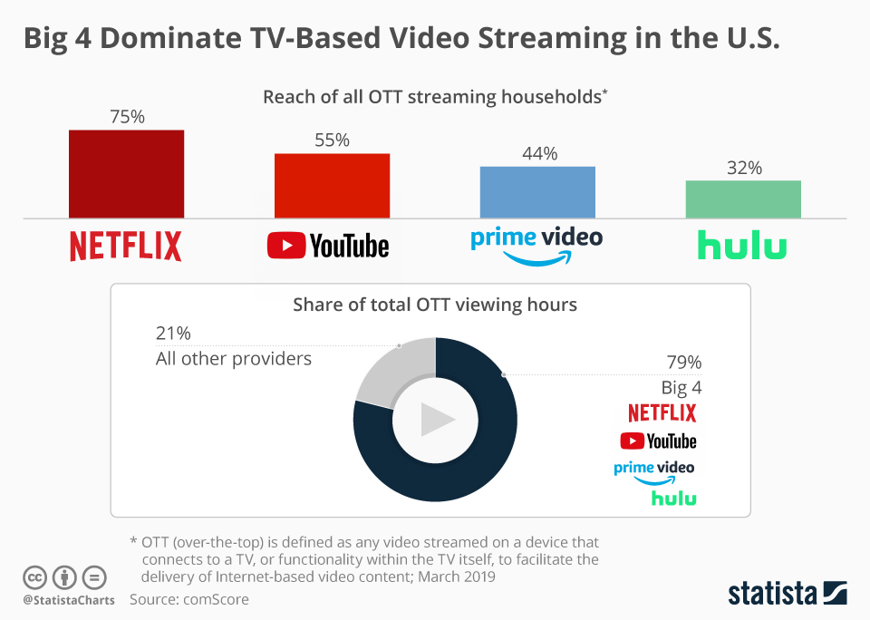
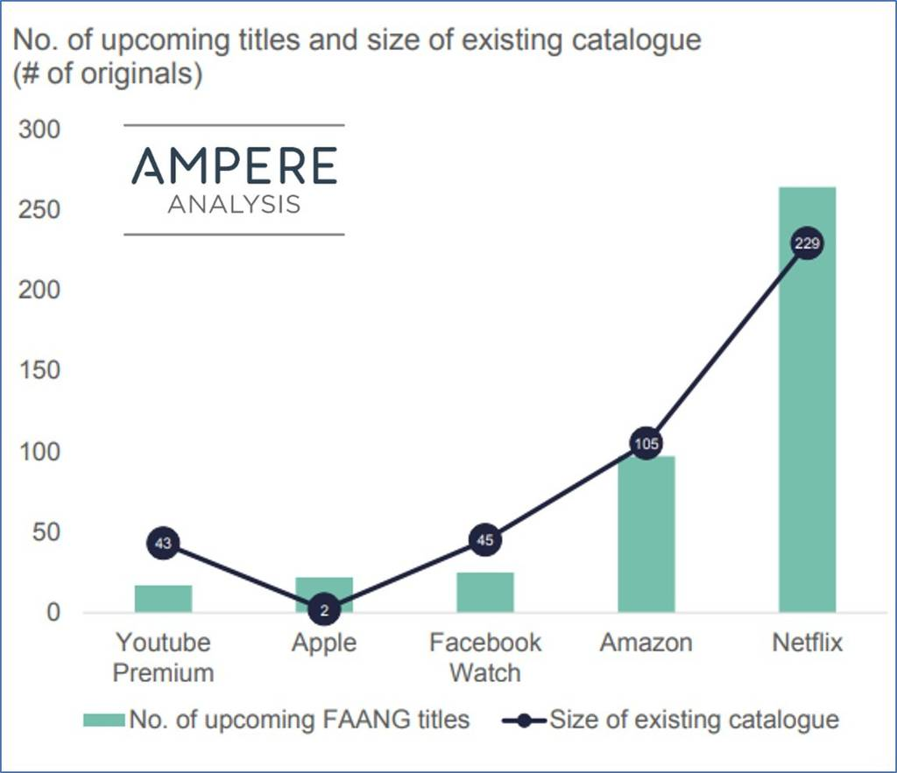
MARKET SHARE

Slide 7
ORGANIZATION
NETFLIX OPERATES IN JUST TWO SECTORS: CONTENT PRODUCTION AND INTERNET STREAMING
AS OF 2019, IT EMPLOYS 8600 FULL-TIME, AND USES CONTRACTORS FOR MOST CONTENT PRODUCTION
NETFLIX IS HEADQUARTERED IN SILICON VALLEY, WITH OFFICES IN HOLLYWOOD
IT EMPLOYS A U-FORM STRUCTURE FOR ITS EMPLOYEE HEIRARCHY
MOST OF NETFLIX’S CAPITAL IS THE RIGHTS TO SHOWS IT OWNS. ITS STOCK PRICE ON 26/3/20 IS $ 363
NETFLIX CONTROLS THE LARGEST PORTION OF THE US STREAMING MARKET; HOWEVER IT IS BEING PUSHED BACK BY COMPANIES SUCH AS DISNEY, GOOGLE, AND HULU
CONCLUSION: NETFLIX WAS EARLY TO THE STREAMING SERVICE MARKET, MEANING IT HAD A HEAD START ON MARKET SHARE. NOW IT IS AIMING TO PRODUCE ITS OWN CONTENT TO KEEP SOME OF THAT MARKET SHARE. WITH A MARKET CAP OF OVER $150 BILLION, IT WOULD BE HARD TO SAY THE TECH GIANT IS A SMALL FIRM, EVEN WITH ITS 8600 EMPLOYEES AND LIMITED PHYSICAL ASSETS.

