Slide 1
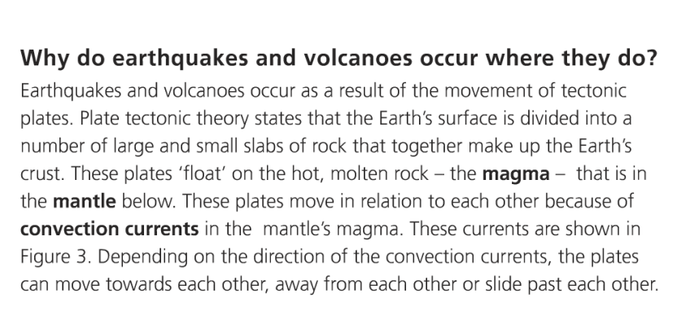
What causes earthquake and volcanic activity?

Slide 2
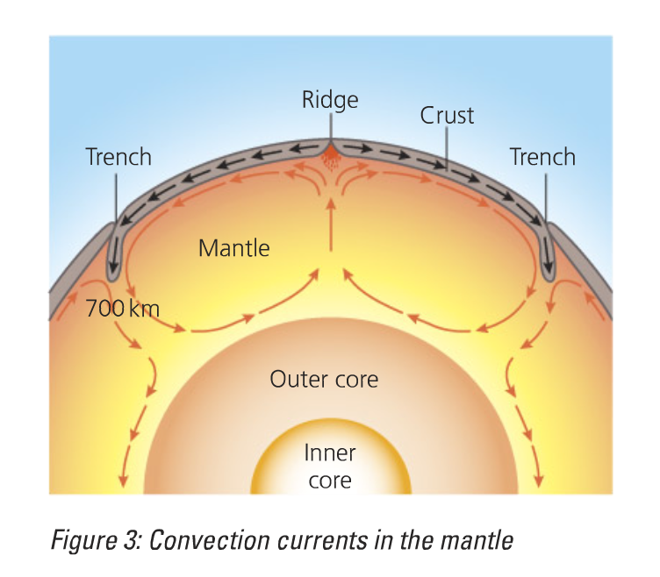

Slide 3
The Structure of the Earth
FACTS
The inner core is the centre of the earth, made of solid iron and nickel, it is the hottest part with a temp. of 5500ºC
The outer core is made up of liquid iron and nickel
The mantle is made up of semi-molten rock, partially melted rocks are called magma, temperatures reach 5000ºC here.
The crust is the thinnest layer, and is made up of solid rock, it is the outer layer, like skin of an apple

Slide 4
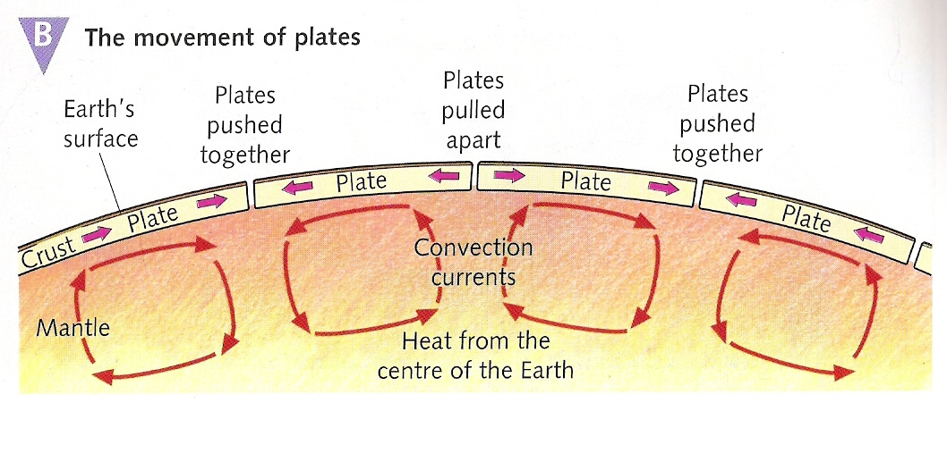
Tectonic Plates
The Earth’s crust is divided up into plates
These plates ‘float’ or move very slowly (a few mm per year) on the molten material of the mantle. This movement is caused by convection currents in the mantle.

Slide 5
CONVECTION CURRENTS
Convection currents are heat currents that rise and fall in the mantle.
They are responsible for causing breaks and cracks in the crust above. The movement then causes the tectonic plates to move apart, towards each other or side by side.
Earthquake and volcanic activity is created at the edge of two plates.

Slide 6
Plate tectonics
The place where two plates meet is called a plate boundary, most earthquakes and volcanoes happen here in a narrow belt called ‘zones of activity’.

Slide 7
In what ways do the plates move?
3 types of plate movements:
Convergent: Plates move together. Can be split into destructive (oceanic and continental crust or oceanic and oceanic) and collision (continental and continental)
Divergent: Plates move apart from each other. Can also be called a constructive margin.
Conservative: Plates slide past each other. Can also be called a transform margin.
http://www.youtube.com/watch?v=ifke1GsjNN0

Slide 8
What you need to know about each plate boundary:
1. What happens at that boundary
2. What activity (e.g. volcano or earthquake that causes)
3. Why that activity is caused
4. Examples of locations
5. Draw an annotated sketch.
NOTE: We will focus on the 2 boundaries that pose the most risk to the USA: The Conservative and convergent plate boundaries

Slide 9
Convergent plate margin (destructive)
READ MORE HERE
Oceanic and continental plates

Slide 10
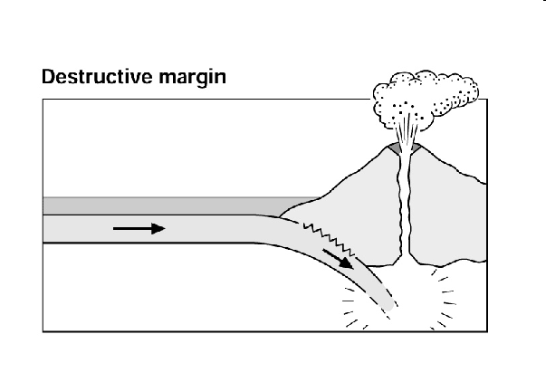
Neatly add these correct labels:
Generally explosive volcanic eruptions. Magma rising to form volcanoes.
Plate being forced into the mantle Deep, violent Earthquakes
One plate is denser than the other so sinks. Plate melting.

Slide 11
Tsunami hazard
Disaster zone?
A huge 'megathrust' earthquake could spark a tsunami and devastate the U.S. northwest if the Juan de Fuca plate is forced further under the North America plate on the Cascadia fault line.

Slide 12
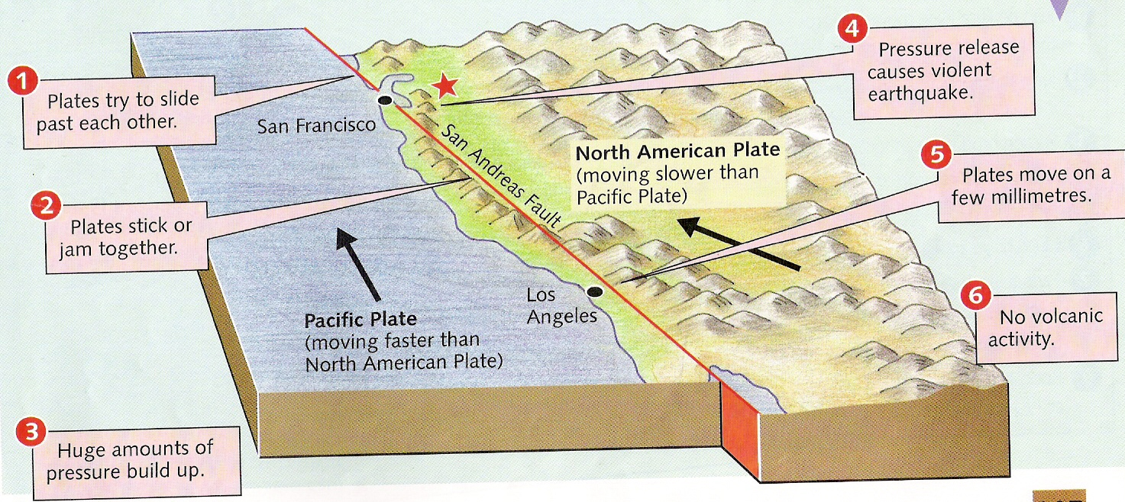
Conservative plate boundary
READ MORE HERE

Slide 13
What happens at conservative margins?
As the plates slide horizontally past each other pressure builds up in the rocks either side of the fault
Fault surface often rough – friction creates large strains along the faults
An earthquake happens when the built up pressure and energy are released in a sudden, jerky movement

Slide 14
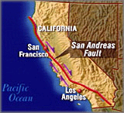
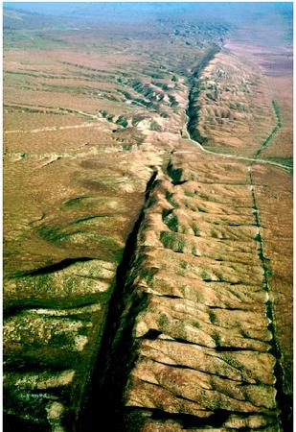
San Andreas Fault
The San Andreas Fault is the border between two tectonic plates — the North American Plate and Pacific (Nazca) Plate

Slide 15
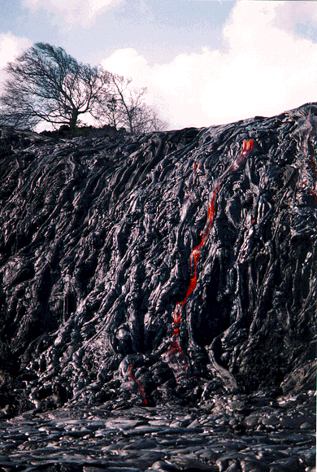
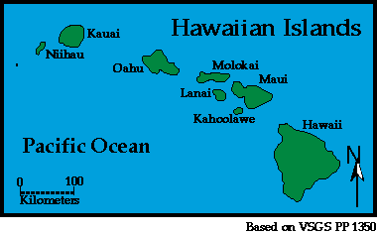
How come the most volcanic place on Earth is nowhere near a plate margin?
https://www.youtube.com/watch?v=bYv6V5EJAKc

Slide 16
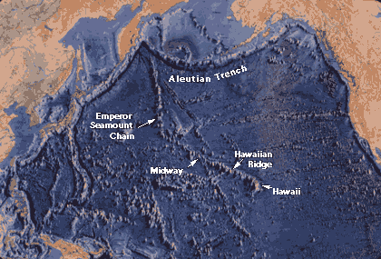
Risk at hotspots e.g. Hawaii!

Slide 17
Hotspots are areas in the lithosphere that are underlain by unusually hot magma.
This heat causes partial melting of the lithosphere, eventually leading to volcanic activity.
The Hawaiian Islands are a classic example of a volcanic grouping formed over one hot spot.
Over thousands of years, as the Pacific Plate inched its way in a northwest direction.
The stationary hot spot underneath the plate has successively created volcanoes above it.
Several of these volcanoes reached the ocean’s surface, forming the Hawaiian Islands.

Slide 18
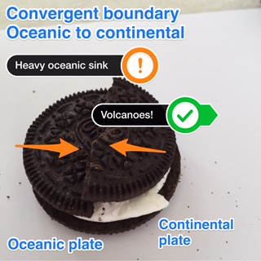
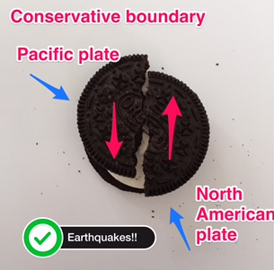
Oreo Style ♯OreoTectonics
Using the top of your Oreo, create models of each plate boundary
Take a photo using Skitch
Annotate the photos showing the following:
Plate name
Plate movement
Landform created

Slide 19
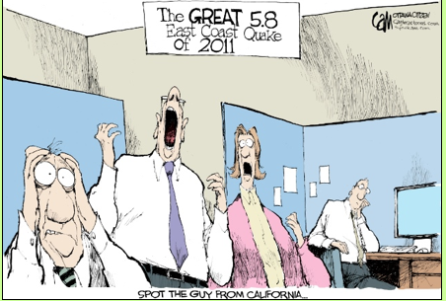
Review
Explain the threat posed by plate tectonics in the USA…
Success criteria:
Describe the plate margins that are found in the USA and explain how these cause tectonic hazards?
Name specific locations
Why are certain locations more risky than others?

