Slide 1
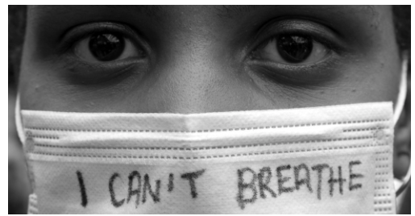
What: An account of 2020-21
Why: To consider how 2020-21 would be portrayed if you were the author
How:
Decide on events
Decide on best presentation method
Evaluate what you have included and what you have omitted
Humanities Introduction
Geography: How do we see the world?
History: Fake news

Slide 2
We are all living through a major turning point in history, one that will be studied for years to come. Future textbook authors will write entries on the year 2020/21, revise them, and revise them some more with each new edition.
Your task is to attempt to write or present—literally—a first draft of history: what you might write if I were wrapping up the last chapter of a high-school history textbook right now.

Slide 3
Starter: List 5-10 significant 2020-21 events you think should be included
Think-pair-share

Slide 4
How does our class view of 2020 compare with this account?
Read: How a History Textbook Would Describe 2020 So Far
What events does the author mention?
Who do you think the author is and where may they be located?
Who is the audience?
What is the viewpoint of 2020 of the author?

Slide 5
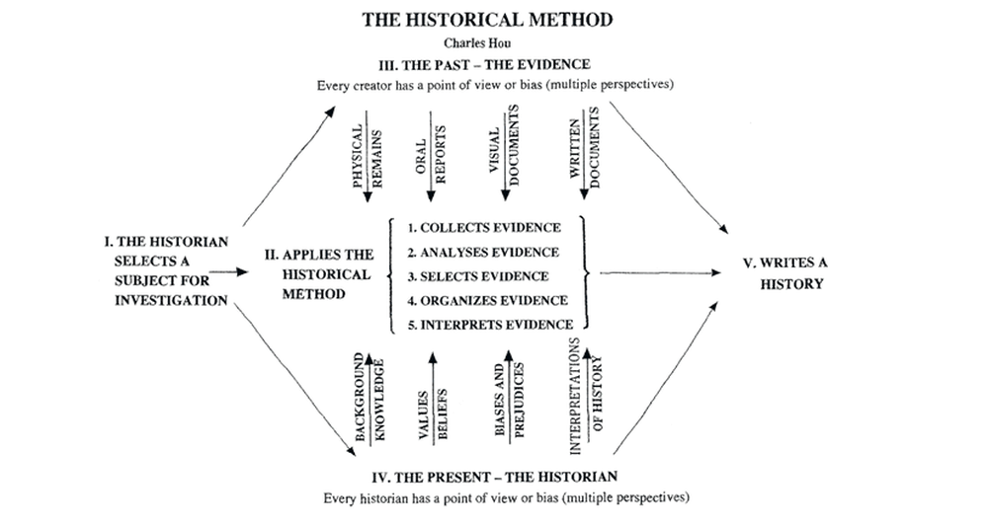

Slide 6
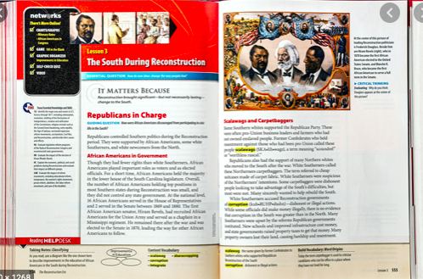
Option 1: History book account of 2020
You have been commissioned to write a double page for a History book that middle school students to give an account of the key events of 2020.
Success criteria:
This should be 500 words
It should include 5 images with captions
It should be written in a style suitable for a 14 year old student

Slide 7
Option 2: Time capsule
Create a time capsule of up to 20 items that represent what life is like in 2020.
Include a note in the box that explains what the message of the box is and what the items represent.

Slide 8
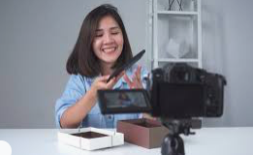
Option 3: Unboxing video
Your box can have up to 20 items and the unboxing video can be a maximum of 5 minutes
Unboxing videos have several important components:
The audience: Who is watching the video?
The recipient: Who is receiving the box? Why?
The sender: Who is sending the box? Why?
The setting: Where is the recipient opening the box? At what time?
The box: What does the box look like? What kind of packaging is there? Is there a message on it?
The contents: What items are in the box? Is there a note in the box? What is the significance?
While creating a video with all of this, the student is constantly asking: How does this show the significant events/ features of 2020?

Slide 9
Evaluation
Once you have completed your account of 2020 in your chosen medium you need to evaluation of what you have included.
-How has your personal bias impacted what is included?
What is the message of the box (is it all negative?)
What factors (i.e. gender/ location you live/ age etc) may have changed how you presented 2020?

