Slide 1
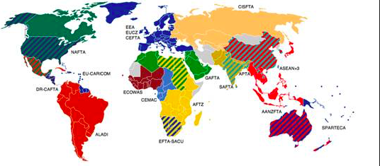
Political factors that affect global interactions

Slide 3
What: Political factors that affect global interactions:
multi-governmental organizations (MGOs) and free trade zones
economic migration controls and rules
Why: To understand how political, technological and physical processes influence global interactions

Slide 5
Background
The process of globalisation has been enabled by a growing political consensus that barriers to the movement of goods, services and investments and acquisitions should be removed. BUT many examples can be found of governments trying to limit their spatial interactions with other states. Global flows can be seen as threatening the well being a sovereignty of states.

Slide 6
Key term: Sovereignty:
Sovereignty: The state of being independent and being able to make your own decisions.
Loss of Sovereignty:
Globalisation has meant that many political borders are now much more porous, with goods, ideas, money and people able to travel much more freely between locations. The increased movement can bring both positive and negative impacts.

Slide 8
Regional MGOs

Slide 10
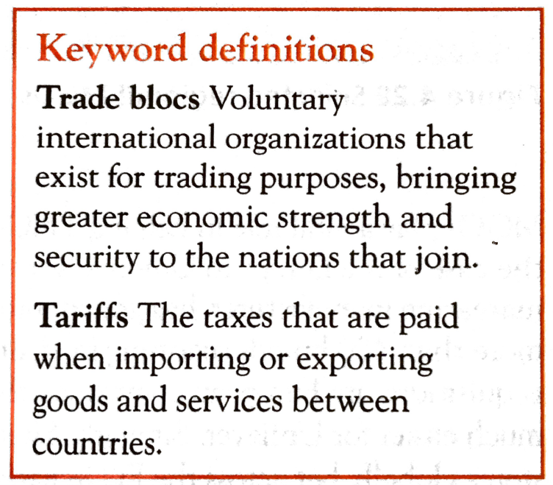
MGOs
Most of the world’s state governments have signed one or more political agreements to become members of trade blocks.
These MGO agreements allow state boundaries to be crossed freely by flows of goods and money.
Within a trade bloc, free trade between neighbours encouraged by the removal of internal tariffs.

Slide 12
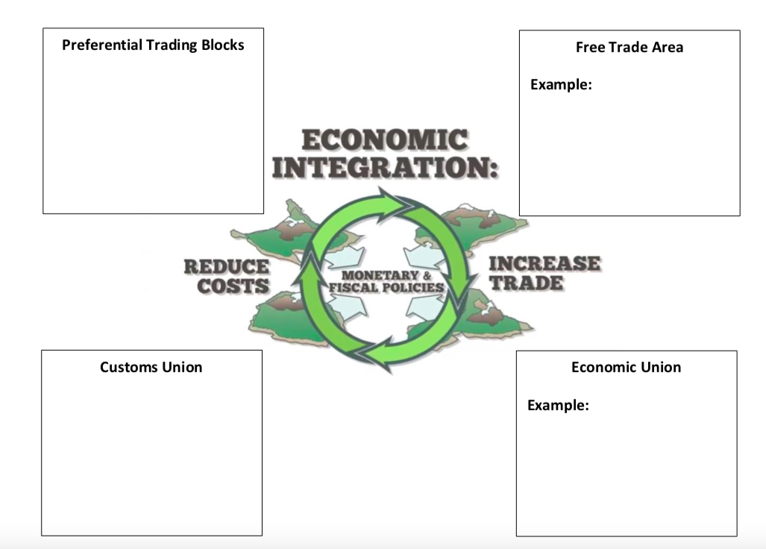
MGOs and Different Types of Economic Integration
Watch the video and make notes on the different types of economic integration

Slide 13
Examples of MGOs: NAFTA
Use the Oxford textbook pages 553-554 to make notes on how NAFTA influences global interactions and who it benefits and causes problems for.

Slide 15
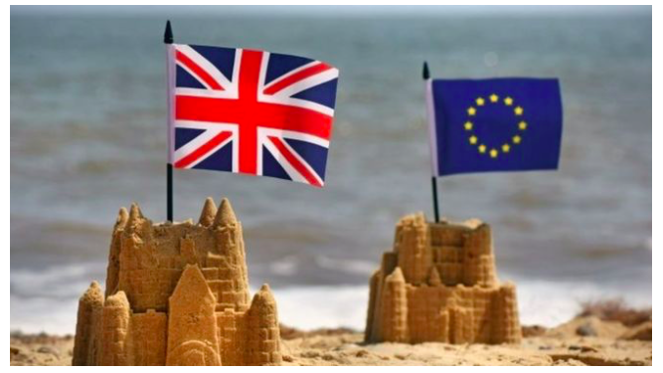
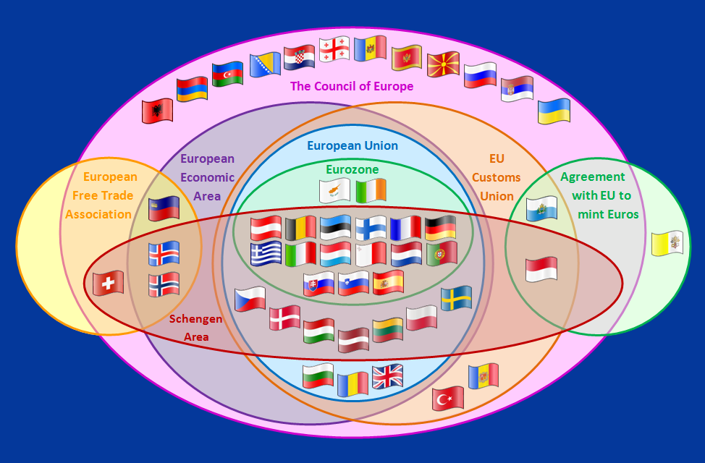
Notes: What is the EU?
https://www.youtube.com/watch?v=O37yJBFRrfg

Slide 17
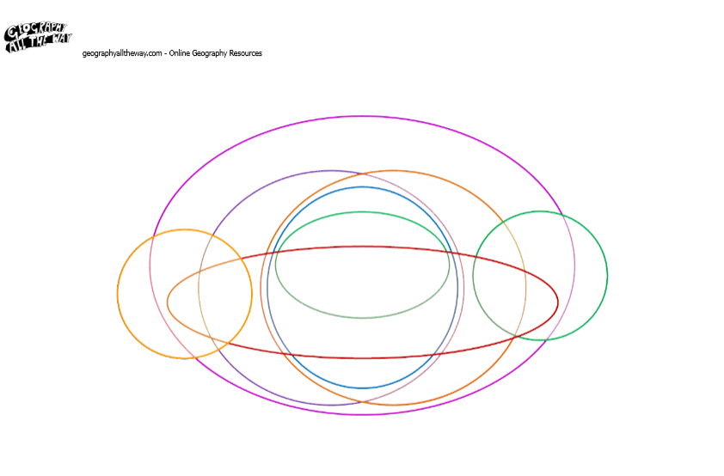

Slide 18
The council of Europe: human rights organisation. It includes 47 member states, 28 of which are members of the European Union.
European Union: a unique economic and political partnership between 28 European countries. It is an economic and political union
Eurozone: is an economic and monetary union (EMU) of 18 European Union (EU) member states that have adopted the euro.
European Free Trade Association: The European Free Trade Association (EFTA) is an intergovernmental organisation set up for the promotion of free trade and economic integration to the benefit of its four Member States: Iceland, Liechtenstein, Norway, Switzerland.
Schengen Area: The Schengen Area is the area comprising 26 European countries that have abolished passport or any other type of border control in-between their common borders, also referred to as internal borders.
EU Customs Union: The European Union Customs Union (EUCU) is a customs union which consists of all the member states of the European Union (EU) and some of its neighbouring countries: Andorra, Monaco, San Marino and Turkey

Slide 19
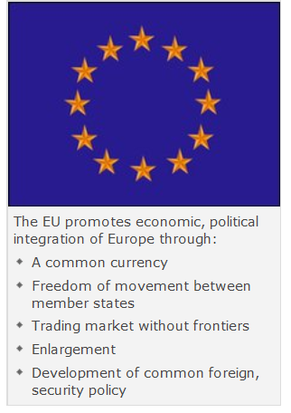

Slide 20
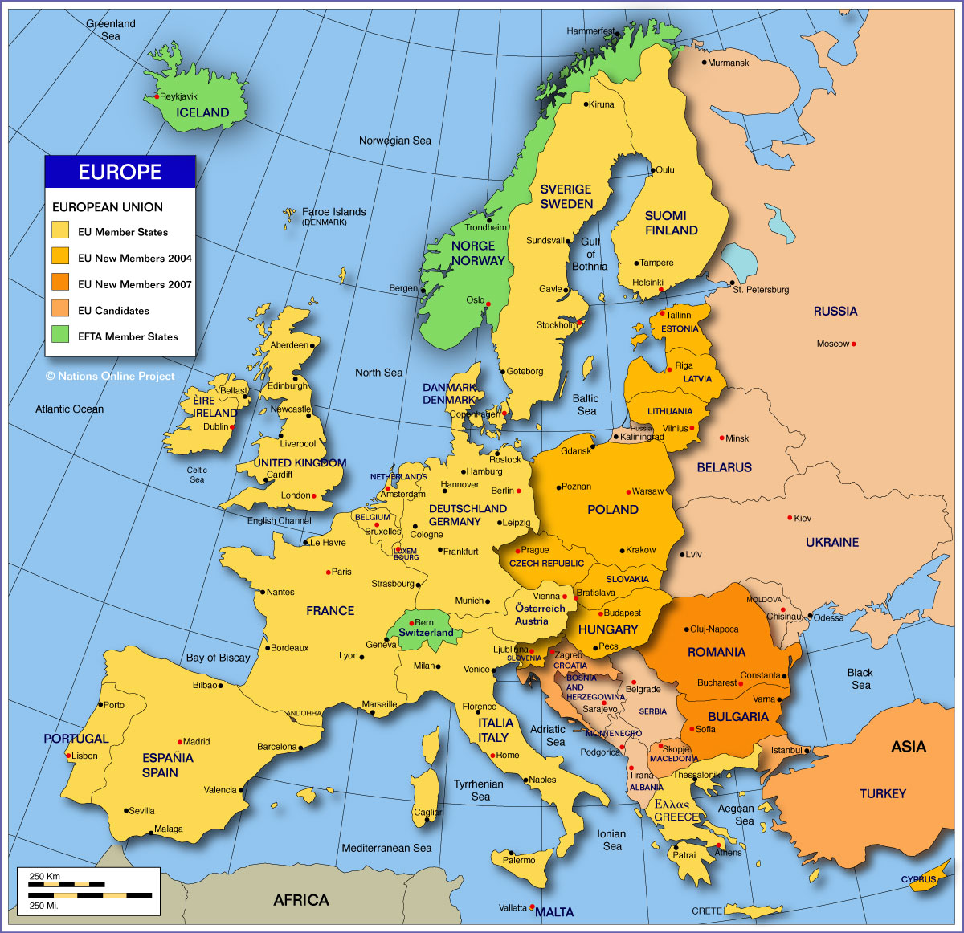

Slide 22
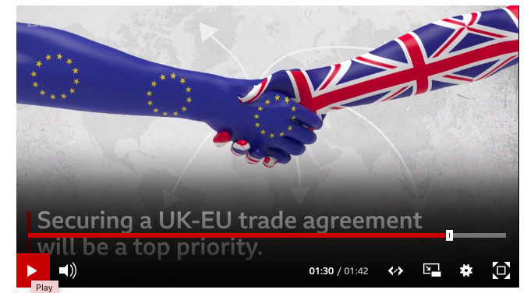
Brexit: 31st Jan 2020
Brexit: All you need to know about the UK leaving the EU: https://www.bbc.com/news/uk-politics-32810887
https://www.bbc.com/news/av/world-51317490/brexit-what-happens-now

Slide 23
Notes: How does the European Union impact the flow of goods?
The EU has established a single market across the territory of all its members.
The single market involves the free circulation of goods, capital, people and services within the EU.
Companies can sell their products anywhere in the member states and consumers can buy where they want with no penalty.
No customs are levied on goods traveling within the EU customs union and (unlike a free trade area) members of the customs union impose a common external tariff on all goods entering the union.
Once goods have been admitted into the market they cannot be subjected to customs duties, discriminatory taxes or import quotas, as they travel internally.
The EU is working to improve cross-border infrastructure within the EU, for example through the Trans-European Networks. Projects include the Channel Tunnel, LGV Est, the Fréjus Rail Tunnel, the Öresund Bridge, the Brenner Base Tunnel and the Strait of Messina Bridge.

Slide 24
Notes: How does the European Union impact the flow of capital?
Currencies and capital can flow freely between the member states and European citizens can use financial services in any member state.
Free movement of capital is intended to permit movement of investments such as property purchases and buying of shares between countries.
Free movement of capital is an essential condition for the proper functioning of the Single Market. It enables a better allocation of resources within the EU, facilitates trade across borders, favours workers mobility, and makes it easier for businesses to raise the money they need to start and grow.

Slide 25
Notes: How does the European Union impact the flow of labour?
Citizens of the EU member states can live and work in any other country and their professional qualifications should be recognised.
With the lifting of most internal border controls, EU citizen can move as freely around Europe as we can within a Member State.
The Schengen Area comprises the territories of twenty-five European countries that have implemented the Schengen Agreement.
Implementing the Schengen rules involves eliminating border controls with other Schengen members while simultaneously strengthening border controls with non-member states.
The UK declined to join Schengen Convention elements related to passport control, one argument being that, for an island, frontier controls are a better and less intrusive way to prevent illegal immigration than other measures, such as identity cards, residence permits, and registration with the police, which are appropriate for countries with "extensive and permeable land borders".

Slide 26
Free trade zones/ special economic zones (SEZ)
SEZ: An industrial area, normally near the coast, where favourable conditions are created to attract foreign TNCS. These conditions include low tax rates and exemption from tariffs and export duties.
These free trade zones are important in the new international division of labour and they are seen as relatively easy paths to industralisation. Many nations in Asia have embraced global markets as a way of meeting economic development goals and the development of SEZs, changing government attitudes and FDI have played important roles.
Read the case study of the Incheon Free Economic Zone (IFEZ), South Korea- page 555-556 Oxford textbook

Slide 27
European Free trade area
Make notes on what Free Trade Zone (FTZ) is and how this differs to a Free Trade Area and a Customs Union.

Slide 28
Alternative MGO: The UN
Read: 70 Ways the UN Makes A Difference: https://www.un.org/un70/en/content/70ways/

Slide 29
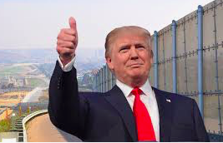
Migration control

Slide 30
Define: Economic Migrant
An economic migrant is someone who emigrates from one region to another to seek an improvement in living standards because the living conditions or job opportunities in the migrant's own region are not sufficient.

Slide 31
Migration control and rules
Individual populations vary enormously in terms of size of the population that is comprised of economic migrants and the rules which govern migration.
It may be that the state needs to adopt liberal controls for it to become deeply integrated into the global economy. Inward investment from TNCs may depend on how easily they can transfer senior staff.

Slide 32
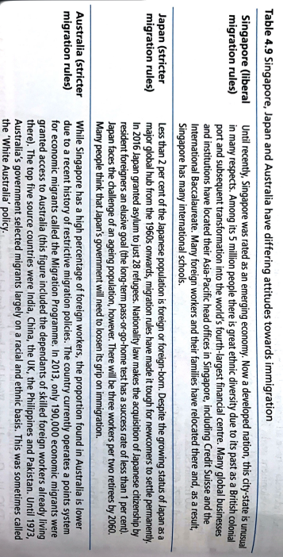
Types of migration control

Slide 33
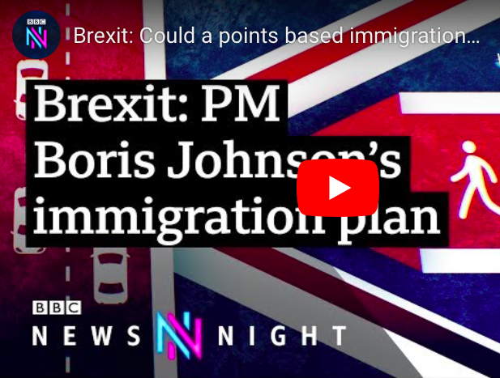
Migration control in UK- want to develop a points based system

Slide 34
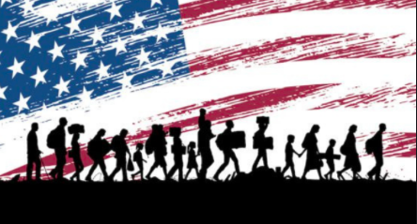
Migration to the USA
The US admits approximately 900,000 legal immigrants (permanent residents) every year (900,000 is .3% of the US population).
• The State Department issues 5 million visas authorizing temporary admission to the US.
• The criteria for admission for permanent residence is much more stringent than for temporary visitors.

Slide 35
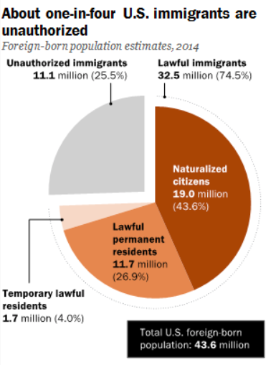
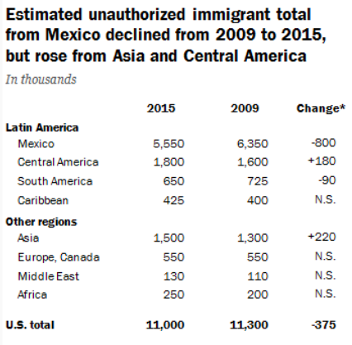

Slide 36
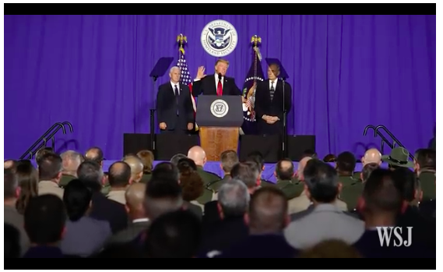
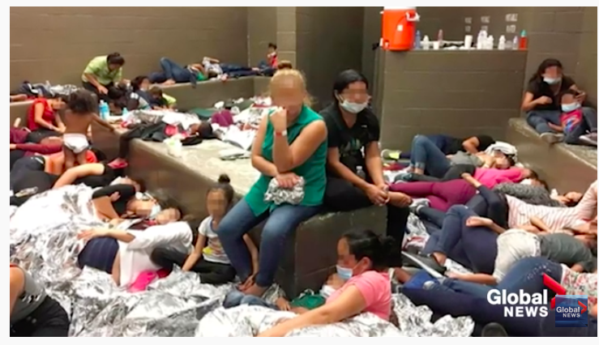
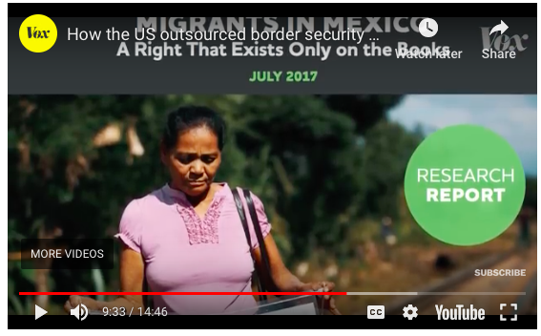
Background Research -
Read Oxford textbook page 557-558 to make notes on illegal migration control in the USA

Slide 37
The Migration caravan
https://www.theguardian.com/us-news/2018/oct/24/caravan-migrants-what-is-it-where-from-guatemala-honduras-immigrants-mexico
https://www.theguardian.com/world/2018/oct/30/migrant-caravan-causes-climate-change-central-america?CMP=share_btn_tw
http://time.com/5431447/donald-trump-threat-turn-back-caravan-migrants-not-legal/
https://www.bbc.com/news/world-us-canada-45983862
https://www.cnbc.com/2018/10/29/us-military-will-deploy-5200-active-duty-troops-to-mexican-border.html
https://www.theguardian.com/world/2018/oct/30/mexico-town-welcomes-migrants-caravan-central-america
Task: Make notes on:
What is the migration caravan?
What is being done to control this and why?
What influence does this have on global interactions?
What synoptic links can be made to other parts of the course?

Slide 38
Task 1 - Using the first two graphs above, describe the pattern of annual migration from Mexico to the United States since 1997. Task 2 - Why does the flow decrease rapidly in 2001, 2002 & 2003? Task 3 - Describe the trend in the second graph in the Mexican born population in the USA. What does this suggest is now happening? Task 4 - The third graph above shows Mexican workers by employment sector in the USA. Describe the changes from 1993 to 2007. Task 5 - Suggest reasons for the three sectors that employing the highest proportion of Mexican labour.

Slide 39
Exam question
Using examples, explain how political factors can positively impact global interactions. [12]

