Slide 1
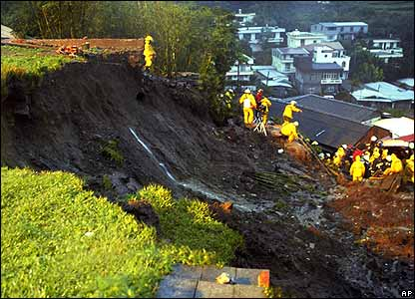
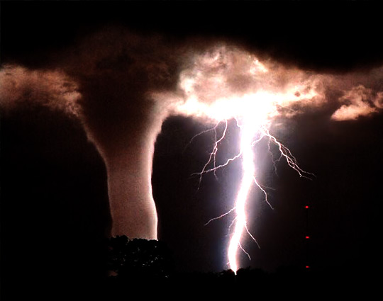
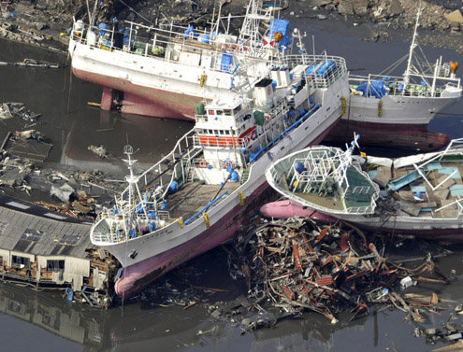
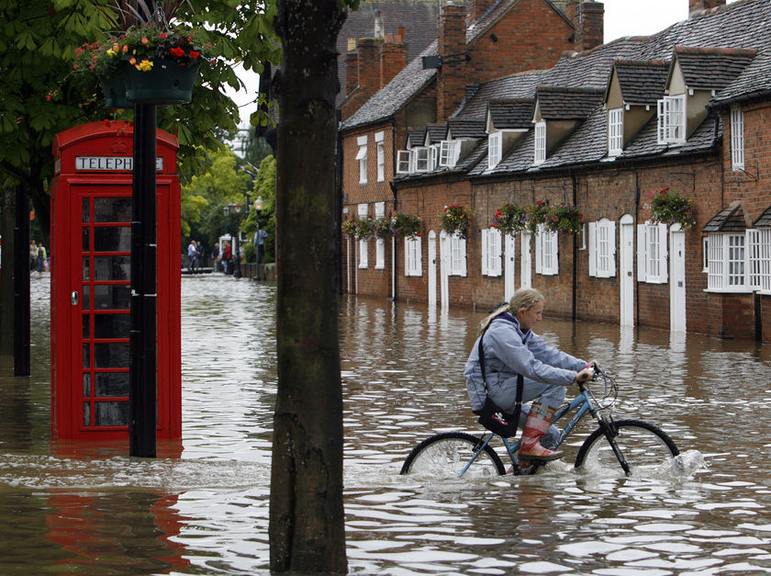
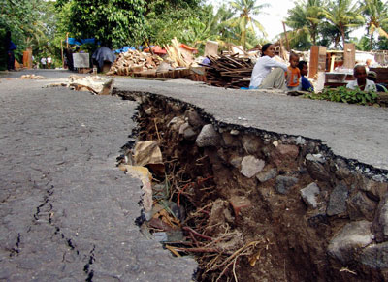
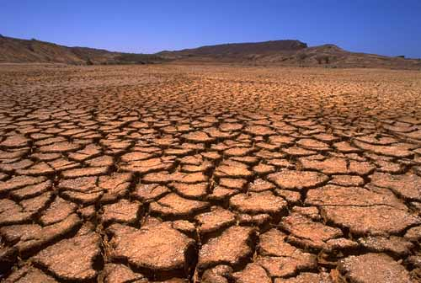
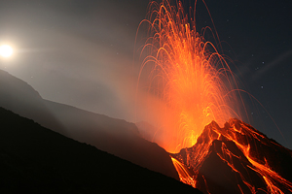
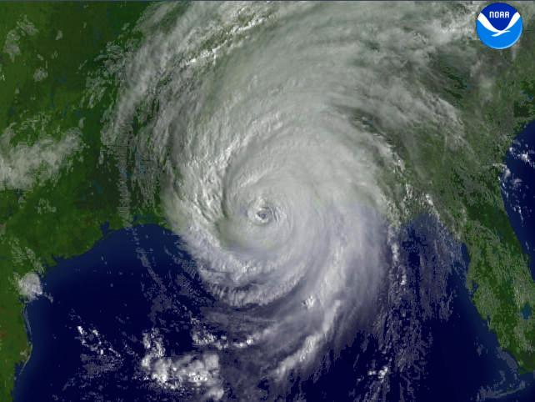

Slide 2

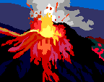

Introducing Natural Hazards
Key idea: Natural hazards pose major risks to people and property.
All will define the term natural hazards and classify them by type
All should explain the difference between natural hazards/disasters and natural/man-made hazards.
All could consider the factors affecting hazard risk.

Slide 3
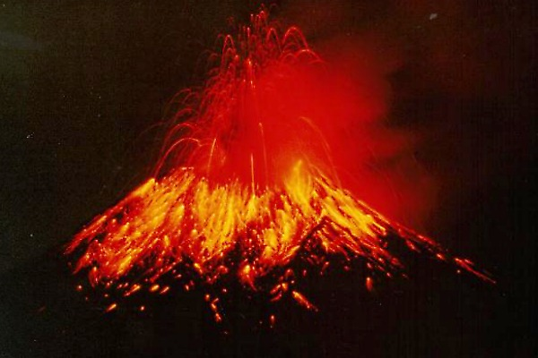
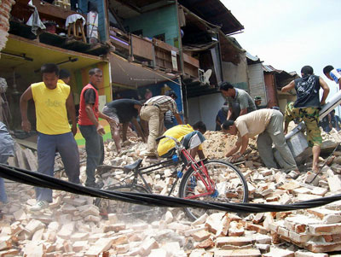
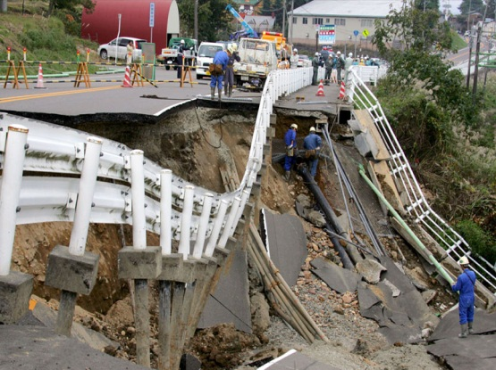
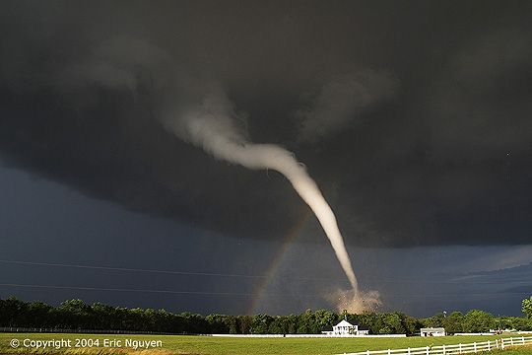
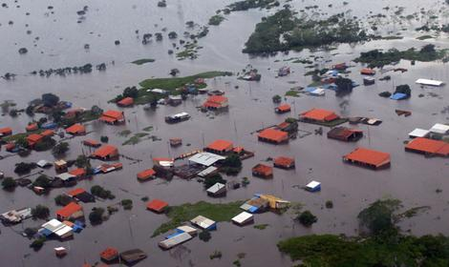
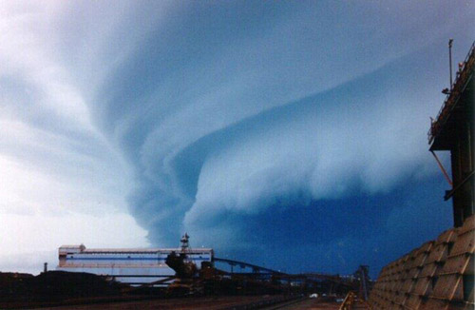
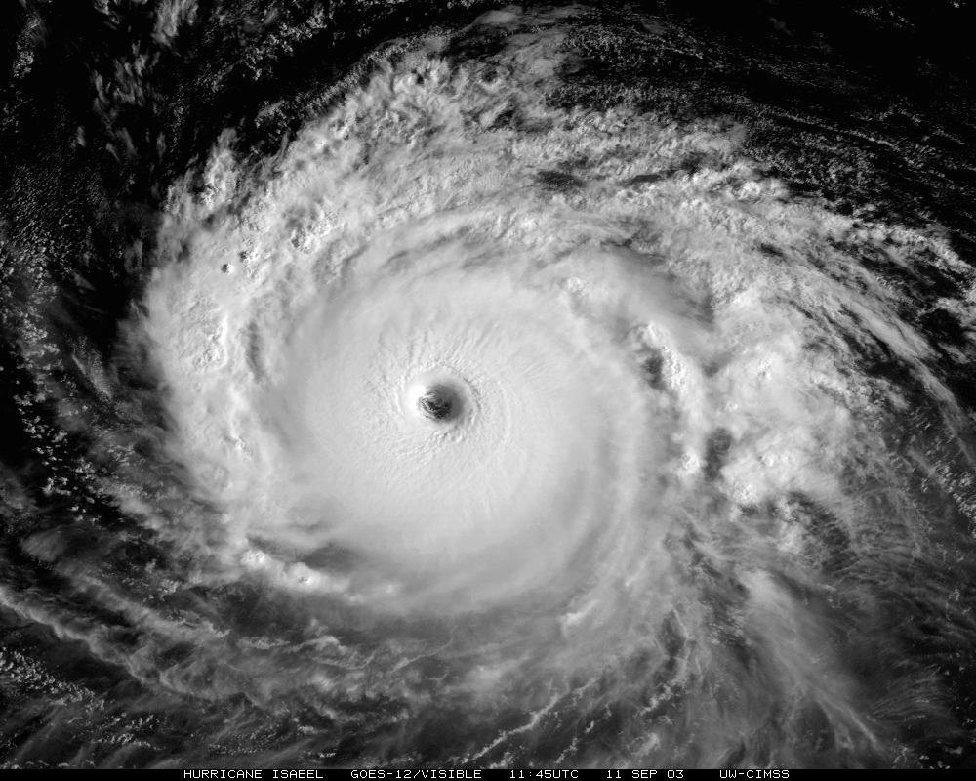
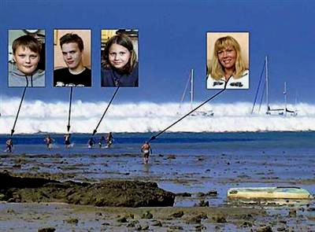
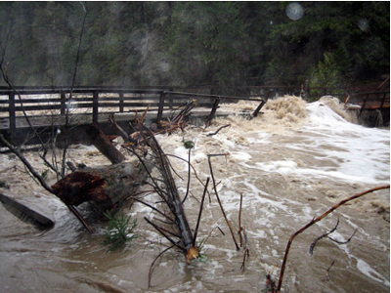
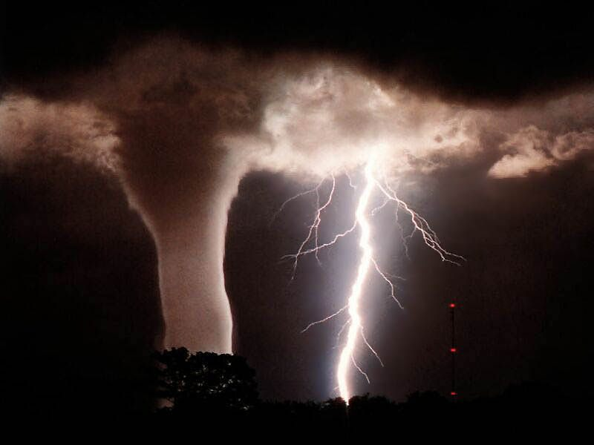
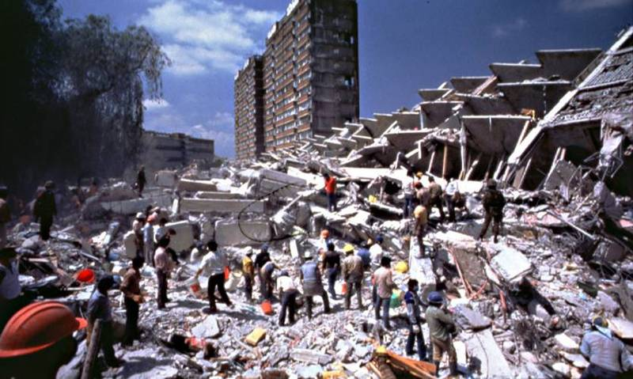
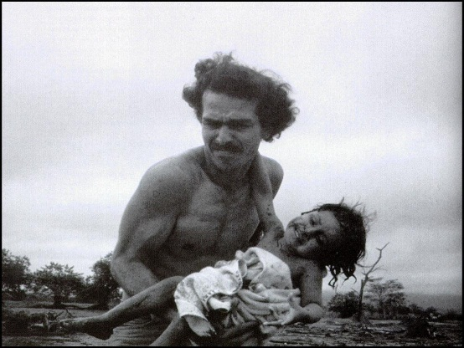
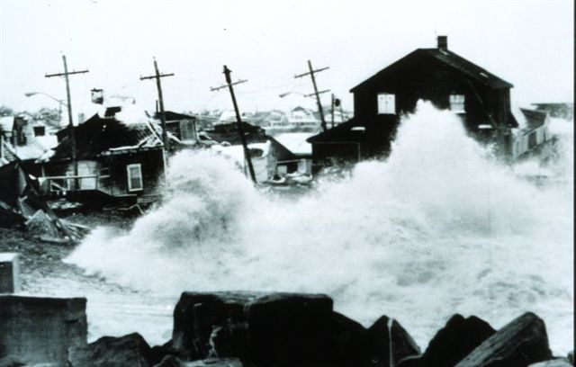
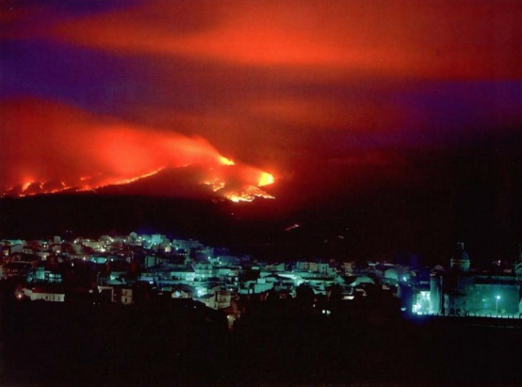
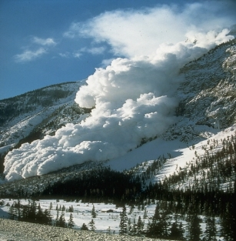
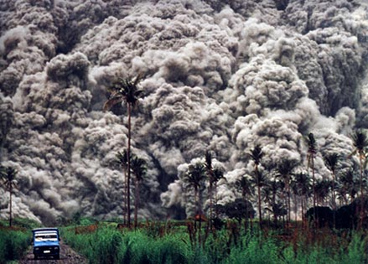

Slide 4

Prepare for Learning
Thoughts and Crosses:
Choose any three tasks as long as they are in a line
Can you sort the Natural Hazards in the photos into groups? (e.g. By what causes them? What their impact is?)
How many hazards can you name from the pictures?
Pick 1 photo. Describe what you can see and what you think it would be like.
Knowledge
Comprehension
Application
Pick 2 pictures and compare them. What is similar and different about the hazards in the pictures?
Choose 1 of the Natural Hazards in the photos. What if it was to happen to Houston? What would the effects be?
Can you rank the Natural Hazards in the pictures from MOST dangerous to LEAST dangerous
Analysis
Synthesis
Evaluation
Which Natural Hazard do you think is most dangerous? Explain your reasons.
What do you think could be done to help people prepare and be protected from Natural Hazards?
Can you make 2 lists from the photos: 1 caused by weather and 1 caused by plate tectonics (e.g. Earthquakes)
Comprehension or Evaluation
Application
Analysis

Slide 5
Starter Challenge: Classifying hazards
The stack of cards has a series of different sorts of hazards on them
You are to categorise them into 4 different categories:
  Tectonic
  Biological
  Atmospheric
  Geomorphological – related to the study of landforms, their processes, form and sediments at the surface of the Earth

Slide 6
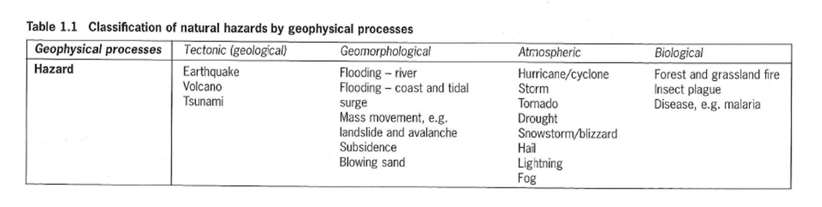
Answer

Slide 7
Natural Hazard Definition
A natural hazard is an extreme natural event or process that has the potential to cause loss of life and/or extreme damage to property and can create severe disruption to human activities

Slide 8
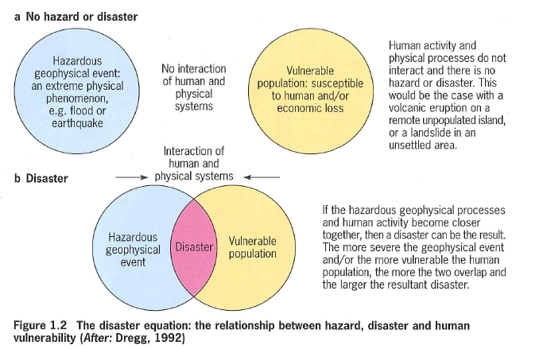
A disaster is the realisation of that hazard when people and a hazard come into contact.
Hazard risk is the probability of being affected by a hazard

Slide 9
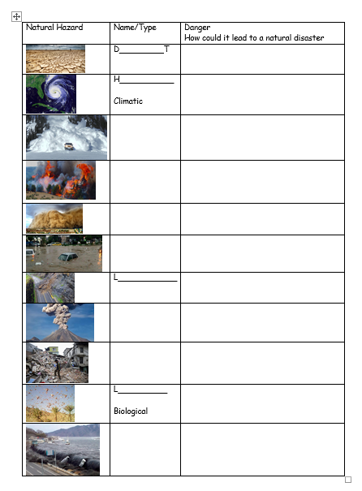
Challenge - Classifying hazards
Take what you have learnt so far to complete the grid of selected hazards

Slide 10
Increasing the level of risk
There are several factors that can increase the level of risk from natural hazards
  Urbanisation
  Poverty
  Farming
  Climate Change
Why might these factors increase risk?

Slide 11
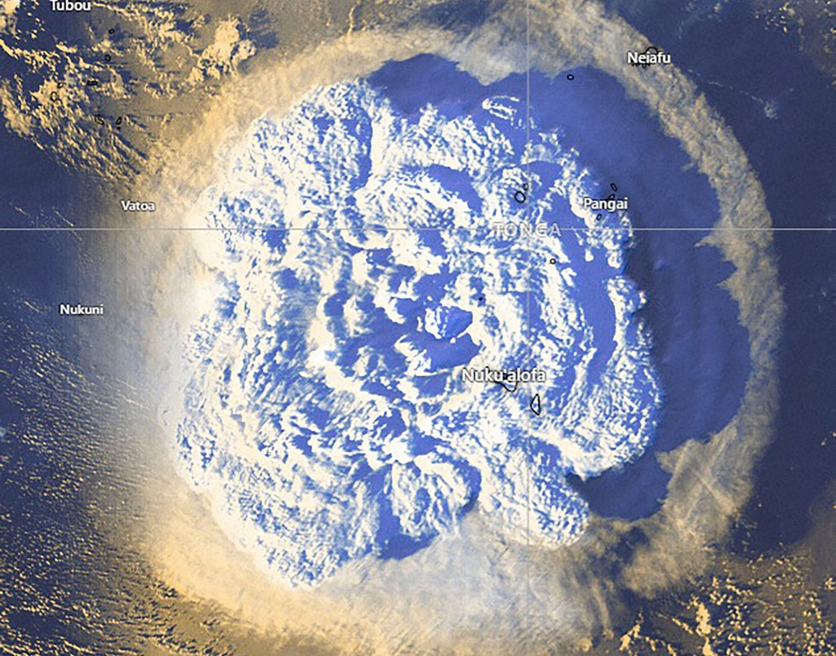

Slide 12

Challenge: Graph skills
Look at the data sheet showing the top 20 deadliest natural hazards.
Rank in order of the highest – lowest number of deaths.
Represent the top 10 on a graph – bar chart.
If you need help, look at the example graph on slide 13.
REMEMBER TO LABEL YOUR AXES!

Slide 13




Challenge: Map skills
Continue with instructions on work sheet.
On a blank world map identify the top 20 (aim for top 10 if that takes too long) deadliest natural hazards.
Extension: Add key information, describe distribution and add key words.

