Slide 1
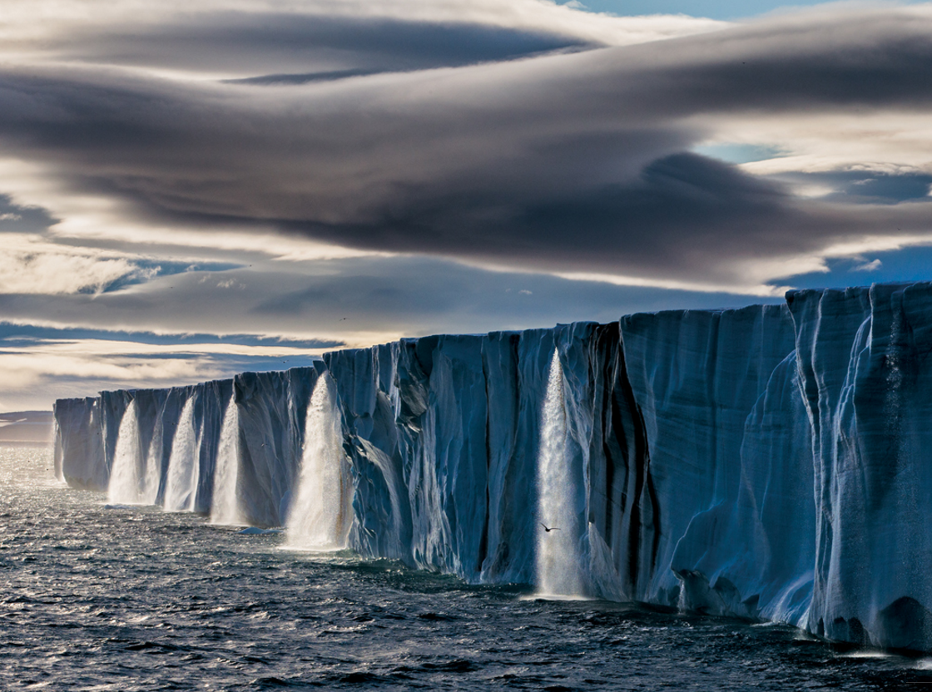
Starter
CLIMATE CHANGE IS HERE.
Meltwater gushes from an ice cap on the island of Nordaustlandet, in Norway’s Svalbard archipelago. The Arctic is warming faster than any other place on Earth.
Why do you think this is a problem?

Slide 2
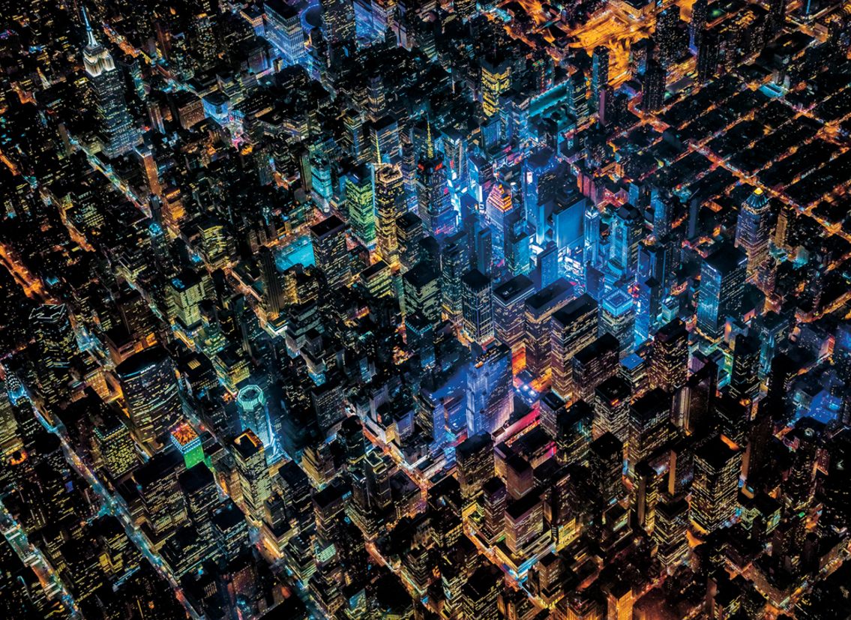
HOW CAN WE POWER THE PLANET...
From 7,500 feet up, the nocturnal grid of New York looks more like a circuit board than a city. The glow of LED bulbs—seen here illuminating Times Square and other parts of midtown Manhattan—accounts for the blue-violet hues.
Why do you think this is a problem?

Slide 3
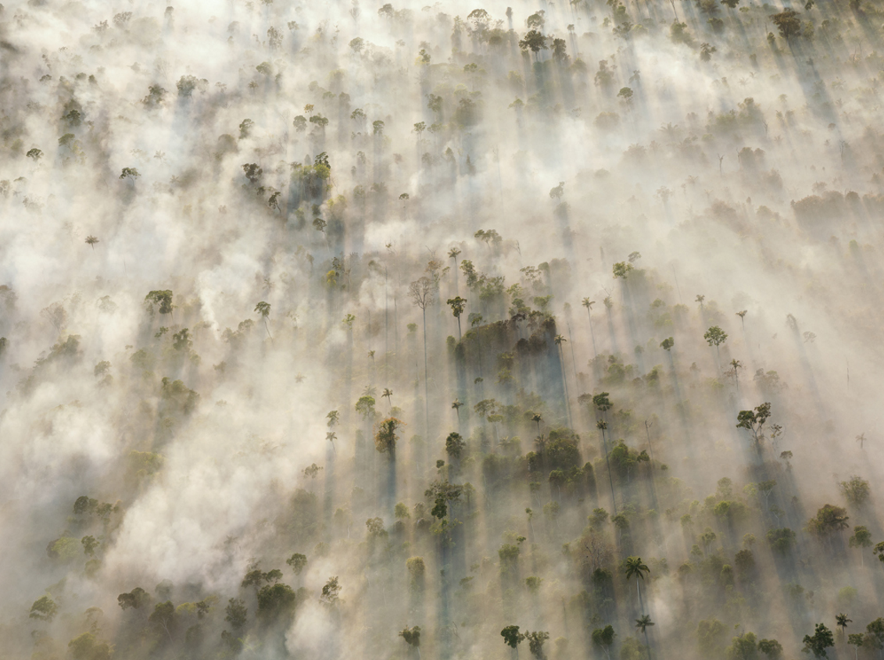
WITHOUT MAKING THINGS WORSE?
Lit by morning sun, smoke from burning trees obscures the Amazon rain forest in Mato Grosso, Brazil. In recent decades nearly a quarter of the forest in Mato Grosso has been cleared for farming, releasing millions of tons of stored carbon into the air
Why do you think this is a problem?

Slide 4
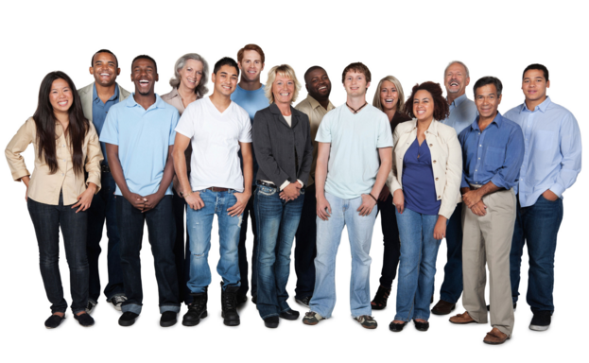
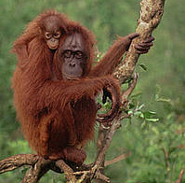
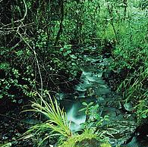
Climate change – How does it affect people and the environment?
Lesson objectives
Will be able to give basic reasons as to how climate change impacts people and the environment.
Will be able to describe and explain the impacts that climate change will have to both people and the environment.
Will be able to evaluate the impact climate change will have on both people and the environment.

Slide 5
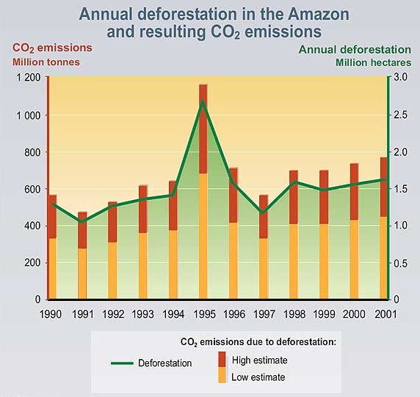
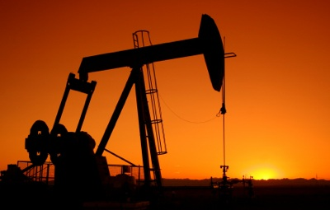
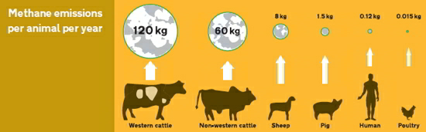
RECAP – Causes
Questions top ask:
What is the picture showing?
How is it causing climate change?
How are humans making it worse?

Slide 6
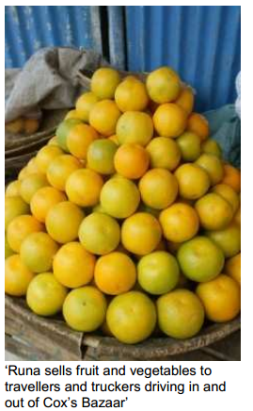
Why did Runa’s stall close down?
It is going to be down to you to solve the mystery.
Your task is to answer the question in the title - Why did Runa’s stall close down?
The cards in front of you contain a set of clues, some of which may be more useful than others.
You need to work in your groups to work out the answer to the question.
The task is not just to solve the mystery by placing the cards in a reasonable sequence, but also to explain the thinking behind their solutions to the rest of the class.
You may leave some cards out and you are allowed to add some extra cards in (on the blank cards)
You are going to feed back your ideas to the rest of the class.

Slide 7
You have now looked at one (very small) consequence of climate change and thought about how your own impacts could lead to it happening.
You are now going to look at much larger range that will show more detailed information on how it will impact both Humans and the Environment.

Slide 8
People And The Environment
You are going to use the information sets that have been given to complete a mind map like you can see to the left.
This can be done in your book or on A3 paper.
What you need to include:
1 – Write the title of a different impact.
2 – Colour code it to represent if it impacts humans or the environment.
3 – Explain how the information you have read will impact either humans or the environment.
4 – Evaluate the impact you think this will have on either humans or the environment.
Agriculture
Coastal areas
How will climate change affect people and the environment?
Health
Forests
The information shows that it will impact the environment because…
I think this is big/small impact because…

Slide 9


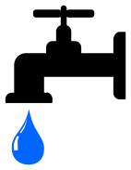

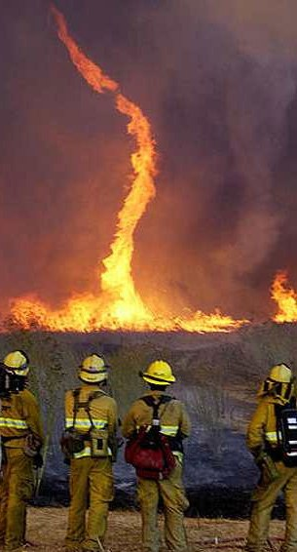
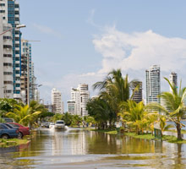
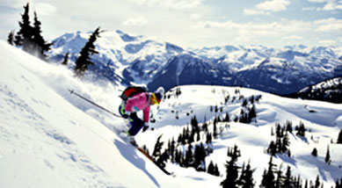
What have I learnt?
Health
Plants, Animals and Ecosystems
Water Supplies
Energy
Recreation
Agriculture
Forest Fires
Coastal Flooding

Slide 10

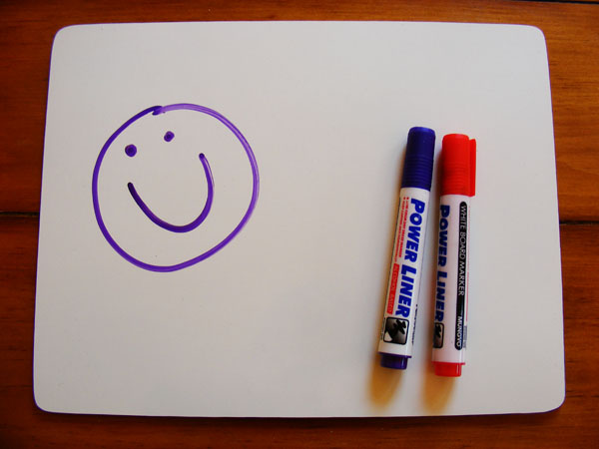
Finally
Using either mini white boards or a sticky note, you need to pick the factor that you think will have the biggest impact on people and the biggest impact on the environment.
You then need to explain in 1-2 sentences why you have picked your choice.
Either show or stick to the board once you have completed your work.

Slide 11
RESOURCES

Slide 12
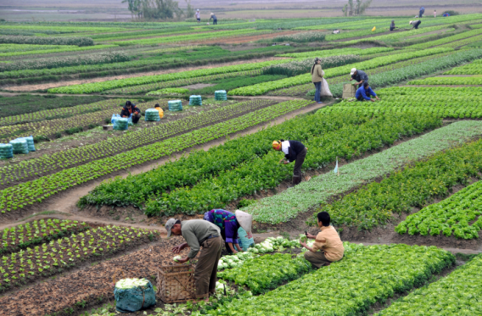
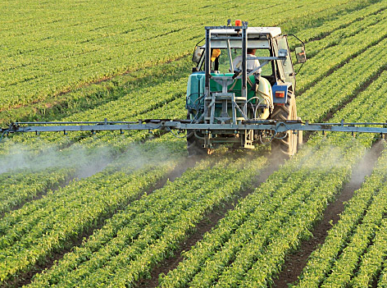
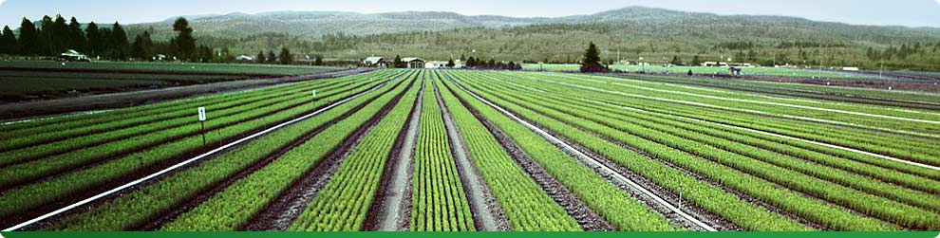
Agriculture
The crops that we grow for food need specific conditions to thrive, including the right temperature and enough water. A changing climate could have both positive and negative effects on crops.
For example, the northern parts of the United States have generally cool temperatures, so warmer weather could help certain crops grow. In southern areas where temperatures are already hot, even more heat could hurt crop growth. Global climate change will also affect agriculture and food supply in many other ways.
What's at stake?
Crop Losses
Climate change could make it too hot to grow certain crops, and droughts caused by climate change could reduce the amount of water available for irrigation. Climate change is also likely to cause stronger storms and more floods, which can damage crops. Higher temperatures and changing rainfall patterns could help some kinds of weeds and pests to spread to new areas. If the global temperature rises an additional 3.6°F, U.S. corn production is expected to decrease by 10 to 30 percent.

Slide 13
Agriculture
The crops that we grow for food need the right conditions to thrive. A changing climate could have both positive and negative effects on crops.
What's at stake?
Crop Losses
Climate change could make it too hot to grow certain crops, and droughts caused by climate change could reduce the amount of water available for irrigation. Climate change is also likely to cause stronger storms and more floods, which can damage crops.

Slide 14

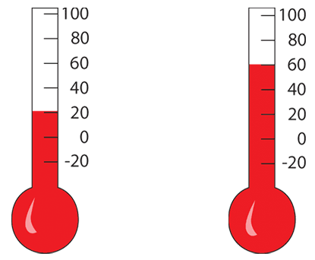
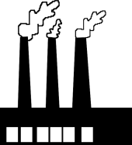
Health
Heat waves, severe storms, air pollution, and diseases linked to climate already threaten people's health in many areas of the world. Global climate change will increase these threats. Some people will be particularly at risk, especially those who are poor, very young or elderly, or disabled, or those who live in coastal areas or big cities.
What's at stake?
Temperature–Related Illnesses
Heat waves are uncomfortable for everyone, but for infants and young children, the elderly, and people who are already sick, they can be especially dangerous. Extreme heat can cause illnesses such as heat cramps, heat stroke, and even death. A 2003 heat wave in Europe caused about 50,000 deaths, and a 1995 heat wave in Chicago caused more than 600 deaths. In fact, heat waves cause more deaths in the United States every year than hurricanes, tornadoes, floods, and earthquakes combined.
On the flip side, as the world gets warmer, the number of illnesses and deaths related to extreme cold (like hypothermia and frostbite) may decrease.
What's at stake?
Air Pollution
You probably know someone with asthma, or maybe you have this condition yourself. Certain kinds of air pollutants, like ozone, can make asthma and other lung conditions worse. Ozone found high in the atmosphere is called "good ozone" because it protects life on Earth from the sun's harmful ultraviolet rays. Ozone can also be found close to the surface of the Earth, where it is considered “bad ozone” because it's the main ingredient of smog and is harmful for people to breathe. Bad ozone is created from pollutants that go through chemical reactions in the atmosphere. Climate change is likely to increase the amount of bad ozone in the air because more ozone is created when the temperature is warm.

Slide 15
Health
Heat waves, large storms, air pollution, and diseases linked to climate already threaten people's health in many areas of the world. Global climate change will increase these threats. People who are poor, very young or elderly, or disabled, or those who live in coastal areas or big cities are most at risk.
What's at stake?
Temperature–Related Illnesses
Heat waves are uncomfortable for everyone, but for infants and young children, the elderly, and people who are already sick, they can be especially dangerous. Extreme heat can cause illnesses such as heat cramps, heat stroke, and even death.
What's at stake?
Air Pollution
You probably know someone with asthma, or maybe you have this condition yourself. Certain kinds of air pollutants, like ozone, can make asthma and other lung conditions worse. Ozone found high in the atmosphere is called "good ozone" because it protects life on Earth from the sun's harmful ultraviolet rays. Ozone can also be found close to the surface of the Earth, where it is considered “bad ozone” because it's the main ingredient of smog and is harmful for people to breathe.

Slide 16



Energy
Global climate change will affect how much energy we need and when we need it. As temperatures rise, more people will need to keep cool by using air conditioning, which uses a lot of electricity. However, some people might need less energy to heat buildings in the winter because it may not get as cold as it used to be. Climate change could also make it harder to produce certain types of electricity, such as hydropower.
What's at stake?
Hydropower
As climate change causes precipitation patterns to shift, some areas that currently have plenty of water to make hydropower, such as northern California, might not have enough water in the future. Without enough water to produce electricity, these areas could experience power shortages and blackouts. They might have to use other energy sources to make more of the electricity they need, and if these sources are fossil fuels like coal, oil, or natural gas, more greenhouse gases will be added to the atmosphere.

Slide 17
Energy
Global climate change will affect how much energy we need and when we need it. As temperatures rise, more people will need to keep cool by using air conditioning, which uses a lot of electricity.
However, some people might need less energy to heat buildings in the winter because it may not get as cold as it used to be. Climate change could also make it harder to produce certain types of electricity, such as hydropower.
What's at stake?
Hydropower
As climate change causes precipitation patterns to change, some areas that currently have plenty of water to make hydropower, might not have enough water in the future. Without enough water to produce electricity, these areas could experience power shortages and blackouts.

Slide 18
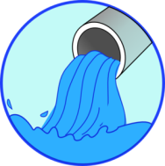

Water Supplies
Climate change is affecting where, when, and how much water is available for people to use. Many parts of the world already have very little water, and climate change could make this problem worse. Rising temperatures, changing precipitation patterns, and increasing droughts will affect the amount of water in lakes, rivers, and streams, as well as the amount of water that seeps into the ground to replenish ground water.
What's at stake?
Public Water Supplies
In 2007, a major drought hit the southeastern United States. Lake Lanier, which is the main source of drinking water for the Atlanta area, was reduced to record–low water levels. People had to use less water in their homes and businesses and make other changes, such as not watering their lawns.
What's at stake?
Lakes, Rivers, and Streams
Many places rely on snowmelt to fill the lakes, rivers, and streams that help keep drinking water reservoirs full and provide water to irrigate crops. For example, many parts of the western United States depend on water from the Colorado River, which is fed by melting snowpack in the Rocky Mountains. Less snowpack and earlier snowmelt will reduce the amount of water flowing into the Colorado and other rivers.

Slide 19
Water Supplies
Climate change is affecting where, when, and how much water is available for people to use. Many parts of the world already have very little water, and climate change could make this problem worse.
Rising temperatures, changing precipitation (rain, snow, hail etc) patterns, and increasing droughts will affect the amount of water in lakes, rivers, and streams, as well as the amount of water that seeps into the ground to replenish ground water.
What's at stake?
Lakes, Rivers, and Streams
Many places rely on snowmelt to fill the lakes, rivers, and streams that help keep drinking water reservoirs full and provide water to irrigate crops.

Slide 20


Plants, Animals, and Ecosystems
Most plants and animals live in areas with very specific climate conditions, such as temperature and rainfall patterns, that enable them to thrive. Any change in the climate of an area can affect the plants and animals living there, as well as the makeup of the entire ecosystem. Some species are already responding to a warmer climate by moving to cooler locations.
For example, some North American animals and plants are moving farther north or to higher elevations to find suitable places to live. Climate change also alters the life cycles of plants and animals.
For example, as temperatures get warmer, many plants are starting to grow and bloom earlier in the spring and survive longer into the fall. Some animals are waking from hibernation sooner or migrating at different times, too.
What's at stake?
Disappearing Habitats
As the Earth gets warmer, plants and animals that need to live in cold places, like on mountaintops or in the Arctic, might not have a suitable place to live. If the Earth keeps getting warmer, up to one–fourth of all the plants and animals on Earth could become extinct within 100 years. Every plant and animal plays a role in the ecosystem (for example, as a source of food, a predator, a pollinator, a source of shelter), so losing one species can affect many others.

Slide 21
Plants, Animals, and Ecosystems
Most plants and animals live in areas with very precise climate conditions, such as temperature and rainfall amounts, that enable them to thrive.
Any change in the climate of an area can affect the plants and animals living there. Some species are already responding to a warmer climate by moving to cooler locations.
What's at stake?
Disappearing Habitats
As the Earth gets warmer, plants and animals that need to live in cold places, like on mountaintops or in the Arctic, might not have a suitable place to live. Every plant and animal plays a role in the ecosystem (for example, as a source of food, a predator, a pollinator, a source of shelter), so losing one species can affect many others.

Slide 22
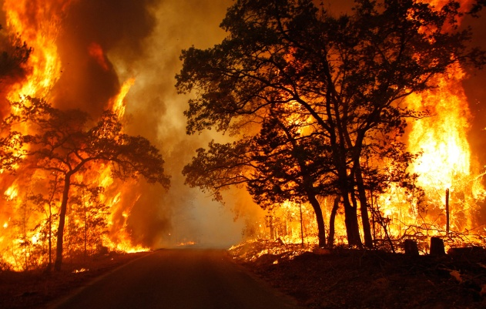
Forests
Forests provide homes for many kinds of plants and animals. They also protect water quality, offer opportunities for recreation, and provide people with wood. Forests are sensitive to many effects of climate change, including shifting weather patterns, drought, wildfires, and the spread of pests like the mountain pine beetle. Unlike some animals, trees can't just get up and move when the temperature gets too hot or other conditions change!
What's at stake?
Wildfires
Wildfires are already common in the forests and grasslands of the western United States. As the Earth gets warmer and droughts increase, wildfires are expected to occur more often and be more destructive. Wildfires do occur naturally, but the extremely dry conditions resulting from droughts allow fires to start more easily, spread faster, and burn longer. In fact, if the Earth gets just 3.6°F warmer, we can expect wildfires in the western United States to burn four times more land than they do now. Fires don't just change the landscape; they also threaten people's homes and lives.

Slide 23
Forests
Forests provide homes for many kinds of plants and animals. They also protect water quality, offer opportunities for recreation, and provide people with wood.
Forests are sensitive to many effects of climate change, including shifting weather patterns, drought, wildfires, and the spread of pests like the mountain pine beetle.
What's at stake?
Wildfires
Wildfires are already common in the forests of some places on earth. As the Earth gets warmer and droughts increase, wildfires are expected to occur more often and be more destructive. Wildfires do occur naturally, but the extremely dry conditions resulting from droughts allow fires to start more easily, spread faster, and burn longer.

Slide 24
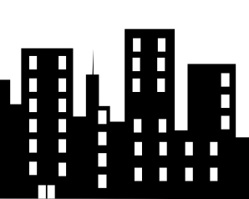
Coastal Areas
Global climate change threatens coastlines and the buildings and cities located along them. Hundreds of millions of people around the world live in low–lying areas near the coast that could be flooded as the sea level rises. Rising sea level will also erode beaches and damage many coastal wetlands. Rising sea level and stronger storms caused by warmer oceans could completely wipe out certain beaches and islands.
What's at stake?
Coastal Cities
Climate change poses risks for cities near the ocean.
Places like Miami; New York City; and Venice, Italy, could flood
more often or more severely if sea level continues to rise.
If that happens, many people will lose their homes and businesses.

Slide 25
Coastal Areas
Global climate change threatens coastlines and the buildings and cities located along them. Hundreds of millions of people around the world live in low–lying areas near the coast that could be flooded as the sea level rises.
Rising sea level will also erode beaches and damage many coastal wetlands. Rising sea level and stronger storms caused by warmer oceans could completely wipe out certain beaches and islands.
What's at stake?
Coastal Cities
Climate change poses risks for cities near the ocean.
Places like Miami; New York City; and Venice, Italy, could flood
more often or more severely if sea level continues to rise.
If that happens, many people will lose their homes and businesses.

Slide 26
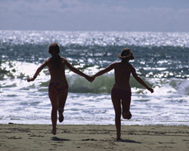
Recreation
In addition to causing all sorts of problems, such as heat waves, droughts, and coastline damage, warmer temperatures could also affect people's jobs, recreational activities, and hobbies. For example, in areas that usually experience cold winters, warmer temperatures could reduce opportunities for skiing, ice fishing, and other winter sports. Also, rising sea level could wash away beaches.
What's at stake?
Beaches
Higher sea level will mean less space at the beach. A combination of stronger storms and sea level rise could increase the rate of erosion along the coast, and some beaches could disappear altogether.

Slide 27
Recreation
In addition to causing all sorts of problems, such as heat waves, droughts, and coastline damage, warmer temperatures could also affect people's jobs, recreational activities, and hobbies.
What's at stake?
Beaches
Higher sea level will mean less space at the beach. A combination of stronger storms and sea level rise could increase the rate of erosion along the coast, and some beaches could disappear altogether.

